Slide 1
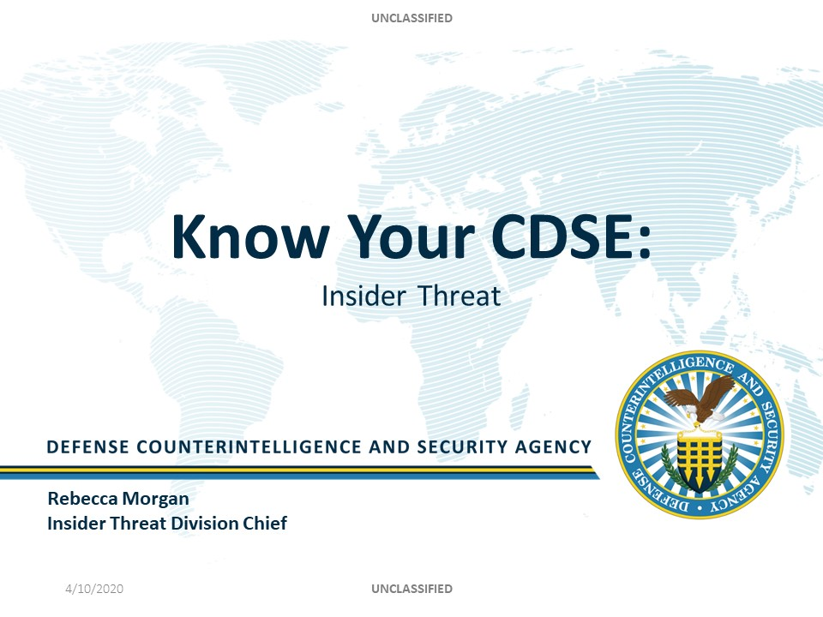

Slide 2
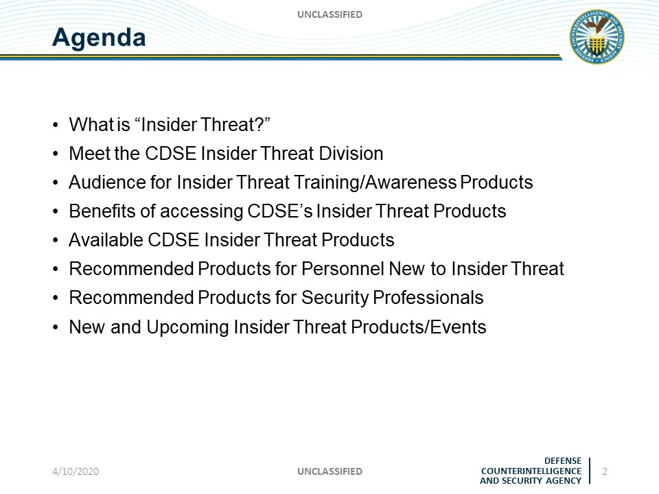

Slide 3
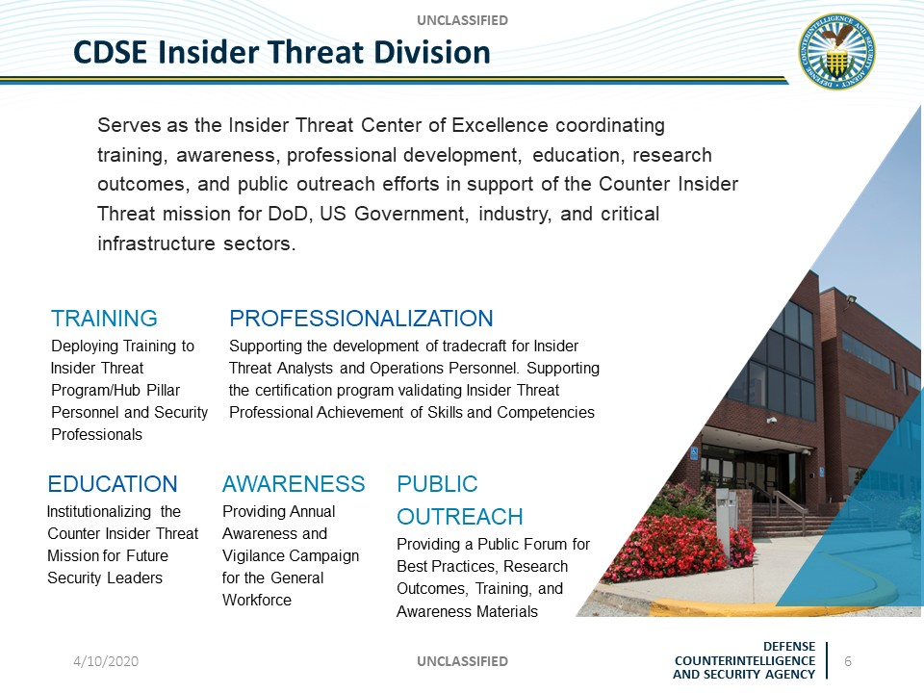

Slide 4
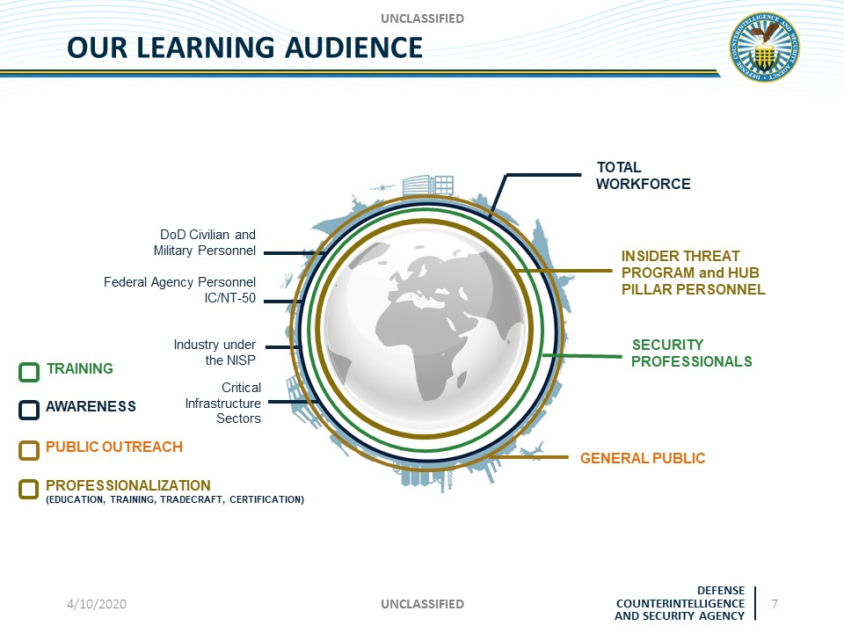

Slide 5
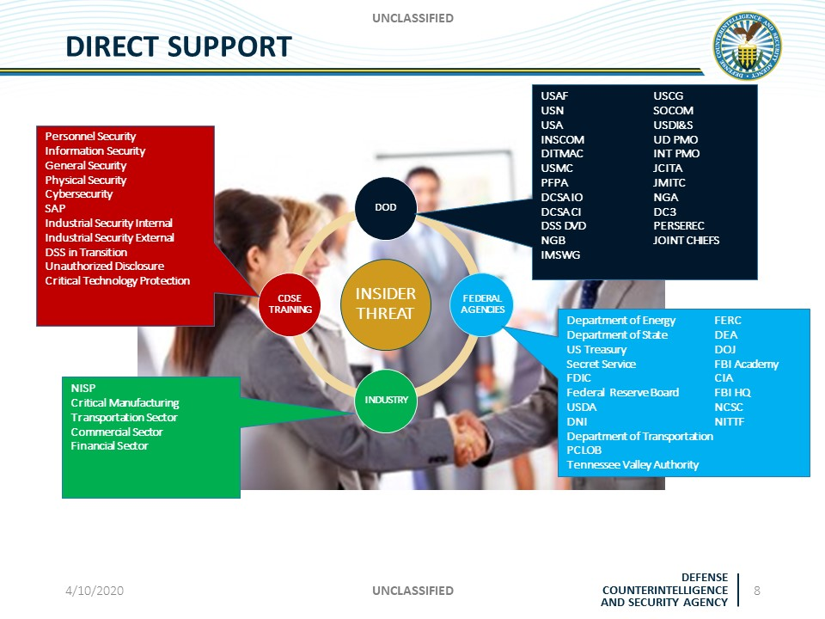

Slide 6
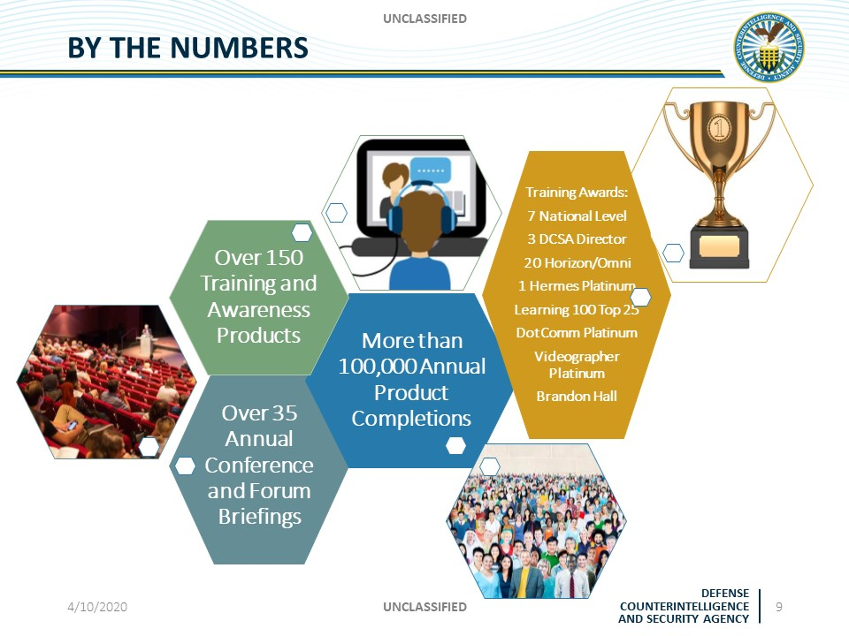

Slide 7
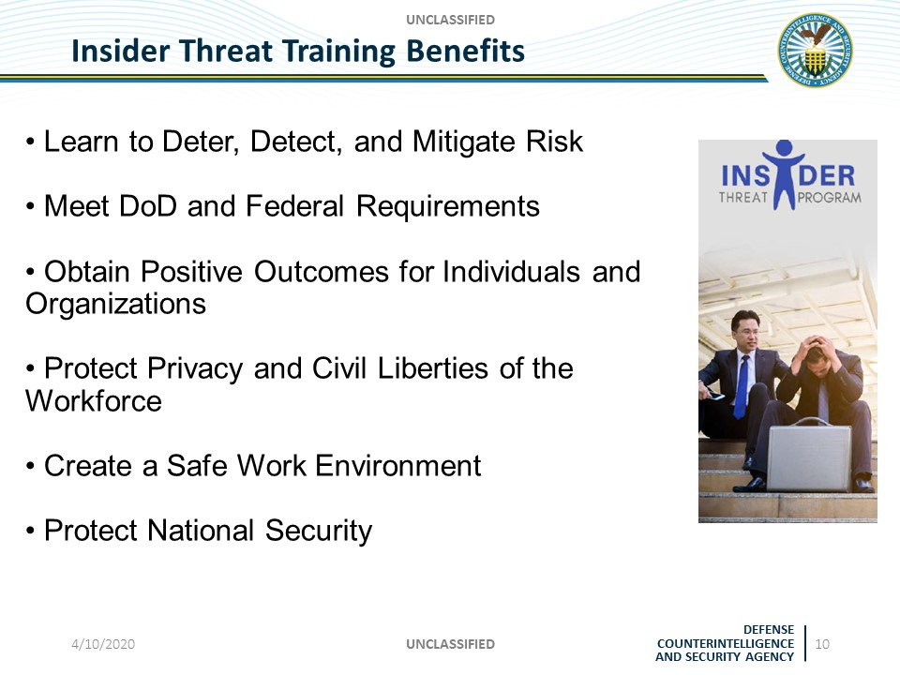

Slide 8
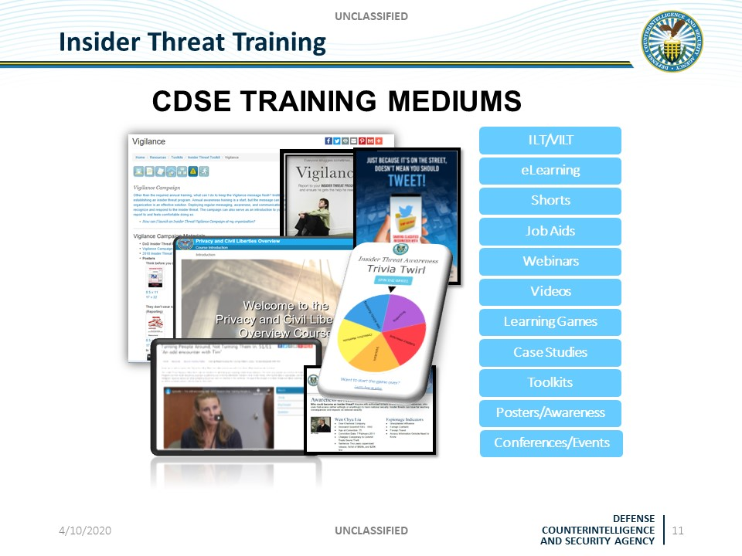

Slide 9
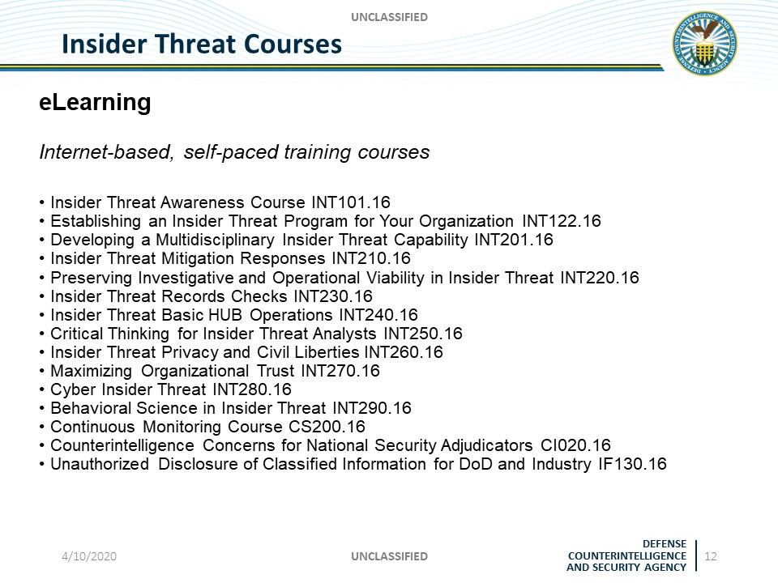

Slide 10
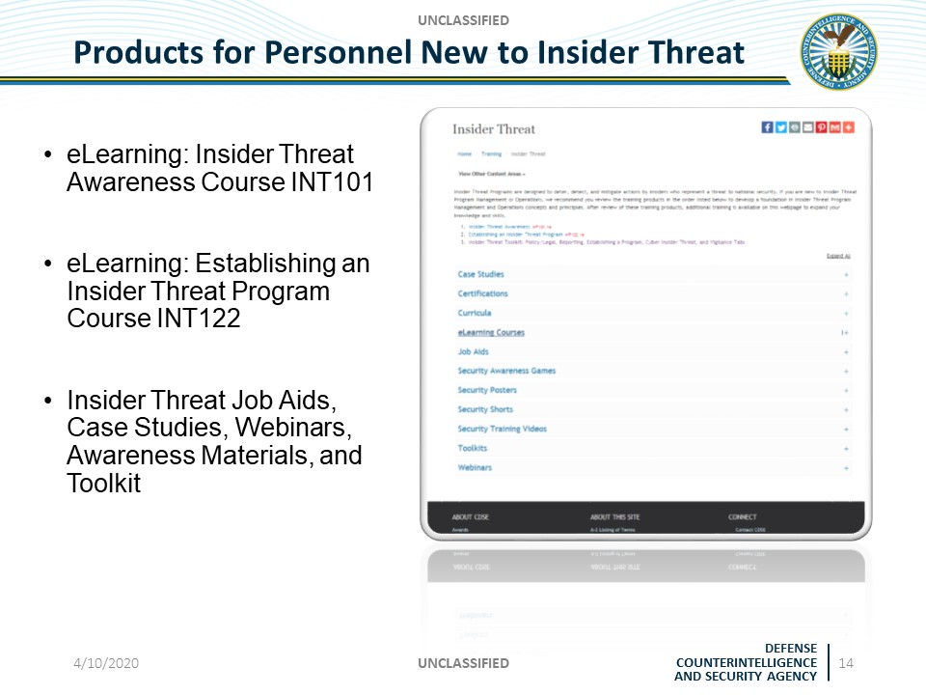

Slide 11
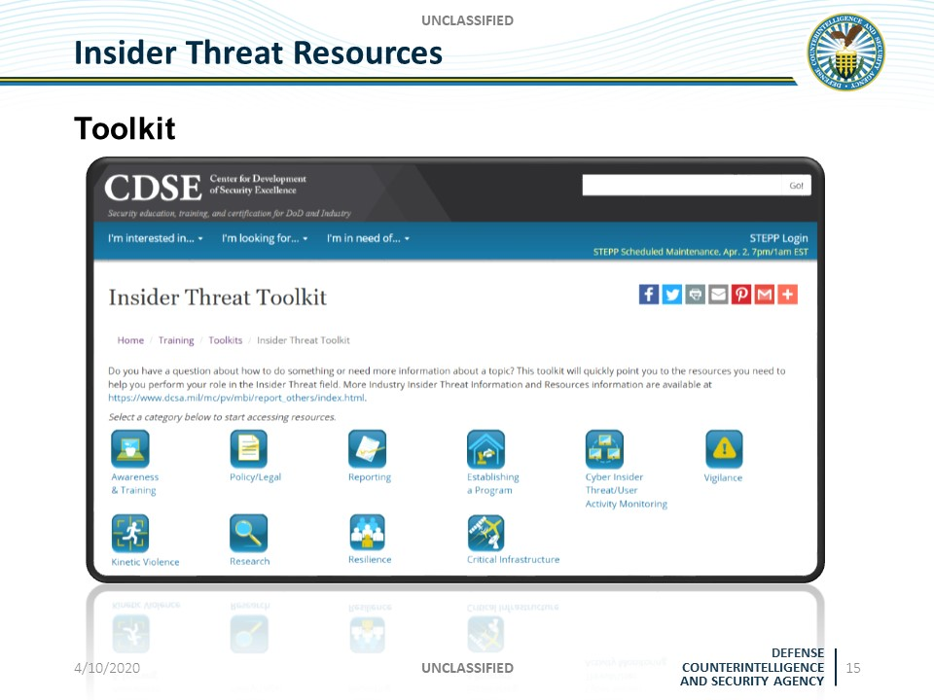

Slide 12
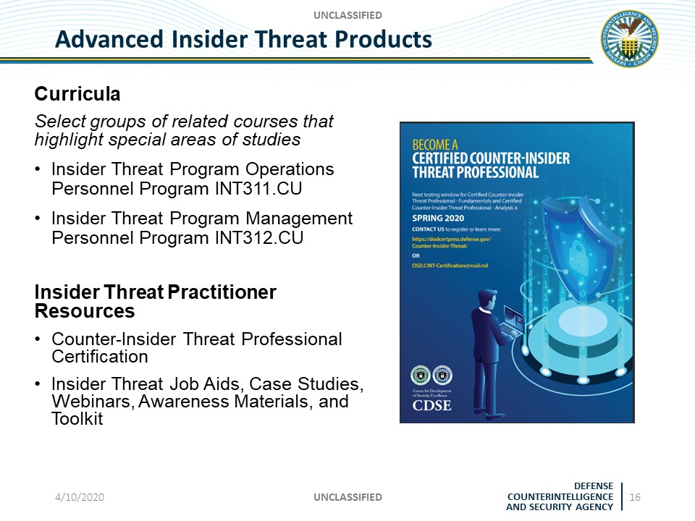

Slide 13
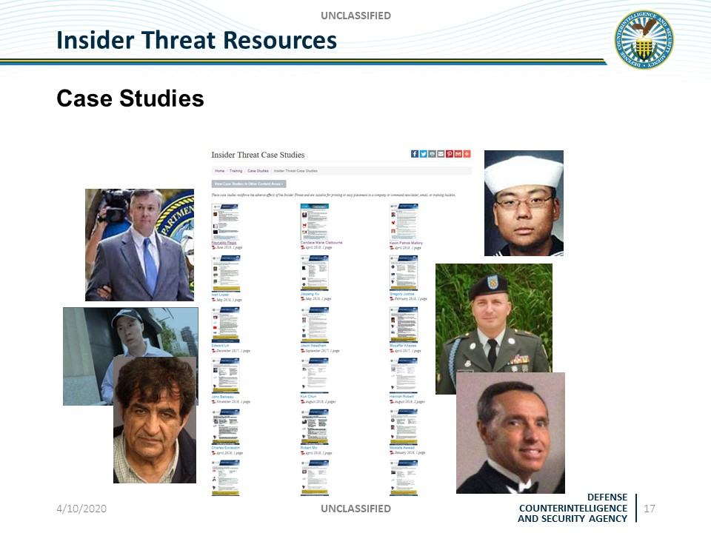

Slide 14
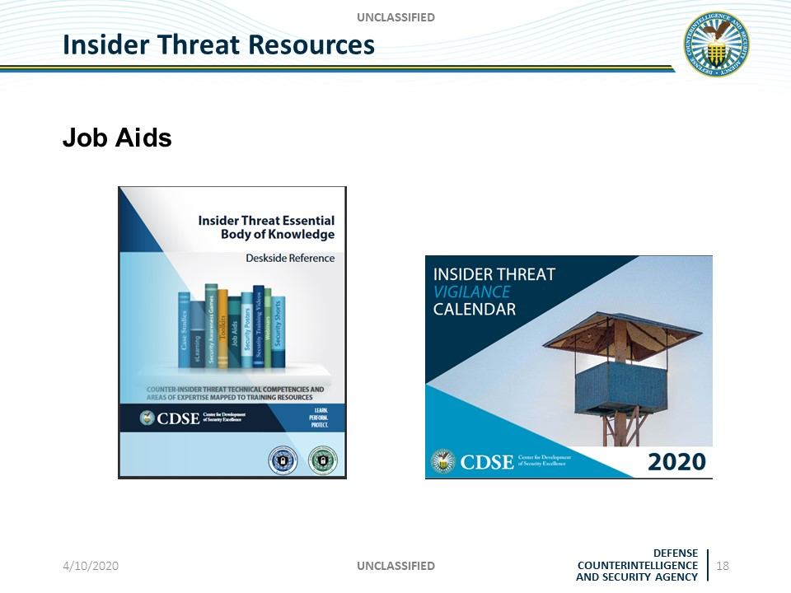

Slide 15
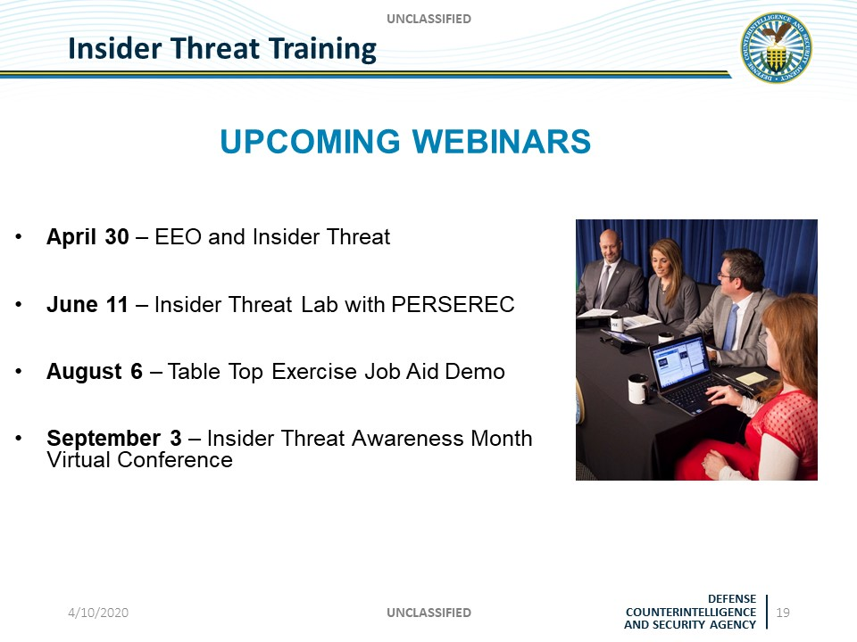

Slide 16
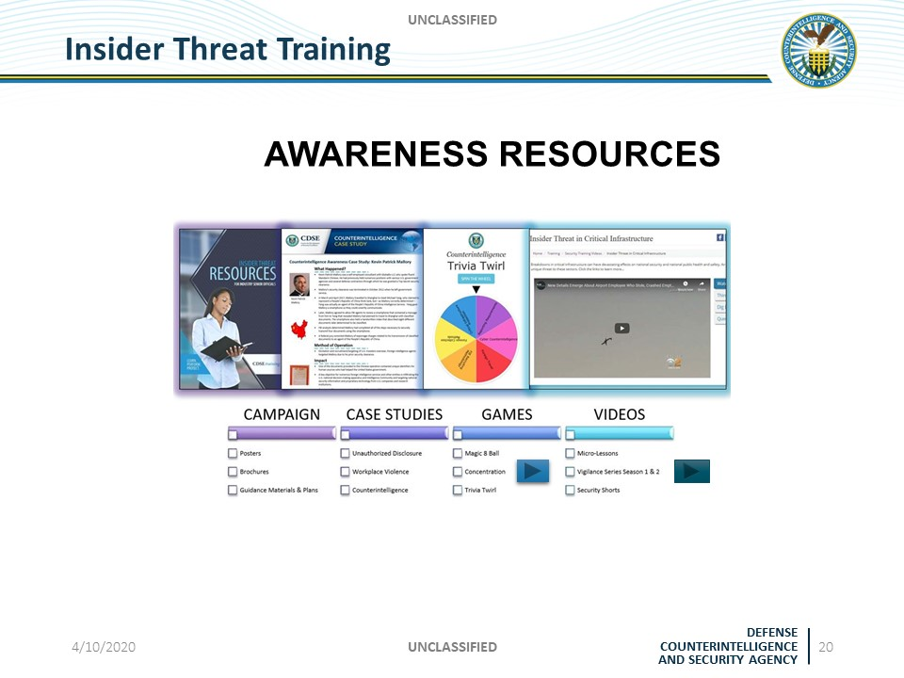

Slide 17
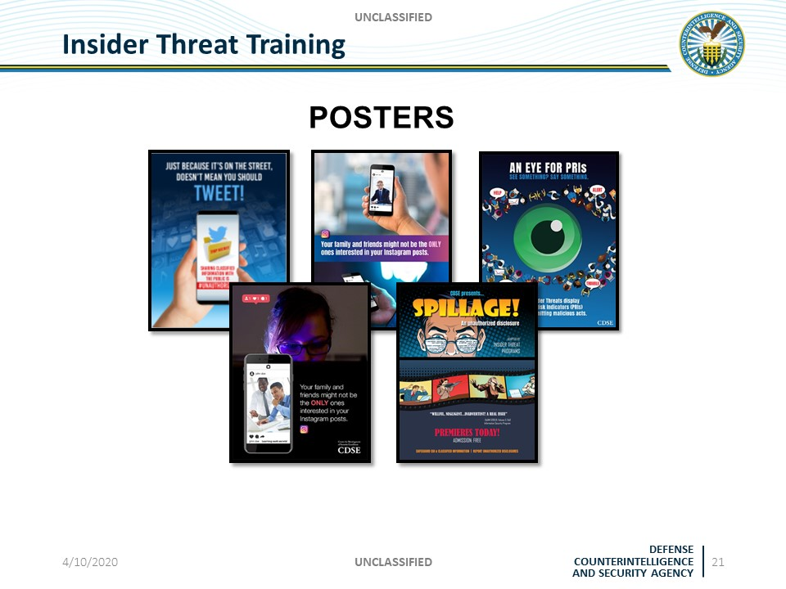

Slide 18
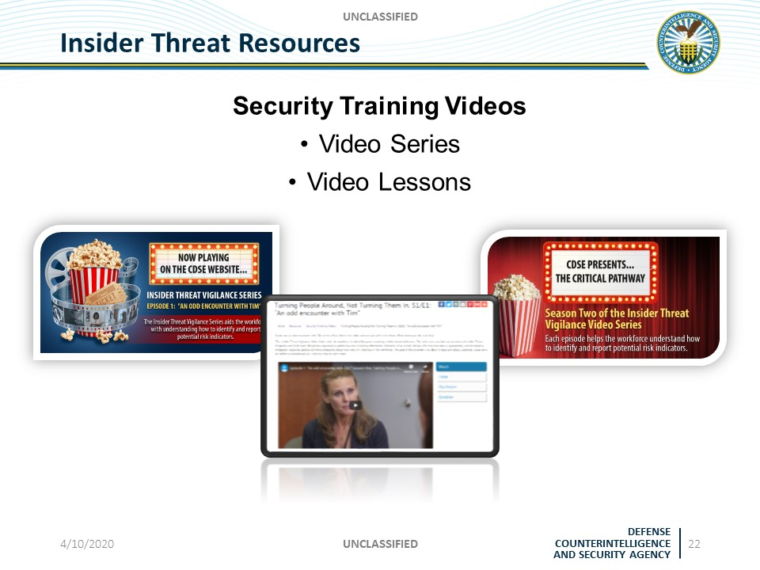

Slide 19
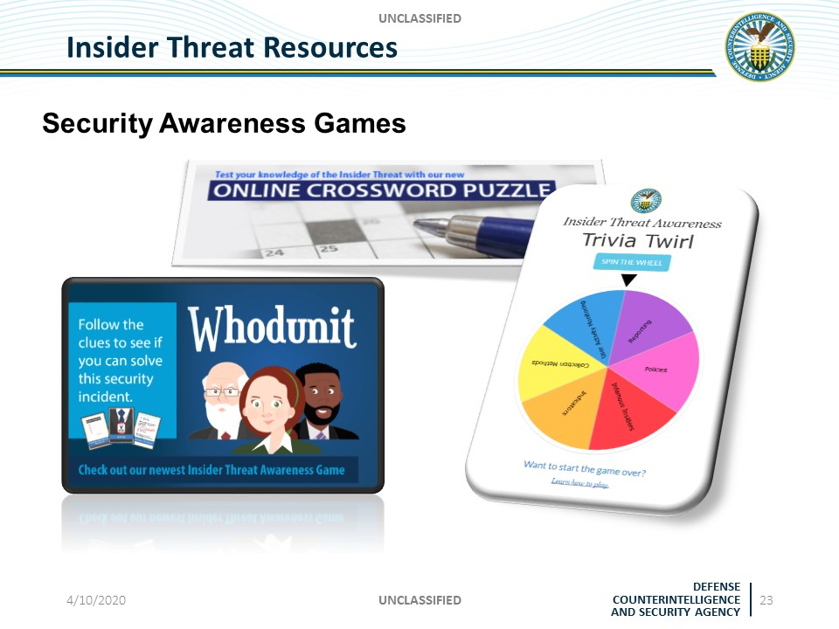

Slide 20
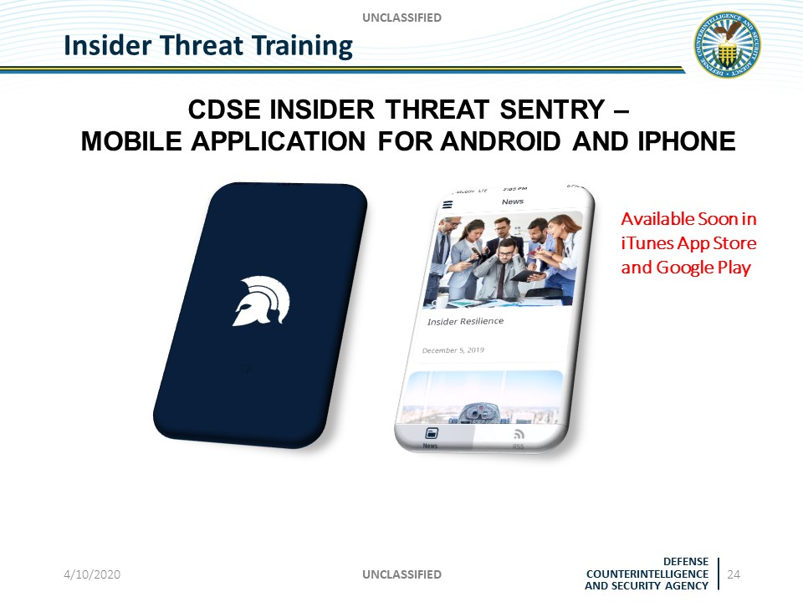

Slide 21
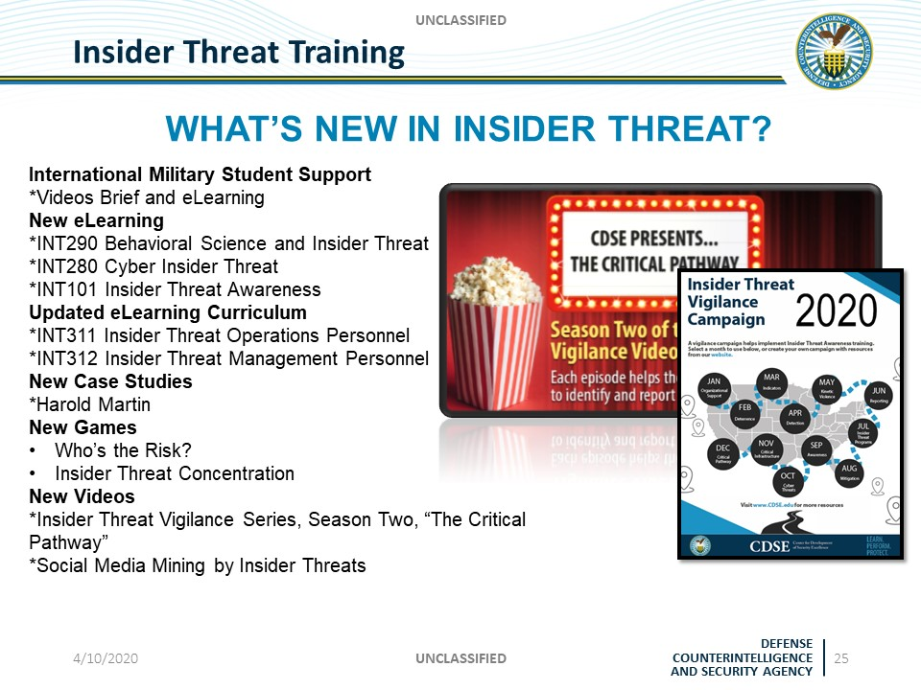

Slide 22
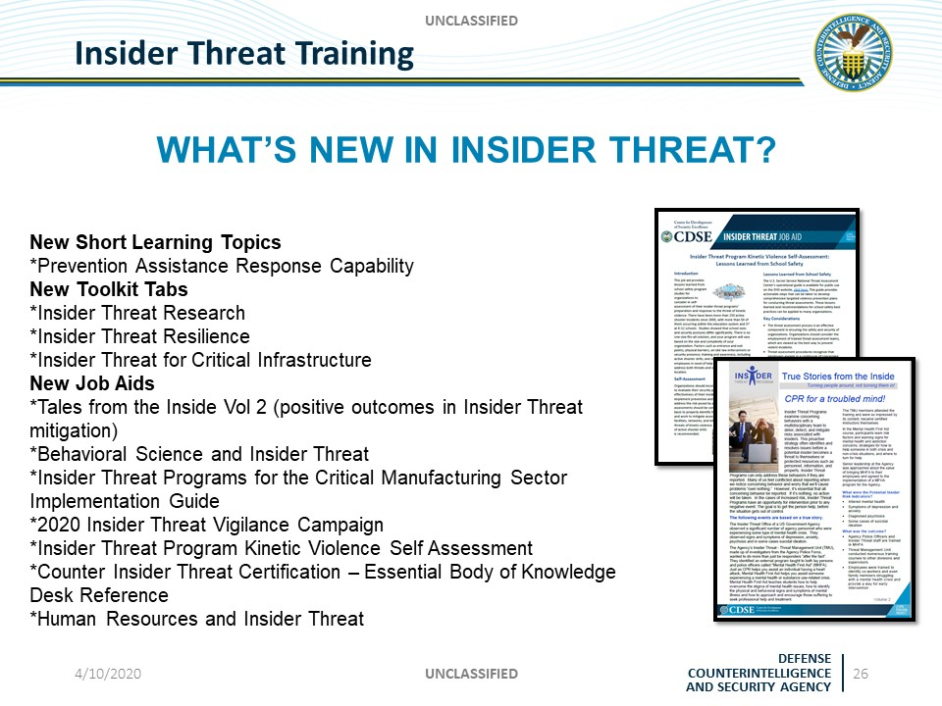

Slide 23
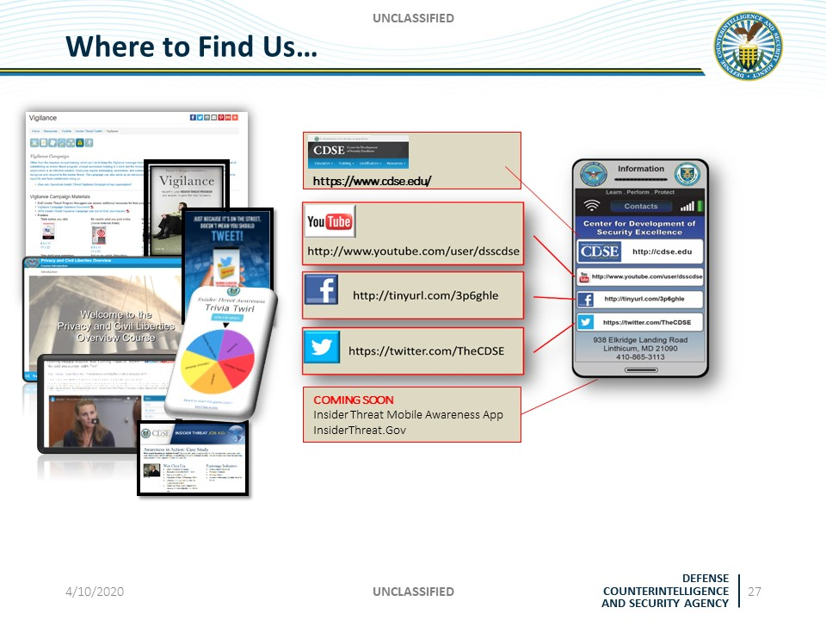

Slide 24
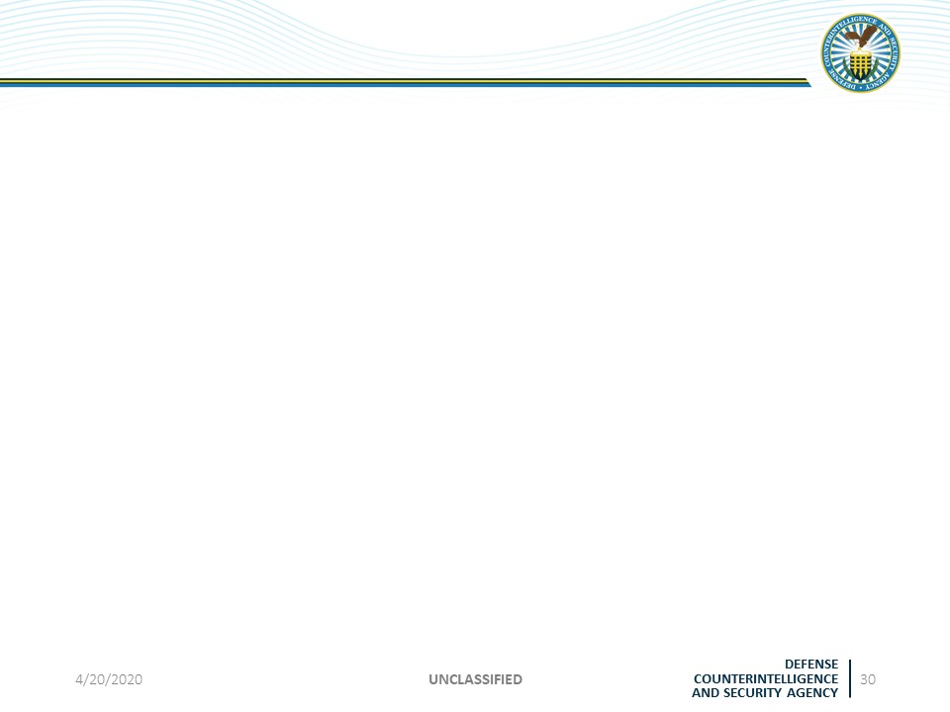
Stay Connected With CDSE
UNCLASSIFIED
Contact Information
Send any Insider Threat questions to: dcsa.cdsetraining@mail.mil
CDSE Email Subscription Service
Go to https://www.cdse.edu/news/index.html to sign up for the latest CDSE news, Insider Threat updates, information, or to manage your current subscriptions.
Social Media
https://twitter.com/TheCDSE
https://twitter.com/InT_Aware
https://facebook.com/TheCDSE
https://facebook.com/CDSEInsiderThreatAwareness
https://www.youtube.com/user/dsscdse

