Slide 1
INSIDER THREAT CENTER FOR DEVELOPMENT OF SECURITY EXCELLENCE (CDSE)
UNCLASSIFIED
AN ALTERNATIVE VIEW OF PREVENTING INSIDER THREATS: TAKING CULTURE SERIOUSLY

Slide 2
Preventing Insider Threats: Taking Culture Seriously
Frank Tortorello, Jr., PhD.
Analyst
United States Senate Sergeant-at-Arms Office
Cybersecurity Department

Slide 3
Disclaimer
The views presented here are the author’s and do not necessarily reflect those of the U.S. Senate, the Senate Sergeant-at-Arms Office, or any other government agency.

Slide 4
My Goals In This Presentation
Provoke thinking differently about ‘preventing insider threats’ by offering a view of what happens if we take culture seriously
Preventing bad behavior - inviting good action
Focus on behaviors/individuals - focus on relationships/organization
What/how - who/why
Data/puzzle pieces - culture/ethics

Slide 5
Biology and Culture: Contradictory Approaches to Understanding and Explaining What People Do
Biology
Culture
Molecules, electricity, chemicals and chemical reactions, proteins, enzymes
Automation, unawareness
A-moral
Physical/Organic
Brains, Hormones, Genes
The (inter)personal activity of using concepts and values to create of a meaningful life
Choice, awareness
Moral/ethical
Physical/Organic/Symbolic
People, language, meaning

Slide 6
Insider Threat Detection and Identification
Threat detection and identification is the process by which persons who might present an insider threat risk due to their observable, concerning behaviors come to the attention of an organization or insider threat team.
(Cybersecurity and Infrastructure Security Agency, CISA)

Slide 7
2004 Indonesian Tsunami: Explaining Threat Detection
How would you explain the threat detection activities of these people using the two approaches?
Is “the process by which concerning behaviors are/are not coming to the attention” of these people biological or cultural?

Slide 8
Choose an Explanation
People are automated by evolution to survive, to react to stimuli and to threats: if they’re not running away there’s something wrong biologically
People choose to use cultural concepts and values to see, and to ascribe a meaning to what they see: if they’re not running away, they’re using the wrong concepts/values

Slide 9
Threat Detection is Cultural…but Being a Threat is Biological?
Las Vegas Gunman’s Brain Will Be Scrutinized for Clues to the Killing
– New York Times, October 26, 2017
Scientists will study brain of former NFL player who police say killed five people then took his own life
- CNN.com, April 9, 2021
Parkland school shooter's brain exams to be subject of court hearing
- CBSNews.com, August 4, 2022
Louisville mass shooting suspect's brain will be tested for CTE, family spokesperson says
- ABCNews.com, April 14, 2023

Slide 10
Biology and Culture: Contradictory Approaches to Understanding and Explaining What People Do
Biology
Culture
Molecules, electricity, chemicals and chemical reactions, proteins, enzymes
Automation, unawareness
A-moral
Physical/Organic
Brains, Hormones, Genes
The (inter)personal activity of using concepts and values to create of a meaningful life
Choice, awareness
Moral/ethical
Physical/Organic/Symbolic
People, language, meaning

Slide 11
People:
Operated by internal biological machinery people are on the “straight and narrow”
Stress causes brain malfunction
They don’t know what they’re doing…they’re off-track
But we know…which justifies
Intervention to make them act differently…without them knowing
Observe behavior of people-machines “objectively”
Determine which ”track” the individual is on
Intervene by alleviating stressors to get them back on track

Slide 12
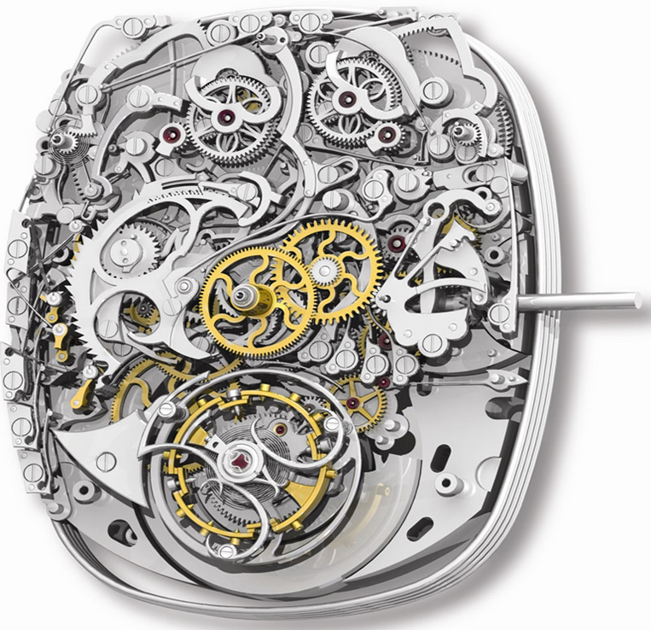
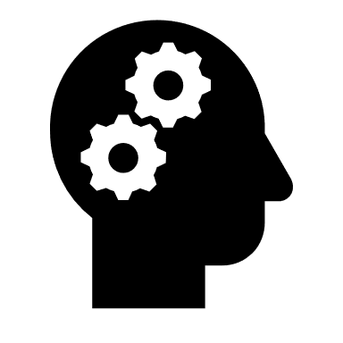
Foundational Assumption: People are Organic Behavior Machines: Automated and Unaware
People are organic machines
The brain/mind is a mechanical system determining behavior
The brain/mind “runs our lives”
Influences, shapes, decides, molds behavior
The brain/mind tells the organism what to do given internal or external stimuli

Slide 13
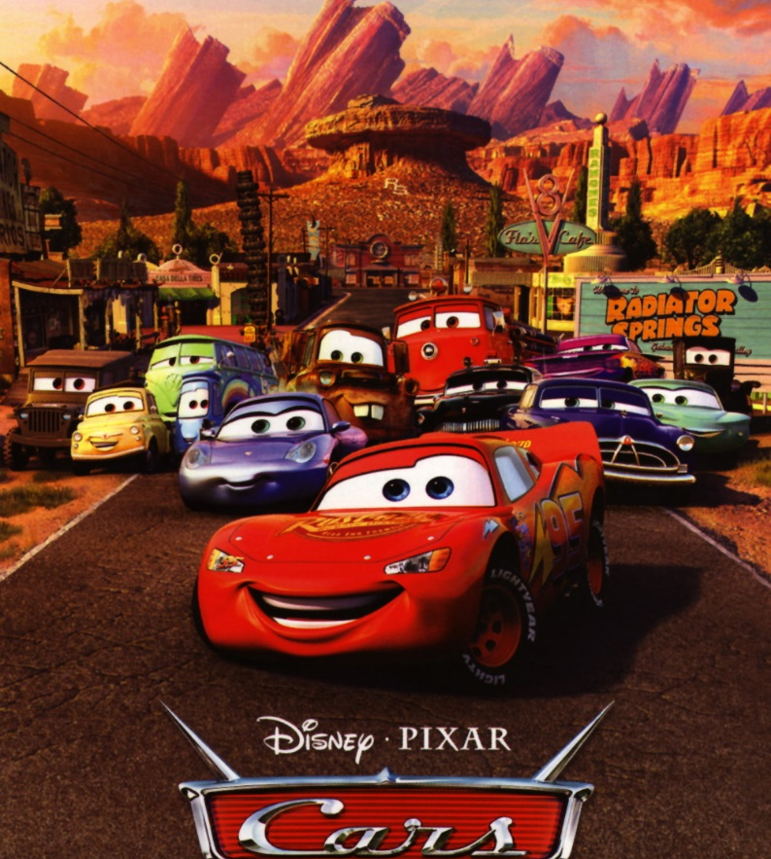
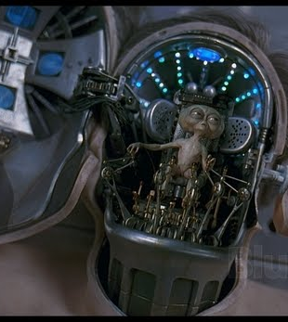
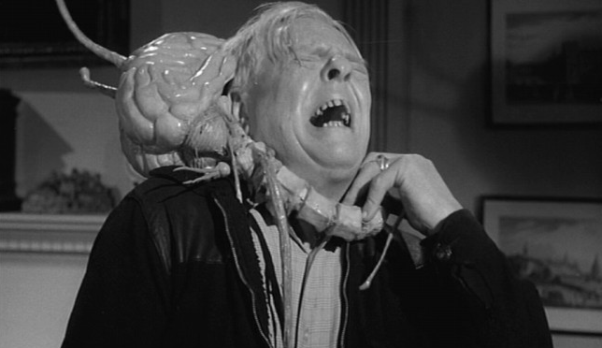
Biological Approach Has LOTS of Cultural Appeal
Cars (2006)
Machines are people
Men In Black (1997)
People inside a machine
Fiend Without a Face (1958)
Brains are evil people

Slide 14
If the Biological Viewpoint Was True, We’d Be Acting Quite Differently
Our talk about important subjects should be different:
“Hello, Lisa? I have something very important to ask you…”
The way we explain people-based events should be different:
How did my car get from my driveway to the grocery store?
The way we address our existential crises should be different:
“I just found out my spouse has been cheating, and I vomited”
“It’s my wedding day and I’m shaking”

Slide 15
Biology and Culture: Contradictory Approaches to Understanding and Explaining What People Do
Biology
Culture
Molecules, electricity, chemicals and chemical reactions, proteins, enzymes
Automation, unawareness
A-Moral
Physical/Organic
Brains, Hormones, Genes
The (inter)personal activity of using concepts and values to create of a meaningful life
Choice, awareness
Moral/ethical
Physical/Organic/Symbolic
People, language, meaning

Slide 16
A Cultural Approach to Preventing Insider Threats
Chris Inglis, Former NSA Deputy Director Former National Cybersecurity Director
“According to Federal Acquisition Regulation, contractors are different in kind, you’re less of a human being, a kind of widget”
Maybe Snowden would have acted differently if he had been:
Treated like a government employee
Enculturated into the NSA’s history of saving lives, averting disasters
Asked to swear to defend the Constitution
Exposed to the “bedrock values” that need to be honored during work
“If I could go back in time, I would violate the Federal Acquisition Regulation, I’d say we’re sending all the contractors to the NSA museum, we’re going to send them thank-you letters…”
https://www.youtube.com/results?search_query=how+to+catch+a+snowden

Slide 17
There are no tracks: people create their paths dynamically every day, minute by minute
Patterns of action are not automated responses to stimuli: they’re habits and choices to realize meanings
“Factors” don’t mitigate anything: people change their actions by choosing to do so, they decide which ‘factors’ matter
Organizations and culture are not factors, they are arrays of value-based relationships among people…invite people to act ethically and in the organization’s interest

Slide 18
The Person, Leadership, and the Organization in the Cultural Approach
USMC Sergeant Stevens
Iraq, 2004, hunting Improvised Explosive Device (IED) makers
Life/death ”stimulus-response” training
Hostile action means hostile intent…means fire
Modified the response despite stimulus in the moment of execution
Intelligent (re)focusing on the meaning of the man’s action, not a focus on the man’s behavior
Not providing a reason for Iraqis to choose to become insurgents
Not protecting himself and his fellow Marines as demanded by the social values of his organization

Slide 19
The Cultural Approach Calls For Different Views, Policies, and Actions
People:
Intelligent, social beings who are perfectly capable of changing their conduct
Live meaningfully by choosing to use cultural concepts and values with others
Can habituate meaningful action and can change it in the blink of an eye
Emotions are (sometimes fast) moral judgments, not internal energy-forcing behavior
If so, focus changes from:
Training, monitoring, and individuals to people, context, meaning, and values
Not just ”them,” but ”us” as well
Are your C-InT activities equitable, trustworthy, and just vs. efficient, cost-effective?
Organizations accountable not just for intervening, but for promoting right action, creating appropriate contexts and clarity, providing good leaders
Three-letter agency visit

Slide 20
Indicators and the “Climate” of Each Approach
Biological Approach: Impersonal
Cultural Approach: Personal
Indicators are treated as equivalent to needles on gauges
Groupings of indicators are thought to be “more” indicative
”Behaviors” are separable from persons and contexts
Matching behaviors with indicators is either value-free or unproblematic
Result: formalistic, analytical, impersonal framework
Spend your time here to increase risk
Indicators do not exist because people are not machines
Indicators are not templates for measuring risk, they’re correlations
People create meaning…but meaning is interpreted, not obvious
People interpret the meaning of actions using theories, cultural concepts and values
Result: agentic, social, and interpersonal framework
Spend your time here to decrease risk

Slide 21
Comparison of Logically-Implied Activities in the Biological and Cultural Approaches
Mitigating/preventing/countering the insider threat
Inviting people to act in accordance with organizational values
Formalistic/Analytical: Impersonal
Build databases
Collect data, seek puzzle pieces
Create templates and triggers for responses
Write policies
Intervene
Create (arbitrary) taxonomies of indicators
Medicalize (mis)behavior
Analyze data about individuals
Separate ‘behavior’ from the person
Hold misbehaving individuals accountable
Agentic/Social: Personal
Build and maintain interpersonal relationships
Choose values, value conflicts, seek clarity
Be better leaders and managers
Create and maintain constructive feedback
Invite
Reward engagement, creativity, teamwork
Ethicize misbehavior
Engage with real people
Hold misbehaving individuals accountable AND misbehaving seniors responsible
Rogers, Allport, Adler, Bruner, Harré, Shotter

Slide 22
Machine-Person Talk: Why We Stand By When Bad Things Are Happening
“The bystander effect occurs when the presence of others discourages an individual from intervening in an emergency situation, against a bully or during an assault or other crime. The greater the number of bystanders, the less likely it is for any one of them to provide help to a person in distress. People are more likely to take action in a crisis when there are few or no other witnesses present.
The intervention of bystanders is often the only reason why bullying and other crimes cease. The social and behavioral paralysis described by the bystander effect can be reduced with awareness and, in some cases, explicit training.”
https://www.psychologytoday.com/us/basics/bystander-effect

Slide 23
Summary: Alternative (Cultural) Framework
Returns focus to understanding the meaning of actions in context
Less danger of imposing a preferred meaning unintended by the actor
Avoids temptation to use reality-destroying models as basis for practices, policies, and methods
Only in extremely limited cases is brain function, automated behavior important
Stops us from using methods that provide false justification for action
Who knows what evil lurks in the heart of people…we do because we read brains
Treats people as the agents they are…respect, integrity, trust
Start with who, not what—don’t treat people like they don’t know what they’re doing
Empowers leaders to make a direct impact on the quality of life: meaningful work, fairness, justice
Example of enculturation: boot camp
Places organizational values and representatives to center stage

Slide 24
My Goals In This Presentation
Provoke thinking differently about ‘preventing insider threats’ by offering a view of what happens if we take culture seriously
Preventing bad behavior - inviting good action
Focus on behaviors/individuals - focus on relationships/organization
What/how - who/why
Data/puzzle pieces - culture/ethics

Slide 25
Questions?
Frank Tortorello
Frank.Tortorello@icloud.com
https://www.linkedin.com/in/franktortorello/

