Slide 1
PERSONNEL VETTING WEBINAR SERIES:
Continuous Vetting
14 March 2023
Stacey Williams – Sr. Personnel Security Specialist, Vetting Risk Operations
Monica Clory – Sr. Personnel Security Specialist, Vetting Risk Operations
Lacole Pugh – Personnel Security Specialist, Vetting Risk Operations
UNCLASSIFIED

Slide 2
PARTICIPANTS
HOSTS:
Ms. Elizabeth Bolin
Personnel Vetting Curriculum Manager
Center for Development of Security Excellence (CDSE)
Mr. Jason Steinour
Industrial Security Curriculum Manager
Center for Development of Security Excellence (CDSE)
GUESTS:
Mr. Stacey Williams
Sr. Personnel Security Specialist
Vetting Risk Operations (VRO)
Ms. Monica Clory
Sr. Personnel Security Specialist
Vetting Risk Operations (VRO)
Ms. Lacole Pugh
Personnel Security Specialist
Vetting Risk Operations (VRO)

Slide 3




ATTENDEE PARTICIPATION & FEEDBACK

Slide 4
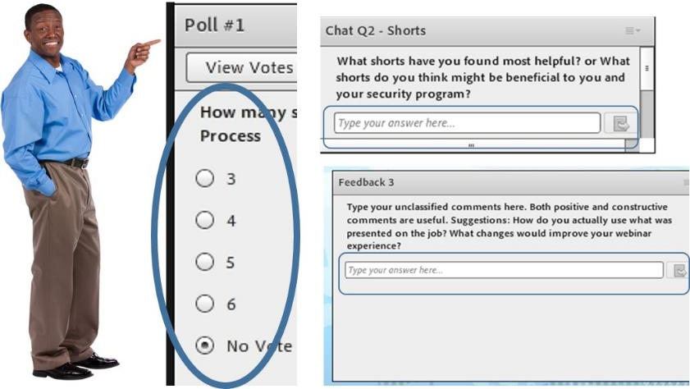
ATTENDEE PARTICIPATION & FEEDBACK
Polls, Chats, and Feedback

Slide 5
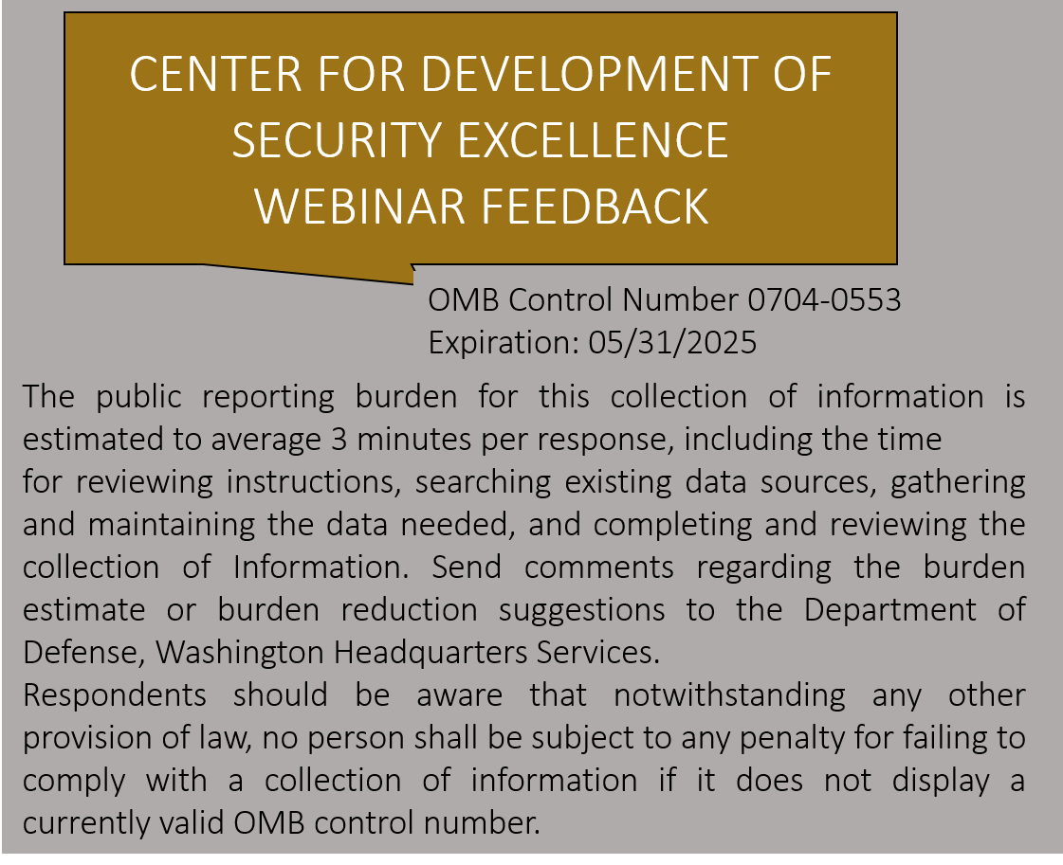
POST EVENT FEEDBACK
At the end of our event, please take a few minutes to share your opinions.
Your feedback helps us improve the quality of our offerings.
Responding will only take a few minutes.
Responding is optional.

Slide 6
Continuous Vetting (CV)

Slide 7
Open Ended Chat Question
Why do you think we have CV?

Slide 8
Continuous Vetting Overview
Individuals with:
  DOD affiliation
  Eligible for Access
  Signed SF-86 dated 2010 or later
WHO
Continuous Vetting (CV), as defined by Executive Order 13764 (2017) is the process of reviewing the background of a covered individual at any time to determine whether that individual continues to meet applicable requirements. Vetting policies and procedures are further sustained by an enhanced risk-management approach that facilitates timely detection of issues. Under the CV process, trusted individuals undergo continuous review to ensure the government and public's confidence that the individual will continue to protect people, property, information, and mission. Unlike its predecessor CE, Continuous Vetting will replace the five- and 10-year periodic reviews with ongoing and automated determinations of a person’s security risk.
WHAT
CONTINUOUS VETTING
WHY
Risk Detection: Goal is to address potential indicators early on, allowing individuals the opportunity to seek assistance and mitigate triggers before becoming an insider threat.
HOW
Automated Records Checks to address 7 data categories

Slide 9

Continuous Vetting Updates
RESULTS OF CONTINUOUS VETTING
CV ENROLLMENT
~3.7 mil
Total Subjects Enrolled in DOD CV Program
~1 mil
Industry Subjects Enrolled in CV
DCSA is responsible for the implementation of the DoD CV program. In accordance with the 27 June 2022 USDI memo “Department of Defense Guidance on Continuous Vetting and Other Measures to Expedite Reform and Transition to Trusted Workforce 2.0”, periodic reinvestigations are no longer being conducted for DoD. There is a requirement for an updated SF86 to be submitted at 5 year intervals, regardless of level of eligibility. The updated SF86 will be enrolled/captured with updated information into the CV program.
Note: VRO posted supplemental guidance on 10 August in support of implementation of the policy. It is understood that there is an impact to Industry to meet the requirement of submission of an SF86 at 5 year intervals, using the most recent date of the CV enrollment or date of last investigation.
Here’s what to do and when:
The Subject has No Eligibility  Submit the SF86 and fingerprints.
The Subject has Eligibility  FSO can grant access and verify enrollment into CV. If Subject is not enrolled into CV, FSO should submit new SF86.
Processing 5 Year Investigation Request  FSO should adhere to 5 years after the CV enrollment date or most recent investigation close date, whichever is more recent.
6%
Rate of CE Alerts Received
2%
Industry Incident Report Rate
40K Valid Alerts on 28K unique subjects
36% not previously reported
CV relies heavily on culture of self-reporting (SEAD-3)
      Risk Identification and Mitigation

Slide 10
Poll Question #1
1. Which adjudicative guideline accounts for the largest amount of CV alerts?
- Financial
- Criminal
- Allegiance to the United States

Slide 11
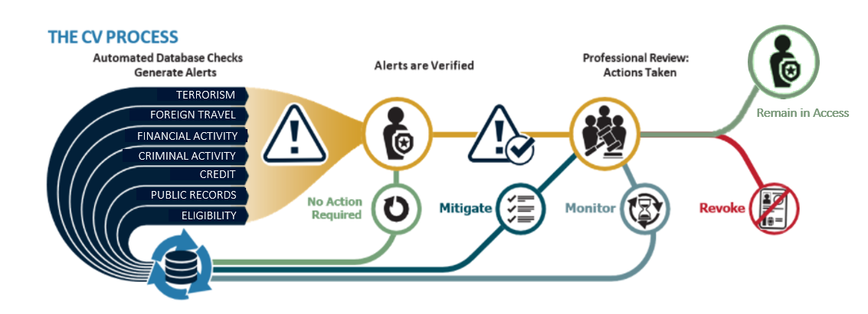
CV Mission & Process
Under the CV process, trusted individuals undergo continuous review to ensure the government and public's confidence that the individual will continue to protect people, property, information, and mission. CV leverages automated record checks which include information from Government and commercial data sources.
Automated record checks pull data from criminal, terrorism, and financial databases, as well as public records, at any time during an individual’s period of eligibility.
When DCSA receives an alert, it assesses whether the alert is valid and meets certain threshold criteria for further investigation.
DCSA investigators and adjudicators then gather facts and make clearance determinations.
CV helps DCSA mitigate personnel security situations before they become larger problems, either by working with the cleared individual to mitigate potential issues, or in some cases suspending or revoking clearances.
Notes:
*Kristen Spida

Slide 12
Poll Question #2
2. T/F: The largest population enrolled in CV is Federal Civilian.

Slide 13



Population Management in CV
Military
Civilian
Industry
POPULATION
2M
672K
1.1M
ALERT RECEIPT
Automated Records Sources
ALERT PROCESSING
Incident information is shared with the SMO for additional action as necessary. Coordinate with insider threat hubs and send referrals to outside agencies
Incident information is triaged and action is taken based on the nature & severity of the adverse information
REPORTING REQUIREMENTS
SEAD 3
SEAD 3
SEAD 3 & NISPOM

Slide 14
Poll Question #3
3. T/F: CV and Trusted Workforce are the same thing?

Slide 15




Personnel Security Clearance Reform Efforts
A vetting process to review the background of an individual determined to be eligible for access to classified information or to hold a sensitive position at any time during the period of eligibility. CE leverages a set of automated record checks and business rules to assist in the ongoing assessment of an individual's continued eligibility.
CE is intended to complement continuous vetting efforts.
Robust and near real-time review of trusted individuals to ensure the government and public's confidence that the individual will continue to protect people, property, information, and mission.
Continuous vetting will replace the five- and 10-year periodic reviews with ongoing, and often automated, determinations of a person’s security risk.
An enterprise approach to overhaul the security clearance process to get people to work faster, have more mobility and ensure they’re trusted through
More nimble policy making
Vetting tailored to mission needs
Aligned security, suitability and credentialing
Reduced number of investigative tiers
Expanded spectrum of investigative methods
Continuous Evaluation
Continuous Vetting
Trusted Workforce 2.0
Notes:
Trusted Workforce is a major overhaul of the security clearance process. This initiative will improve the security clearance processes, update the policy framework, and modernize IT capabilities.

Slide 16



The Future of Personnel Security
Establish Trust
Maintain Trust
Re-Establish Trust
INITIAL VETTING
VRO processes initial eQIP for NISP individuals
Individual is enrolled in CV
CONTINUOUS VETTING
⬄
Has replace the five- and 10-year periodic reviews with ongoing, and often automated, determinations of a person’s security risk
Individual is enrolled into CV program
Checks run on pre-determined schedule based on risk in person and position
Initial output of CV Automated Records Checks sets baseline for individual
UPGRADING VETTING
Will offer a more seamless approach to upgrading security clearance levels as needed
RE-ESTABLISHING TRUST
Re-establishment of a clearance after a lapse in continuous vetting, currently known as a “Break in Access”
TRANSFER OF TRUST
Reciprocity, as we know it today, will be revamped to make for a smoother transition from one government agency to another
The Trusted Workforce 2.0 initiative is an effort to overhaul and improve:
  the security clearance process
  the issue of security clearance timeliness, while offering up a risk-based process that looks more strategically at which types of behaviors and positions constitute a security risk – and which do not.
The revamped vetting will focus on mission needs, outlining five specific vetting scenarios.

Slide 17
DCSA Support
Knowledge Center Inquiries
In an effort to continue to protect our workforce during the COVID-19 pandemic, Personnel Security Inquiries (option 1/option 2) of the DCSA Knowledge Center has been suspended until further notice. We will continue to provide status updates via DISS Customer Service Requests and VRO email dcsa.ncr.dcsa-dvd.mbx.askvroc@mail.mil. When calling (888) 282-7682, customers will have the following menu options:
  Personnel Security Clearance Inquiries (e-QIP PIN Resets, Golden Questions & VRO)
  For Industry PIN Resets: HANG UP and Call the Applicant Knowledge Center at 724-738-5090, or; Email DCSAAKC@mail.mil, or;
  For all other PCL related inquiries email dcsa.ncr.dcsa-dvd.mbx.askvroc@mail.mil
Other DCSA Offices
DCSA Adjudications Call Center
* Temporarily suspended due to COVID-19
DCSA Policy | DSS.quantico.DSS-hq.mbx.policyhq@mail.mil
DCSA Facebook | https://www.facebook.com/DCSA.Stakeholders
DCSA Twitter | https://twitter.com/DSSPublicAffair
Background Investigations
DCSA's System Liaison |  | 724-794-5612, Ext. 4600 or DCSAEqipTeam@mail.mil
For Technical Issues with e-QIP |  | 866-631-3019
For Agent’s/ Investigator’s Identity or Status |  | 1-888-795-5673 or dcsa.boyers.bi.mbx.investigator-verifications@mail.mil
Phone | 301-833-3850* (SSOs and FOSs ONLY) Option 5 –Industry
Email | dcsa.meade.caf.mbx.call-center@mail.mil
DOHA
Phone | 866-231-3153
Website | dohastatus@ssdgc.osd.mil

Slide 18
Questions & Answers

