Slide 1
Insider threat awareness
YOUR NAME AND organization;
INSERT LOGO / SEAL ON LOWER RIGHT
UNCLASSIFIED

Slide 2
Learning objectives
Understand what constitutes an Insider Threat
Understand the Department of Defense Insider Threat Program supports personnel and mission
Understand potential risk indicators and concerning behaviors
Understand threats from Foreign Intelligence Entity targeting and recruitment
Understand real-world examples of insiders threats
Understand reporting requirements and procedures
UNCLASSIFIED

Slide 3

What is insider threat?
DOD definition per DoDD 5205.16: The threat an insider will use her or his authorized access, wittingly or unwittingly, to do harm to the security of the United States. This can include damage to the United States through espionage, terrorism, unauthorized disclosure of national security information, or through the loss or degradation of departmental resources or capabilities.
UNCLASSIFIED
Notes:
- Insider acts can be witting or unwitting.
- Damaging insider acts can be intentional or unintentional (due to complacency or negligence).
- Degradation of departmental resources can include damage to data, facilities, personnel or organizations.

Slide 4
Who can be an insider threat?
Espionage
Internal Threat
Trusted Insiders
Supply Chain Members
Employees with National Security Eligibility
Sabotage
Security Violations
Fraud
Trade Secret Theft
Criminal Activity
Harm to Self / Others
Negligent Acts
Unauthorized Disclosure
Workplace Violence
These individuals can be cleared or NOT cleared
UNCLASSIFIED
Notes:
The trusted employee we come in contact with every day –
Not necessarily members of the cleared community!
No environment is immune from insider threat.

Slide 5

discussion
Name Examples of Insider Threats
UNCLASSIFIED
Notes:
This is a brief check on how much knowledge and awareness does the class attendees have about Insider Threat. Ask audience to name examples of insider threat. The discussion should include Name, Potential Risk Indicators, Manifestations, Actions and Impact.
Examples for your reference:
Aaron Alexis, Navy Yard Shooter, In 2013, Alexis, a Navy contractor shot and killed 12 people at the Washington Navy Yard in Washington, D.C., before being killed at the scene by police. Alexis displayed indications of depression, anxiety, paranoia, and other mental health concerns.
Gabriel Romero, In 2019, Romero, A 22 year-old active-duty sailor shot and killed two civilian employees, wounding a third at the Pearl Harbor Naval Shipyard. Leading up to the shooting, the sailor was subject to repeated disciplinary actions related to poor work performance: https://securityawareness.usalearning.gov/cdse/case-studies/case.html?Romero
Daniel Hale, In 2014, Hale took classified documents he had no right to retain from his work at the NGA and sent them to a reporter while purposefully disregarding the law. Hale became an anti-war activist and released documents because of his opposition to war and the use of drone warfare. Security and Compliance Issues: Hale released TS/SCI documents in violation of classified non-disclosure agreements; Technical Activity: Hale had Tor Software and the Tails operating system to be used to provide anonymity during transfer of documents: https://securityawareness.usalearning.gov/cdse/case-studies/case.html?Hale

Slide 6
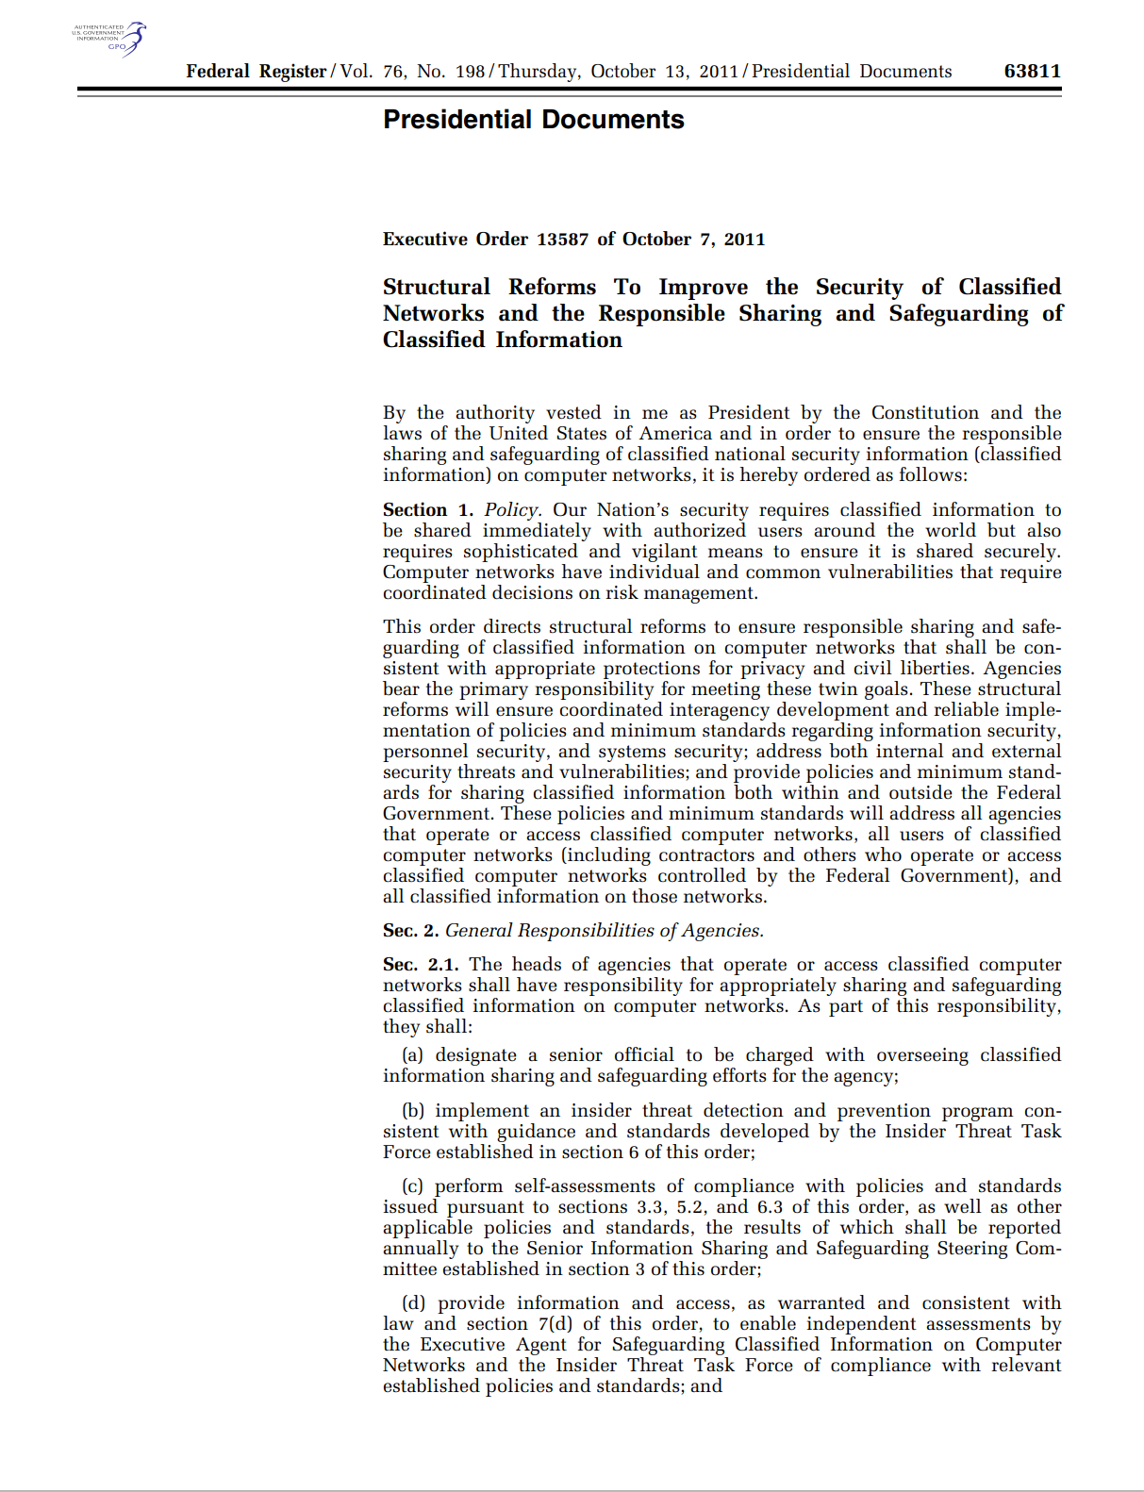
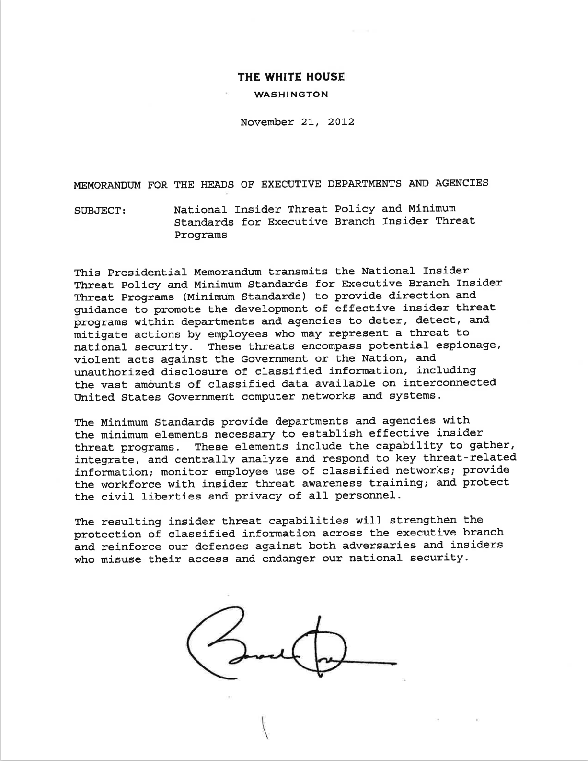
The Dod insider threat program
National Insider Threat Policy and Minimum Standards for Executive Branch Insider Threat Programs
National Insider Threat Program
Executive Order 13587
UNCLASSIFIED
Notes:
DOD ITP and Minimum standards:
(1) The DoD applies the NITTF Minimum standards to the enterprise through DoD Directive 5205.16.
(2) Within the minimum standards are employee training and awareness requirements. The NITTF minimum standards require that all cleared employees receive insider threat awareness training either in person or via computer within 30 days of employment or following the granting of a clearance. The training should include lessons on the importance of detecting and reporting potential insider threats, methodologies that adversaries use to recruit trusted insiders, indicators of insider threat behavior, and counterintelligence and security reporting requirements.

Slide 7
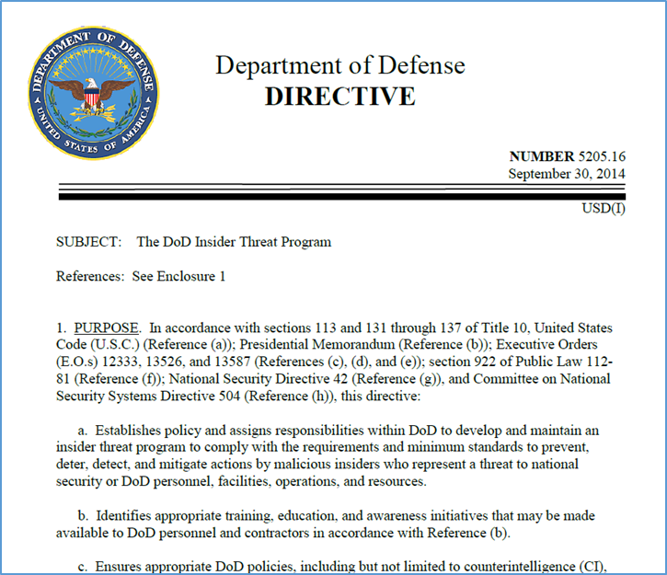
The Dod insider threat program
DoD Directive 5205.16
“Establishes policy and assigns responsibilities within DoD to develop and maintain an insider threat program to comply with the requirements and minimum standards to prevent, deter, detect, and mitigate the threat insiders may pose to DoD and U.S. Government installations, facilities, personnel, missions, or resources.”
UNCLASSIFIED
Notes:
DoDD 5205.16 –
Identifies appropriate training, education, and awareness initiatives that may be made available to DoD personnel and contractors in accordance with Reference
Ensures appropriate DoD policies, including but not limited to counterintelligence (CI), cybersecurity, security, civilian and military personnel management, workplace violence, emergency management, law enforcement (LE), and antiterrorism (AT) risk management, are evaluated and modified to effectively address insider threats to DoD.
POLICY.
a. DoD will implement the National Insider Threat Policy and Minimum Standards for Executive Branch Insider Threat Programs in accordance with References (b), (e), (f), and (h).
b. The threat that an insider may do harm to the security of the United States requires the integration and synchronization of programs across the Department. This threat can include damage to the United States through espionage, terrorism, unauthorized disclosure of national security information, or through the loss or degradation of resources or capabilities.
c. Through an integrated capability to monitor and audit information for insider threat detection and mitigation, the DoD Insider Threat Program will gather, integrate, review, assess, and respond to information derived from CI, security, cybersecurity, civilian and military personnel management, workplace violence, AT risk management, LE, the monitoring of user activity on DoD information networks, and other sources as necessary and appropriate to identify, mitigate, and counter insider threats.
The DoD Prevention, Assistance and Response (PAR) is a supportive element to the DoD Insider Threat Program. PAR implements a risk assessment mechanism that focuses on potential threats at the installation post/base level. PAR capabilities will provide installation commanders and their equivalent civilian leaders with options to assist personnel who are at risk of potentially violent behavior and address the problems or stressors.
What are PAR Capabilities? PAR Capabilities is a network of multi-disciplinary efforts, each led by a functional expert. These functional experts operate at the installation or base level. Installation commanders or their equivalent civilian leaders shall use PAR Capabilities to identify the level of risk that violent behavior poses to DoD personnel, organizations, installations, or separate facilities, and to develop risk response recommendations to mitigate or remediate this risk.
The DoD Memo (2 Feb 17) by the Deputy Secretary of Defense requires all DoD Components to have PAR or PAR-like programs or capabilities. This memo implemented recommendations following the 2009 Ft Hood shooting and other active shooter events.
An updated DoDD 5205.16 is scheduled to be published in Jan 2023, and will establish PAR Coordinators at DoD installations.

Slide 8
INSIDERs at risk
The Critical Pathway to Insider Risk Model
Personal Predispositions
Stressors
Medical / Psychiatric Disorders
Personality or Social Skills
Previous Rule Violations
Social Network Risks
Concerning Behaviors
Personal
Professional
Financial
Maladaptive Organization Response
Interpersonal
Technical
Security
Financial
Personnel
Social Network
Travel
Plans, Recruitment, Insider Attack, Op Sec Action
Mitigating Factors
Shaw & Sellers, 2015; Lenzenweger & Shaw, 2022
UNCLASSIFIED
Notes:
Most individuals do not set out to become an insider threat. A combination of factors including personal predisposition and life stressors in the home or on the job place people on the Critical Pathway to Insider Threat. The “Critical Pathway” model for understanding insider attacks has four components:
Personal Predispositions
Stressors
Concerning Behaviors
Poor Organizational Response
It begins with personal predispositions and personal and professional stressors, which are often the behaviors that emerge as PRIs. Over time, these factors may combine and increase the risk that an individual may become an insider threat
Personal Predispositions: Normal and well-adjusted individuals rarely commit hostile insider acts. Some of the personal characteristics that could predispose individuals toward becoming insider threat risks include the following (keep in mind, an individual with these issues is not necessarily an insider threat): Medical/psychiatric conditions ; Social network risks ;Previous rule violations; Personality or social skills risks; Decision-making deficits
Stressors can be negative or positive events that result in changes in personal, social, or professional responsibilities that require individuals to spend effort and energy to adjust. While everyone experiences stress in life, research indicates that stressors especially place pressure on those who possess vulnerable predispositions and can lead them down the next step of the critical path (not everyone with these issues is an insider threat): Personal, Financial or Professional
Certain organizational cultures may cause or intensify stressors for members of its community and increase the risk of a potential threat. If this risk is not mitigated, then it can lead to exceptionally grave damage. A culturally competent organization has the capacity to introduce and integrate various cultures or subcultures in order to produce better outcomes and enhance operational effectiveness. In the context of insider risk, better outcomes and enhanced operational effectiveness can be measured by the successful prevention, detection, deterrence, and mitigation of the potential insider threat in all of its manifestations
CDSE Job Aid: CULTURAL COMPETENCE AND INSIDER RISK
https://www.cdse.edu/Portals/124/Documents/jobaids/insider/Cultural-Competence-and-Insider-Risk.pdf
CDSE Job Aid: Behavioral Science and Insider Threat
https://www.cdse.edu/Portals/124/Documents/jobaids/insider/Behavioral-Science-and-Insider-Threat.pdf

Slide 9
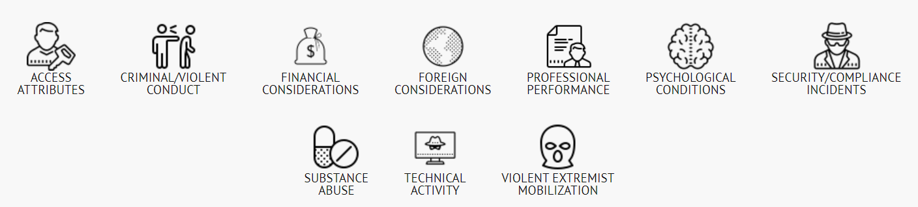
Potential risk indicators
PERSONAL
CONDUCT
SUBSTANCE
MISUSE
Most employees engaging in threat behavior showed one or more Potential Risk Indicators (PRIs).
UNCLASSIFIED
Notes:
What are potential risk indicators? Individuals at risk of becoming insider threats, and those who ultimately cause significant harm, often exhibit warning signs, or indicators. PRI include a wide range of individual predispositions, stressors, choices, actions, and behaviors. Some indicators suggest increased vulnerability to insider threat; others may be signs of an imminent and serious threat.
Indicators do not always have diagnostic value or reflect wrongdoing. Some PRI may involve activities that are constitutionally protected. Timely and appropriate reporting of PRI is crucial for assessing and mitigating insider threats. National security, critical services, and public safety depend on it. Preventing harm due to insider threat is a shared responsibility. Individuals adhere to insider threat policies and procedures; organizations investigate potential threats while preserving employee privacy and civil liberties
The threat that an insider will use her/his authorized access, wittingly or unwittingly, to do harm to the security of the United States. This threat can include damage to the United States through espionage, terrorism, unauthorized disclosure of national security information, or through the loss or degradation of departmental resources or capabilities. Unwitting insiders may inadvertently disclose sensitive information, cause spillage, unknowingly download malware, or facilitate cybersecurity events, causing damage to our national security.
CDSE Job Aid: Insider Threat Potential Risk Indicators (PRI)
https://www.cdse.edu/Portals/124/Documents/jobaids/insider/INTJ0181-insider-threat-indicators-job-aid.pdf?ver=_HedcDtQk9sSEZItNMLQzA==

Slide 10
potential risk indicators explained
Access Attributes: Security clearance and information access, DOD system(s) privileged user, Other Examples..
Criminal Behavior: Sexual assault and domestic violence, parole or probation or violation thereof, Other Examples..
UNCLASSIFIED
Notes:
Activity: Ask the audience for additional examples on each category.
Access Attributes: Security clearance and information access (Confidential, Secret, TS, SCI, SAP, etc.), access to physical facilities (secret-cleared spaces, SCIF, SAP, etc.), access to systems and applications (SIPR and other Secret, JWICS or other SCI, SAP, etc.), DOD system(s) privileged user, explosives access or training, CBRN access or training
Criminal Behavior: Criminally violent behavior, to include sexual assault and domestic violence or other criminal behavior (voluntary admission, included during polygraph examination or investigation, substantiated report or arrest, criminal proceedings), exhibiting violence at work (directed against property or persons), threatening violence, possessing unauthorized weapon, authorized weapon at an unauthorized time or location, weapon mishandling, criminal behavior involving weapons, failure to follow court order, parole or probation or violation thereof, criminal affiliations

Slide 11
potential risk indicators explained
Financial Considerations: Filing for bankruptcy, delinquent debts, pay garnishment, Other Examples..
Foreign Considerations: Foreign travel to countries of concern (official or non-official), Foreign business or political interest, Other Examples..
UNCLASSIFIED
Notes:
Activity: Ask the audience for additional examples on each category.
Financial Considerations: Financial crime (voluntary admission, including during polygraph or investigation, substantiated report or arrest, criminal proceeding), filing for bankruptcy (adverse changes to financial status, foreclosure or repossession, loan default, involuntary lien or unfavorable judgement), delinquent debts, high debt-to-income ratio, failure to file tax returns, pay garnishment, displaying signs of unexplained affluence, experienced gambling problem
Foreign Considerations: Citizenship (threat or non-threat country – past/present), foreign travel to countries of concern (official or non-official), frequent foreign travel (excluding official travel), other foreign travel, service in foreign military or government, possessing foreign passport, voting in foreign election, possession of foreign assets, foreign residency, foreign business or political interest, receiving benefits from a foreign nation, foreign citizenship - spouse or cohabitant, foreign citizenship - immediate family member, living with foreign national, foreign national contact, unauthorized contact with an officer or agent of a foreign intelligence entity (FIE), enabling or facilitating an officer, agent, or member of a FIE

Slide 12
potential risk indicators explained
Professional Lifecycle Performance: Poor performance ratings, Suspension, involuntary administrative leave, Other Examples..
Personal Conduct: Falsifying hiring information, Anti-social or compulsive behavior, mental instability, self-harm, Other Examples..
UNCLASSIFIED
Notes:
Activity: Ask the audience for additional examples on each category.
Professional Lifecycle Performance: Declining performance ratings, poor performance ratings, reprimand/non-judicial punishment, Human Resources (HR) complaints, demotion, separation status (pending voluntary separation, pending involuntary separation), suspension, involuntary administrative leave, leave of absence, unauthorized absence/AWOL, negative characterization of previous employment or service
Personal Conduct: Falsifying hiring information, falsifying data at place of work, subject to judgement in civil litigation, Expressing ill-will towards USG or employing organization, communicating extremist views, associating with extremist or terrorist groups, enabling or facilitating an extremist or terrorist group, admission to inpatient mental health facility (voluntary, involuntary), insanity plea in a criminal case, anti-social or compulsive behavior, mental instability, past untruthfulness (including voluntary admission, including during polygraph or investigation), failure to successfully complete a polygraph, communicating endorsement of workplace violence, other psychiatric or psychological condition, self-harm, suicidal ideation, or attempting suicide

Slide 13
potential risk indicators explained
Security/Compliance Incidents: Compliance violation, security violation, Other Examples..
Substance Misuse: Illegal substance use or trafficking, legal substance abuse or trafficking—alcohol or prescription drugs, Other Examples..
UNCLASSIFIED
Notes:
Activity: Ask the audience for additional examples on each category.
Security/Compliance Incidents: Compliance violation, security infraction, security violation, non-compliance with training requirements, delinquent Government Travel Charge Card (GTCC), misuse of DOD purchase card or expense violations, time entry violations, security clearance denial, suspension, or revocation
Substance Misuse: Illegal substance use or trafficking (voluntary admission, including during polygraph or investigation, drug test failure, substantiated report or arrest, criminal proceeding, incident at work involving an illegal substance), legal substance abuse or trafficking—alcohol or prescription drugs (voluntary admission, including during a polygraph or investigation, substantiated report or arrest, criminal proceeding, incident at work involving alcohol abuse or legal substance abuse), voluntary or involuntary treatment for abuse of drugs, alcohol, or controlled substances

Slide 14
potential risk indicators explained
Technical Activity: Violating acceptable user or other automated information system policies, attempting to introduce unapproved USB device, Other Examples..
Outside Activities: An individual who engages in outside employment or services, whether on a volunteer or paid basis, does not represent an inherent threat. However, outside activities are a security concern if they pose a conflict of interest with an individual’s security responsibilities.
Examples..
UNCLASSIFIED
Notes:
Activity: Ask the audience for additional examples on each category.
Technical Activity: Violating acceptable user or other automated information system policies, suspicious or unauthorized email or browsing activity, attempting to introduce unapproved USB device, anomalous volume of data transferred to removable media inserted in USB port, attempting to burn discs without authorization, transfer data to personal or suspicious account, erasing, modifying, or tampering with any record-keeping data, introduction of unauthorized software, attempted modification to registry or system settings, disabling anti-virus or firewall settings, introducing malicious code, technical violations admitted during investigation or polygraph
Outside Activities: An individual who engages in outside employment or services, whether on a volunteer or paid basis, does not represent an inherent threat. However, outside activities are a security concern if they pose a conflict of interest with an individual’s security responsibilities.
Examples:
Foreign employment or service
Any employment or service involving analysis, discussion, or publication of Intelligence, National defense, Foreign Affairs or Protected Technology
Concealment or failure to fully disclose outside activities

Slide 15
OTHER potential risk indicators
Violent Extremist Activity: Active participation in domestic violent extremist activities, conducting an attack, or traveling overseas to join a foreign terrorist organization, Other Examples..
UNCLASSIFIED
Notes:
Activity: Ask the audience for additional examples on each category.
Violent Extremist Activity: Engaging in, or conspiring to engage in violent extremist activities, such as conducting an attack or traveling overseas to join a foreign terrorist organization.

Slide 16
VIOLENT EXTREMIST ACTIVITY
US Violent Extremist Mobilization Indicators 2021, jointly produced by the National Counterterrorism Center, Federal Bureau of Investigation, and Department of Homeland Security.
UNCLASSIFIED
Notes:
Download US Violent Extremist Mobilization Indicators 2021: https://www.dni.gov/index.php/nctc-newsroom/nctc-resources/item/2272-u-s-violent-extremist-mobilization-indicators-2021
Traditional pathway models may include the following steps:
• Grievance – motivations may include revenge for a perceived injury or grievance, a quest for justice, as well as a desire for notoriety or recognition
• Violent Ideation – forming a conclusion that violence is a justified and necessary solution to a problem
• Research and Planning – determining how, when, and where the violence will be committed
• Preparation – acquiring the weapons, equipment, and/or skills to carry out the attack; end of life planning, farewell writings, or other means of claiming credit or explaining motivations for the attack
• Probing and Breaching – testing and circumvention of security measures at the site of the attack
• Attack – may involve violence against both preplanned and opportunistically chosen targets

Slide 17
Foreign Intelligence Entity targeting and recruiting
Spot and Assess
Recruit
And/or Elicit
Develop
UNCLASSIFIED
Notes:
Identify and discuss the targeting and recruitment cycle by foreign intelligence services and emphasize on elicitation attempts.
Refer to CDSE Job Aid: FOREIGN INTELLIGENCE ENTITY (FIE) TARGETING and RECRUITMENT
https://www.cdse.edu/Portals/124/Documents/jobaids/insider/foreign-intelligence-entity-targeting-recruitment-methodology.pdf
Spot and Assess: Intelligence officers spot and assess individuals for potential recruitment. Adversaries are not necessarily looking for someone with a high level of access; sometimes the potential for future access or the ability of the recruit to lead to other high value targets is enough to generate adversary interest. Spotting and Assessing can take place anywhere, but is always approached in a non-threatening and natural manner. Trade shows, business contacts, social events, or online venues such as chat rooms and social media, are used for this process. During this phase, the FIE will often explore potential exploitable
weaknesses which may be used as a lever against the recruit. These could include: Drugs or Alcohol, Gambling, Adultery, Financial Problems, or other weaknesses.
Develop: Once a potential recruit has been identified, adversaries begin to cultivate a relationship with that individual. In the “Development Phase,” meetings with the recruit become more private and less likely to be observable or reportable. By the time the “recruitment and handling phase” is initiated, the individual is likely emotionally tied to the adversary.
Recruit: The actual recruitment may involve appeals to ideological leanings, financial gain, blackmail or coercion, or any other of a number of motivators unique to that recruit. Some of these may manifest as observable and reportable behaviors.
Elicit: Not all FIE Targeting ends in recruitment. Sophisticated social engineering efforts including personal elicitation of information and targeted on-line phishing campaigns can be used to gather information from an unwitting source

Slide 18
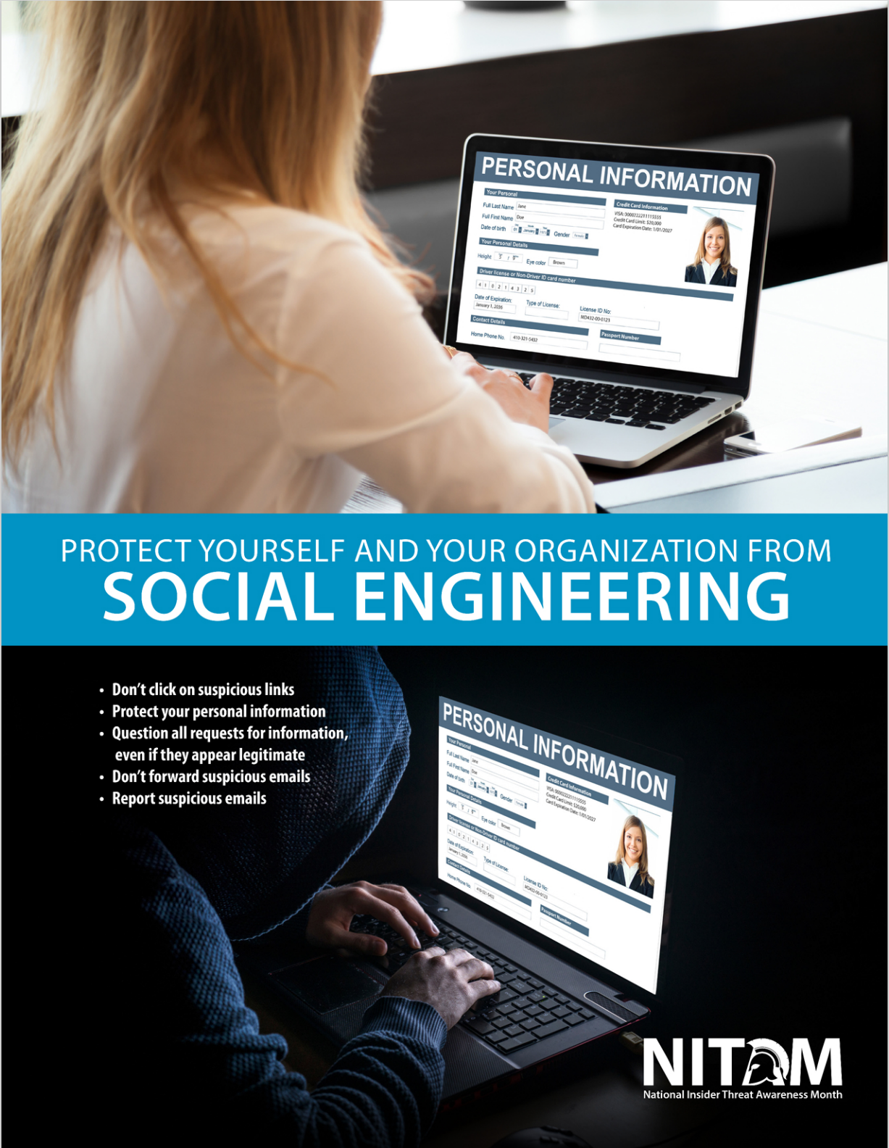
Foreign Intelligence Entity targeting and recruiting
Not all FIE Targeting ends in recruitment.
Sophisticated social engineering efforts including personal elicitation of information and targeted on-line phishing campaigns can be used to gather information from an unwitting source.
UNCLASSIFIED

Slide 19
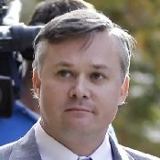
CASE STUDY: Financial considerations, security and compliance incidents
Deleted emails, used masked email accounts, and leaked investigative files.
Received over $30,000 from the target of a criminal investigation and luxury travel from Virginia to Singapore, the Philippines, and Thailand
Conspired with target to continue his fraud scheme and evade detection
Suffered from mental health conditions, including depression, anxiety, post-traumatic stress, and alcoholism
NCIS Agent John Beliveau -
Pled guilty to bribery in Dec 2013. Sentenced to 12 years in prison.
UNCLASSIFIED
Notes:
John Beliveau: Beliveau’s arrest was only part of what is often called the “Fat Leonard” scandal. John Beliveau II disclosed sensitive law enforcement reports to Leonard Glenn Francis, former Glenn Defense Marina Asia (GDMA) CEO, who was the target of a criminal fraud investigation. By providing this sensitive law enforcement information, Beliveau helped Francis perpetrate a massive fraud scheme on the U.S. Navy that allowed Francis to evade and thwart criminal investigations into misconduct by GDMA. Beliveau regularly searched confidential NCIS databases for reports of investigations related to Francis and GDMA. Over the course of years, he helped Francis avoid multiple criminal investigations by providing copies of these reports. He also admitted that he counseled Francis on how to perpetuate his fraud scheme and evade detection. Beliveau provided Leonard Francis with 225 documents and received items of value totaling approximately $30,000 before his arrest.

Slide 20
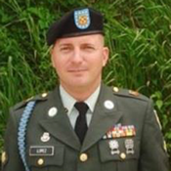
CASE STUDY: psychological conditions, financial considerations and prof performance
Depression, anxiety, sleep disturbances and self-reported traumatic brain injury/possible post-traumatic stress disorder
Recent death of mother and grandfather
$14,000 debt
Frustration in getting his leave approved and processed
Counseled regarding a non-promotion status
SPC Lopez - Shot three soldiers, turned the weapon and shot himself.
UNCLASSIFIED
Notes:
SPC Ivan A. Lopez: On March 2014, SP4 Lopez was transferred to Ft. Hood. His mother and grandfather had both died in the previous two months. His unit was experiencing a high operational tempo and undergoing turnover of leadership. He had recently been counseled regarding a non-promotion status. Lopez experienced a five day delay in getting leave approved to attend his mother’s funeral and encountered additional delays in leave approval for moving his family into a new apartment. He went home, retrieved his pistol, and returned to Ft. Hood. He went into the administration office and began shooting soldiers. When confronted by the military police, he turned his weapon and shot himself. Lopez’s actions resulted in the death of three soldiers, who left behind wives and children. Fourteen additional soldiers were wounded. Lessons learned from this case and several others has shaped DoD response to Insider Risk.

Slide 21
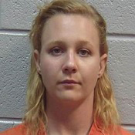
CASE StuDY: Security and compliance incidents, technical activity, access attributes
Had a deep distrust of the Presidential administration
Posted on social media and expressed support for Taliban leaders and Osama bin Laden as well as proclaiming that she wanted to burn down the White House
Used the unauthorized software to search for, identify, and print a classified intelligence report of a U.S. Government Agency
Sent a hard copy of the intelligence report to an online news outlet
NSA contractor Reality Winner -
Pled guilty to unlawful retention and transmission of National Defense Information.
UNCLASSIFIED
Notes:
Reality Winner. Winner installed software on her computer that enabled her to surf the internet, chat, and send instant messages anonymously. She researched whether it was possible to insert a thumb drive into a Top Secret computer without it being detected, and inserted an unauthorized thumb drive never recovered by the government, into a Top Secret computer. Winner used the unauthorized software to search for, identify, and print a classified intelligence report. Winner then secreted the document in her pantyhose and removed it from the building. Winner sent a hard copy of the intelligence report to an online news outlet. The intelligence report revealed the sources and methods used to acquire the information contained in the report.

Slide 22
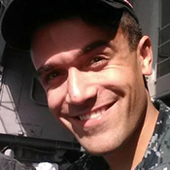
CasE STUDY: Foreign considerations, substance abuse and professional performance
Served aboard the nuclear powered warship USS Carl Vinson (CVN-70)
Tried to give confidential information about the U.S. Navy’s nuclear-powered warships to a news reporter who he believed would go public with it
Wanted to publish an exposé on waste in the U.S. military
He was in contact with Sevmash, Russia’s only nuclear submarine producer and largest shipbuilder
US Navy Petty Officer Stephen Kellogg III - Pled guilty to two counts of espionage in May 2019.
UNCLASSIFIED
Notes:
Stephen Kellogg III. In May 2019, Kellogg pled guilty to two counts of espionage. He was sentenced to three years confinement, reduced in rank from E-5 to E-1, and received a dishonorable discharge from the Navy. Kellogg admitted in August 2018 that he tried to take a commercial flight from San Diego, California, to New York City to give confidential information about the U.S. Navy’s nuclear-powered warships to a news reporter who he believed would go public with it. According to court documents, Kellogg was in contact with Sevmash, Russia’s only nuclear submarine producer and largest shipbuilder. Authorities stated Kellogg admitted to photographing areas containing sensitive information about the Navy’s nuclear propulsion program on the ship and sent the photos to family and friends. Kellogg separately admitted to, in July and August 2018, telling his roommate he was planning to defect to Russia. During this time-period, Kellogg searched the Internet for information relating to flights to Moscow, contact information for the Russian Consulate in San Diego, and contact information for Sevmash, a Russian shipbuilding enterprise.

Slide 23
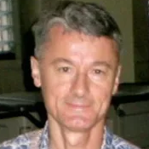
CASE STUDY: Security and compliance incidents, foreign considerations
Retired U.S. Army Lieutenant Colonel (O-5)
Emailed classified information to a female Chinese national he met at an international defense conference, with whom he had a romantic relationship
Also provided, at her request, a classified photograph of a Chinese naval asset he retrieved from classified sources
DOD Contractor Benjamin Bishop - Pled guilty to unlawful retention and willfully communicating National Defense Information in March 2014.
UNCLASSIFIED
Notes:
Benjamin Bishop. He was arrested in March 2013 and plead guilty on March 13, 2014, for unlawfully retaining classified national defense information at his home and willfully communicating classified national defense information to a person not authorized to receive it. Mr. Bishop was sentenced to 87 months of imprisonment and 3 years of supervised release. Mr. Bishop emailed classified information to a Chinese woman he met at an international defense conference, with whom he had a romantic relationship and who was in the United States as a graduate student on a J1 Visa. In the email, he provided SECRET information related to joint training and planning sessions between the United States and the Republic of Korea.

Slide 24
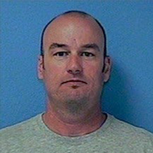
CASE StuDY: Judgement, character, psychological conditions, professional performance
Associating with extremist group or with individuals’ espousing extremist views
Expressing ill will toward U.S. Government
Possessing illegal weapons and/or illegal drugs
Misuse of U.S. Government automated information system
US Coast Guard Lt. Christopher Hasson - Sentenced to 160 months in prison, on four federal counts.
UNCLASSIFIED
Notes:
LT Christopher Hasson: Christopher Paul Hasson was arrested on February 15, 2019, which prevented him from possibly carrying out acts of violence. His arrest followed a multi-year investigation that included monitoring the use of his U.S. Government automated information system. Hasson self-identified as a “White Nationalist” for over 30 years in writings advocating for “focused violence” in order to establish a white homeland. He performed Internet searches and developed lists of potential targets, including media personalities and current and former elected officials. He conducted attack and targeting research and planning, and operational cover support activities.
Christopher Paul Hasson’s performance evaluations characterized him more as an advocate of equal opportunity rather than a “White Nationalist.”
This is an example in which the potential violent attack was prevented. A potential insider threat was identified and the organization was able to act, resulting in a positive outcome.

Slide 25
REMEMBER!
Not everyone that exhibits indicators is an Insider Threat!
UNCLASSIFIED
Notes:
Activity: Discuss cultural awareness in workplace and play the following videos.
Cultural Awareness in the Workplace Video
https://www.cdse.edu/Training/Security-Training-Videos/Insider-Threat/Cultural-Awareness-in-the-Workplace/
Military Virtual Cultural Awareness Training (VCAT)
https://www.cdse.edu/Training/Security-Training-Videos/Insider-Threat/Military-Virtual-Cultural-Awareness-Training-VCAT/
You can also refer to the following CDSE Job Aids:
Human Resources and Insider Threat Programs
https://www.cdse.edu/Portals/124/Documents/jobaids/insider/INTJ0183-Human-Resources-and-Insider-Threat-Programs.pdf
Behavioral Science and Insider Threat
https://www.cdse.edu/Portals/124/Documents/jobaids/insider/Behavioral-Science-and-Insider-Threat.pdf

Slide 26
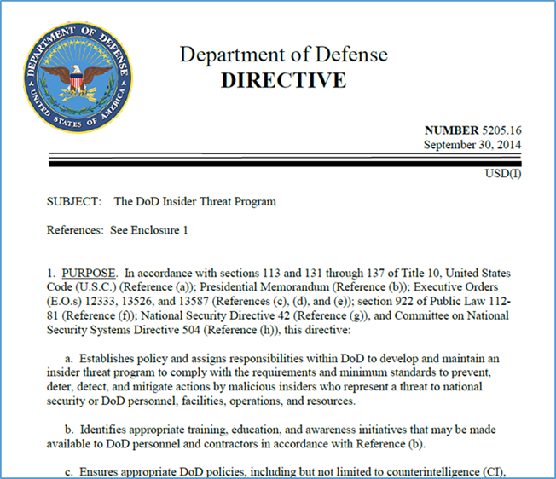
reporting
DOD Reporting Requirements:
Identify and report indicators of illicit foreign collection activity
Identify and report illicit foreign cyber activities
Identify and report potential espionage indicators
Identify and report factors contributing to insider threat vulnerability
UNCLASSIFIED

Slide 27
DITMAC
The DOD Insider Threat Management and Analysis Center
  For DOD component insider threats, this includes referral of certain threshold level events to the DITMAC
  DITMAC sets reporting thresholds for DOD Insider Threat programs to ensure that DITMAC can integrate data from multiple sources and keep the risk low to both the component and the DOD. Delayed reporting impacts the ability of all organizations to appropriately mitigate risk
UNCLASSIFIED
Notes:
A cross-functional team of analysts that aggregates, integrates reviews, analyzes, and shares information that is indicative of a potential insider threat. The DITMAC will exercise this information management capability with the ability to assess risk; refer issues for further consideration, investigation, and potential action; synchronize responses; and oversee resolution of identified issues across the Department within DoD-approved resources
DITMAC Short: https://securityawareness.usalearning.gov/cdse/multimedia/shorts/ditmac/story_html5.html

Slide 28
Failure to report
DOD personnel who fail to report information that identifies reportable contacts, activities, indicators and behaviors, may be subject to judicial or administrative action (or both), pursuant to applicable law and regulations.
  UCMJ: Punitive action under Article 92
  Civilian Employees: Appropriate disciplinary action under regulations governing civilian employees.
UNCLASSIFIED

Slide 29
Organization specific reporting
Identify Agency Standard Operating Procedures:
Identify Point of Contact (POC) for Insider Threat Briefing:
Identify POC for Security Reporting:
Identify your local Counterintelligence Field Office and/or POC:
UNCLASSIFIED
Notes:
Add your own commands specific information on reporting SOPs and provide POCs. Keep any flyers, posters, trifold and business cards handy.

Slide 30
ACTIVITY / ENGAGEMENT
Class Discussion on PRIs and Reporting or Short Video
UNCLASSIFIED
Notes:
FBI: The Nevernight Connection
https://www.fbi.gov/video-repository/nevernight-connection-093020.mp4/view
CDSE Vigilance Video Series: Turning People Around, Not Turning Them In.
The Critical Pathway. S2/E1: “Organizational Trust” (cdse.edu)
The Critical Pathway. S2/E2: “Indicators” (cdse.edu)
The Critical Pathway. S2/E3: “See Something, Say Something” (cdse.edu)
The Critical Pathway. S2/E4: “Outcomes” (cdse.edu)
Refer to the CDSE Insider Threat Vigilance Campaign Guide
https://www.cdse.edu/Portals/124/Documents/jobaids/insider/vigilance-campaign-guidance.pdf
FBI: The Company Man: Protecting America’s Secrets
https://www.youtube.com/watch?v=Gy_6HwujAtU

Slide 31
summary
Understand what constitutes an Insider Threat
Understand The Department of Defense Insider Threat Program supports personnel and mission
Understand potential risk indicators and concerning behaviors
Understand threats from Foreign Intelligence Entity targeting and recruitment
Understand real-world examples of insiders threats
Understand reporting requirements and procedures
UNCLASSIFIED

