Slide 1
Insider Threat Prevention and Mitigation
A Problem-Based Learning Experience for Organizational Leaders
Notes:
Suggested language:
Welcome to a session on insider threat prevention and mitigation. This session will help you to understand the concept of insider threat and the organization’s role in preventing and mitigating potential threats.
You will read a real-world example of insider threat, discuss possible prevention and mitigation approaches, and propose an actionable recommendation.

Slide 2

Agenda
Introduction (~30 minutes)
Small Group Discussion (~45 minutes)
Break (~15 minutes)
Class Discussion (~45 minutes)
Individual Recommendations (~15 minutes)
Review Recommendations and Wrap-Up (~30 minutes)
Notes:
Suggested Language:
This problem-based learning experience includes:
a small group discussion where you will review an InT case, identifying and categorizing individual and organizational risk factors and actions,
a class discussion where you will discuss and evaluate the organization’s preparedness and response,
individual reflection time to propose at least one actionable recommendation for the organization, and
a wrap-up to discuss your recommendations, generate a Call to Action, and share any final questions or comments you have with the class.

Slide 3
Introduction: Overview
Leaders are responsible for their organization’s culture, health, and well-being.
Organizational mismanagement can amplify employee dissatisfaction, disgruntlement, and counterproductive work behavior, increasing the risk of an insider threat incident such as espionage, theft, or workplace violence.
Insider threat incidents occur when individuals use their authorized access to harm an organization’s assets, including employees, wittingly or unwittingly.

Slide 4

Introduction: Purpose
  This problem-based learning experience provides a case synopsis of a known insider threat incident for you to analyze from the perspective of organizational risk prevention and mitigation.

Slide 5
Introduction: Learning Objectives
Identify and categorize:
  concerning behaviors displayed by the individual,
  risk factors introduced by the organization’s culture, structure, and organizational controls (or lack thereof), and
  actions that the organization took in an effort to mitigate the potential threat posed by the individual.
Evaluate the organization’s preparedness and response, identifying which actions taken by the organization helped to mitigate the potential threat and which actions failed to mitigate, or even exacerbated, the potential threat.
Propose and discuss alternative actions that the organization could have taken to prevent or mitigate the insider threat.
Notes:
Important Points:
Explain that this learning experience uses three main appendices, provided as part of the Participant Guide, including:
The Case Synopsis (Appendix A)
The Information Gathering Worksheet (Appendix B)
The Case Analysis Tool (Appendix C)

Slide 6
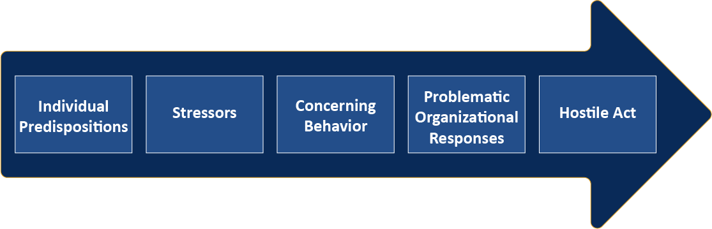
Introduction: Critical Pathway to Insider Risk Model
The Critical Pathway to Insider Risk (CPIR) suggests that concerning behaviors often precede a hostile act.
Effective organizational responses increase the safety and security of everyone involved and reduce the risk of harm.
Note: From “Application of the Critical-Path Method to evaluate insider risks,” by Shaw, E., & Sellers, L. (2015), Studies in Intelligence, 59(2), 41-48. https://www.cia.gov/resources/csi/studies-in-intelligence/volume-59-no-2/application-of-the-critical-path-method-to-evaluate-insider-risks/ Copyright Studies in Intelligence.
Notes:
Suggested Language:
At this point, everyone should be familiar with the Critical Pathway to Insider Risk (CPIR) model and the role organizations play in monitoring and mitigating risks prior to a hostile act.
As you work through this learning experience, use what you know about this model to evaluate and analyze how the organization could have prevented or mitigated this incident.
Important Points:
Participants should be familiar with the CPIR model as a prerequisite for participating in this learning experience.
Provide a brief overview of the CPIR model with participants.
The Critical Pathway to Insider Risk (CPIR) model describes the development of insider risk and how it can lead to an insider threat incident.
Within the CPIR framework, individuals who have certain predispositions such as poor judgment, substance misuse, or personality dysfunction may be at increased risk of becoming an insider threat.
Employees and other insiders with such predispositions may engage in concerning behaviors when they face significant life stressors (e.g., the death of a loved one, relationship problems, or loss of their job).
Concerning behavior varies but it often includes increasingly erratic, unsafe or aggressive behaviors, expressions of hostility or blame, and dramatic changes in personality or performance.
An organization may contribute to or mitigate the concerning behavior depending upon how and when they respond.
When an organization fails to identify and manage the situation in a timely manner, the behavior may escalate until it culminates in an attack, breach or compromise of the organization’s information, systems, facilities or personnel.
This learning experience will help you think critically about how you might prevent or mitigate such a situation.

Slide 7

Doug Williams
This case synopsis describes an incident of workplace homicide at a Meridian, Mississippi facility owned by the United States’ largest defense contractor. On July 8, 2003, Doug Williams, an employee, killed five employees and wounded nine more (one of whom later died, leading to a total of six victims killed) before turning the gun on himself.
Notes:
Suggested Language:
The Doug Williams case is an example of workplace violence in which a malicious insider attacked and killed his coworkers. This case study provides an example of an insider with a significant number of concerning behaviors prior to the insider threat event, and an organization that was not prepared to prevent or effectively mitigate the threat.
Everyone should have read this case prior to class and be ready to discuss the organizational implications of this case.

Slide 8
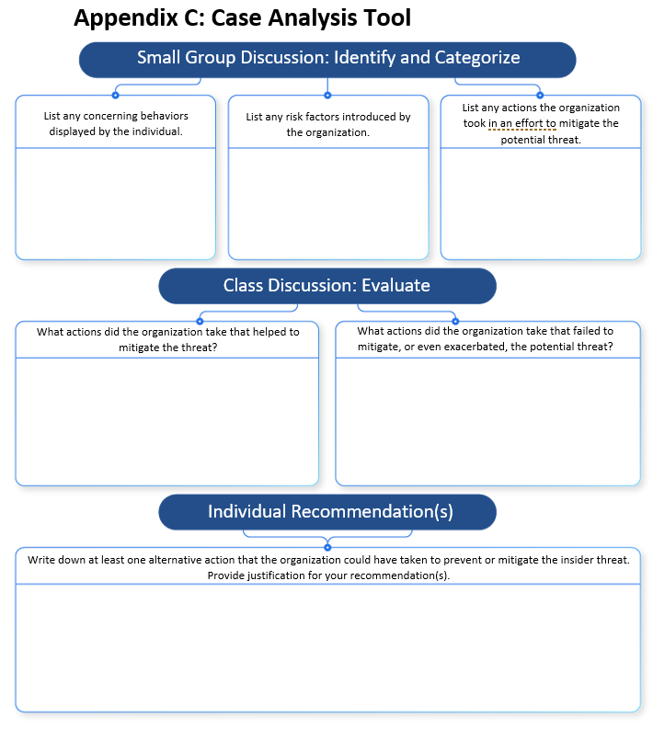
Case Analysis Tool
The tool will be used in three sections of the in-class portion of the learning experience:
  Small Group Discussion: Identify and Categorize
  Class Discussion: Evaluate
  Individual Recommendation(s)
Notes:
Suggested Language:
Use the Case Analysis Tool in your Participant Guide to guide discussion and take notes regarding your findings. These notes will be especially valuable during the third and final section of the activity when you’ll propose alternative actions that the organization could have taken to prevent or mitigate the insider threat along with your rationale.

Slide 9

Small Group Discussion
Identify and Categorize:
  concerning behaviors displayed by the individual,
  risk factors introduced by the organization’s culture, structure, and organizational controls (or lack thereof), and
  actions that the organization took in an effort to mitigate the potential threat posed by the individual.
Your goal is to compete the top row of the Case Analysis Tool.
  Use the discussion questions in the Participant Guide to help guide your discussion.
Your facilitator will provide a signal at the 10 and 5-minute marks to begin wrapping up your discussion.
Notes:
Suggested Language:
We are now going to break out into small groups (~4 individuals per group).
Once you have your group assignments please get together and prepare for your small group discussion
You will have ~45 minutes for this portion of the learning experience.
Once you are in your groups, use the Information Gathering Worksheet you completed to:
Identify and categorize:
Concerning behaviors displayed by the individual,
Risk factors introduced by the organization, and
Actions that the organization took in an effort to mitigate the potential threat posed by the individual.
During the discussion, be sure to document your notes/thoughts in the Small Group Discussion ꟷ Identify and Categorize section of the Case Analysis Tool.
At the end of the small group discussion, we’ll have a 15-minute break and then come back together as a class to evaluate the organization’s level of preparedness and risk and discuss which mitigation and prevention actions could be taken to prevent an incident like this in the future.
Important Points:
Read through the instructions slowly and carefully with the class.
Remind participants to fill out the Small Group Discussion ꟷ Identify and Categorize section of the Case Analysis Tool, focusing on identifying and categorizing actions and behaviors, and using the discussion questions provided in the Participant Guide to guide them.
Ask for and field any questions.
Once all participant questions are answered, assign participants to small groups.
Begin the timer.
Visit each small group to provide guidance, feedback, and answer questions as needed.
Be sure to notify the participants when time is running out, especially at the 10 and 5-minute marks so they know to wrap up their work.

Slide 10
Break

Slide 11

Class Discussion
Do you think that this attack was planned or was it impulsive?
  Does that change your perspective on the organization’s ability to prevent such an incident?
If the organization had terminated Williams’ employment when his problematic behavior toward coworkers first became apparent, would this have guaranteed that his concerning behavior did not escalate to violence?
  If not, what could the organization have done to reduce the risk of escalation to violence when terminating his employment?
Is there any way that the organization could have prevented the attack without removing Doug Williams from the organization?
What else could the organization have done to protect its employees?
  If you were Doug Williams’ supervisor, what would you have done differently?
  If you were the Equal Employment Officer who referred Doug Williams’ case to the Employee Assistance Program, what might you have done differently to reduce the risk of his concerning behavior leading to an insider threat incident?
What steps has the organization taken since the incident that may help to prevent future workplace violence?
  Might any of these changes have helped to prevent this incident?
Notes:
Suggested Language:
Now, let’s come back together and discuss the behaviors and actions we identified during the small groups to evaluate the organization’s level of preparedness and response.
Important Notes:
Pose each of the questions on the slide and facilitate discussion.
Encourage participants to refer to their Case Analysis Tool notes to help them answer the questions and participate in the class discussion. They should justify their responses.
Remind participants to record their notes during this discussion in the Class Discussion section of the Case Analysis Tool.

Slide 12

Individual Recommendations
Write down at least one action the organization could have taken to prevent or mitigate the insider threat incident.
Include the rationale for your recommended action.
Your instructor will provide a signal at the 5-minute mark to begin wrapping up your recommendations.
Notes:
Suggested Language:
Over the next 15 minutes, use your notes and thoughts from both discussions to develop at least one actionable recommendation that the organization could have taken to prevent or mitigate the insider threat incident.
This can be something previously brought up in class discussion, but take this opportunity to think creatively about the problem and consider outside-the-box recommendations.
Document your proposed recommendation and rationale in the Individual Recommendations section of the Case Analysis Tool.
Important Points:
Provide a timer and let participants know when they have 5 minutes left.

Slide 13

Wrap-Up
Let’s share our recommendations!
Are there any final thoughts or recommendations on alternative actions that the organization could have taken to prevent or mitigate the insider threat? Or how this organization, or a similar organization, could prevent an attack like this in the future?
How will you apply what you’ve learned here to your own organization?
Notes:
Suggested Language:
Before we conclude, let’s take an opportunity to share any final thoughts on recommendations for how the organization could prevent a similar event in the future.
Who would like to share their recommendation?
Important Points:
Be prepared to ask clarifying questions as participants share their recommendations.
Remember you don’t have a lot of time with this wrap-up.
Consider limiting recommendations to ~3 min per participant.
Consider how you can connect the recommendations back to the Critical Path Model.
Try to limit yourself to ~3min of feedback per recommendation to conserve time.
If possible, build a list of the participant’s recommendations so you can continue to develop your own list of recommendations to share with future classes.
Before the class concludes, encourage participants to consider how they will apply what they’ve learned to their own organizations.
They can share this with the group, time permitting.

Slide 14
Thank you!

