Slide 1
Initial Orientation and Awareness Training
UNCLASSIFIED
[Organization Name Here]
Initial Orientation Training is required per DODM 5200.01, Vol. 3, Enclosure 5. This training provides basic security knowledge to recognize and respond to threats to National Security Information.
NOTE FOR SECURITY MANAGERS:
This template is provided so you may customize it to meet
your organization’s specific needs.

Slide 2
AGENDA
UNCLASSIFIED
National Security Eligibility Process
Information Security Program
Pre-Publication Process
Physical Security Program
Operations Security (OPSEC) Program
Security Executive Agent Directive 3 Reporting Requirements
Insert additional topics as needed

Slide 3
Position Designations
UNCLASSIFIED
Whenever a DOD employee or contractor requires access to classified national security information in the performance of their duties, the individual must be granted national security eligibility at the proper level to access that information. National security eligibility is a favorable determination that affords an individual eligibility for access to classified information or assignment to a national security sensitive position. The National Security Eligibility Process is a four-phased approach that ensures the DOD does not grant access to national security information to people who cannot be trusted.

Slide 4
Personnel Security
UNCLASSIFIED
The Personnel Security Program: This program provides security policies and procedures; establishes the standards, criteria, and guidelines personnel security determinations are based upon.
Position Designations:
  Special-Sensitive: Access to Sensitive Compartmented Information (SCI)/Top Secret (TS) or Special Access Program (SAP). Potential for inestimable damage to National Security.
  Critical-Sensitive: Access to Top Secret (TS). Potential for exceptionally grave damage to National Security.
  Noncritical-Sensitive: Access to Secret or Confidential. Potential for significant or serious damage to National Security.
  Non-Sensitive: No eligibility required. Does not pose damage to National Security.

Slide 5
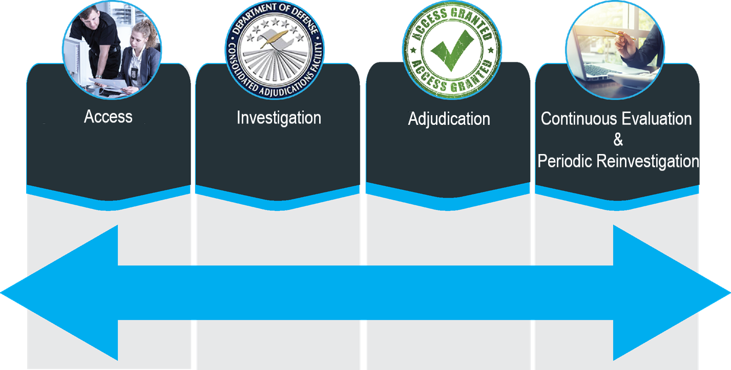
National Security Eligibility Process
UNCLASSIFIED
The four phases of the National Security Eligibility Process are Access, Investigation, Adjudication, and Continuous Evaluation/Periodic Reinvestigation.

Slide 6
Investigations
UNCLASSIFIED
The Federal Investigative Standards, also known as FIS, defines a five-tiered investigative model developed in accordance with Executive Order (EO) 13467, “Reforming Processes Related to Suitability for Government Employment, Fitness for Contractor Employees, and Eligibility for Access to Classified National Security Information”. The FIS set standard requirements used to conduct background investigations which determine eligibility to access classified information or hold a national security sensitive position.

Slide 7









Personnel Security Investigation
UNCLASSIFIED
Investigation:
  New Federal Investigative Standards (FIS)
  Uses a five-tiered approach
Five-Tiered Investigative Model
HSPD-12
SUITABILITY
NATIONAL SECURITY
5 CFR 731 OR 731 LIKE
5 CFR 732
High Risk
Public Trust
4 SF85P
5 SF86
Q, Top Secret, Sensitive
Compartmented Information,
Critical-Sensitive, Special-Sensitive
Moderate Risk
Public Trust
2 SF85P
3 SF86
Noncritical-Sensitive, L,
Confidential and Secret Information
1 SF85P
Low Risk, Non-Sensitive
Physical/Logical Access
(HSPD-12 Credentialing)

Slide 8
Personnel Security Investigation
UNCLASSIFIED
The Tier 3 and Tier 5 national security background investigations determine eligibility for:
Access to classified information
Uses a five-tiered approach
Assignment to a designated national security sensitive position
HSPD-12
SUITABILITY
NATIONAL SECURITY
5 CFR 731 OR 731 LIKE
5 CFR 732
High Risk
Public Trust
4 SF85P
5 SF86
Q, Top Secret, Sensitive
Compartmented Information,
Critical-Sensitive, Special-Sensitive
Moderate Risk
Public Trust
2 SF85P
3 SF86
Noncritical-Sensitive, L,
Confidential and Secret Information
1 SF85P
Low Risk, Non-Sensitive
Physical/Logical Access
(HSPD-12 Credentialing)

Slide 9

Personnel Security Adjudication
UNCLASSIFIED
Adjudications
DOD Consolidated Adjudications Facility (DOD CAF) is the primary authority for making security eligibility determinations for DOD personnel
Utilizes whole person concept (looks at all available and reliable information about an individual’s past and present prior to reaching an adjudicative determination)
Uses 13 Adjudicative Guidelines

Slide 10

Personnel Security
Periodic Reinvestigation
UNCLASSIFIED
Continuous Vetting (CV)
In accordance with DODI 5200.02, “DOD Personnel Security Program (PSP)”
For all personnel in national security positions
Reviews background of individuals with access to National Security Information (NSI)
  Additional or new checks of commercial databases
  Government databases
Determines if individual continues to meet eligibility requirements

Slide 11
Personnel Security
Periodic Reinvestigation
UNCLASSIFIED
Periodic Reinvestigation
Tier 3R: Secret and Confidential
  Reinvestigations will continue to be conducted every ten (10) years.
Tier 5R: Top Secret (TS) or Sensitive Compartmented Information (SCI)
  Reinvestigations have been extended from five (5) years to six (6) years with the Director of National Intelligence (DNI) endorsement.
See DOD Memorandum “Extension of Periodic Reinvestigation Timelines to Address the Backlog Investigation Backlog” <http://www.cdse.edu/documents/toolkits-psa/extension.pdf>

Slide 12

Personnel Security Self-Reporting
UNCLASSIFIED
Self-Reporting
IF YOU DON’T SELF REPORT, SOMEONE ELSE MIGHT.
Report changes in:
  Status: Marriage, co-habitation, addition of new family member, divorce, receipt of large sum of cash
  Adverse Information:
    Criminal activity (domestic violence, issuance of restraining order)
    DUI/DWI
    Traffic tickets over $300
    Excessive indebtedness, financial difficulties, bankruptcy
    Use of illegal drugs
  Foreign Contacts and Foreign Travel
See The Security Executive Agent Directive 4 for more information. Reporting does not automatically result in revocation of eligibility, so don’t be afraid to report!

Slide 13
Information Security Program
UNCLASSIFIED
The Information Security Program is a system of policies, procedures, and requirements established to protect classified and controlled unclassified information (CUI) that, if subjected to unauthorized disclosure, could reasonably be expected to cause damage to National Security.

Slide 14
Classified Information
UNCLASSIFIED
Classified national security information is official government information that has been determined to require protection against unauthorized disclosure in the interest of national security. Marked to indicate its classified status when in documentary form.
The only individuals who may access classified information:
Appropriate eligibility,
Need-to-know,
Signed Standard Form (SF) 312 Classified Information Non-disclosure Agreement

Slide 15
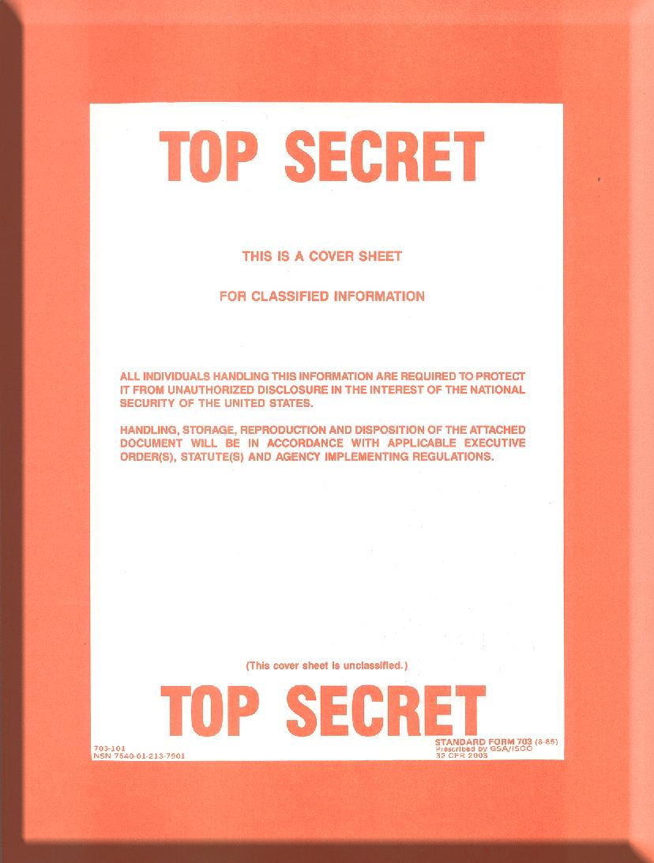
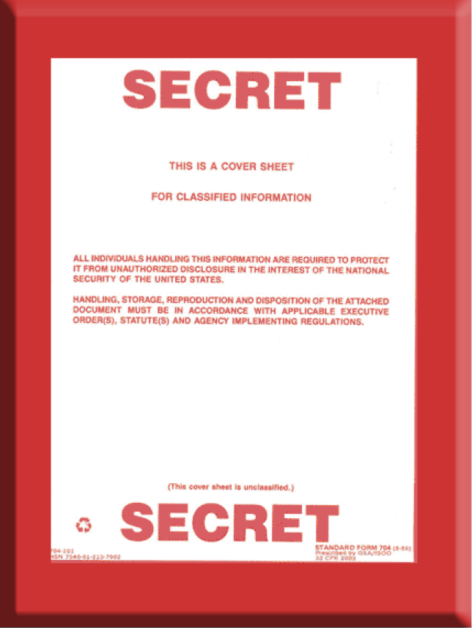
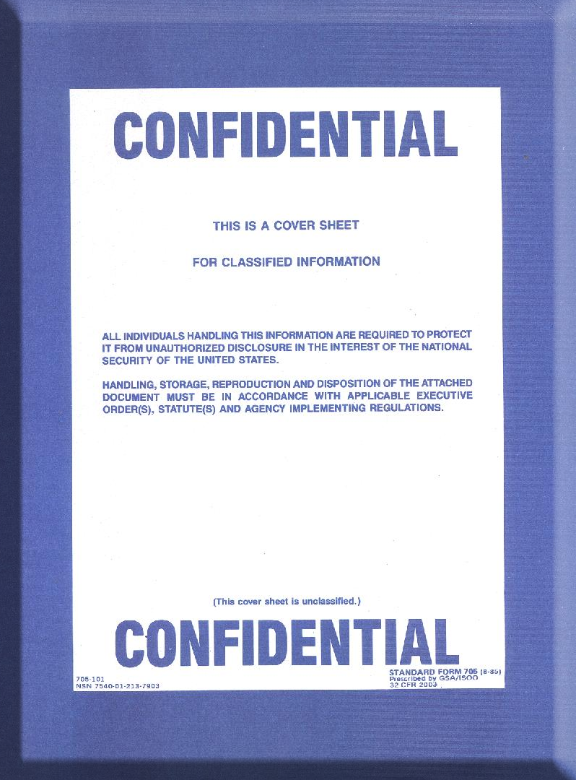
Information Security
Levels of Classified Information
UNCLASSIFIED
All classified documents require a cover sheet. Classified media such as CDs, DVDs, hard drives, and thumb drives require medium tags or stickers.
Top Secret: Could cause exceptionally grave damage to national security that the OCA is able to identify or describe (SF703)
Secret: Could cause serious damage to national security that the OCA is able to identify or describe (SF704)
Confidential: Could cause damage to national security that the OCA is able to identify or describe (SF705)

Slide 16
Information Security
Original Classification
UNCLASSIFIED
ORIGINAL CLASSIFICATION: The initial government decision that an item of information could reasonably be expected to cause identifiable or describable damage to national security if subjected to unauthorized disclosure and requires protection in the interest of national security.
Information may be originally classified only by the Secretary of Defense, the Secretaries of the Military Departments, and other officials to whom they delegate this authority in writing.
Delegation of OCA shall be limited to the minimum number of officials required for effective operation of the Department of Defense (DOD).
The authority shall be delegated to, and retained by, only those officials who have a demonstrable and continuing need to exercise it.

Slide 17
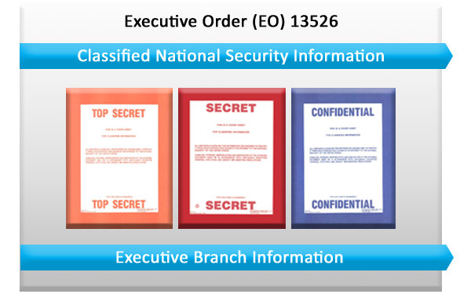
Information Security
Original Classification
UNCLASSIFIED
Top Secret, Secret, and Confidential may only be used to mark Executive Branch information that has been properly designated as classified national security information under Executive Order (EO) 13526. Information shall not be classified for any reason unrelated to the protection of national security.

Slide 18
Information Security
Derivative Classification
UNCLASSIFIED
DERIVATIVE CLASSIFICATION: Defined as incorporating, paraphrasing, restating, or generating in new form, information that is already classified, and marking the newly developed material consistent with the classification markings that apply to the source information.
Derivative Classification Requirements
Appropriate security eligibility
Need-to-know
Properly trained

Slide 19
Information Security Marking Syntax
UNCLASSIFIED
Banner lines are at the top and bottom of the document and provide the overall classification of the document.
Portion markings denote the classification for each paragraph, sub-paragraph, or section in the document.
The Classification Authority Block (CAB) must include the name and position title or personal identifier of the DERIVATIVE classifier and, if not otherwise evident, the Component and office of origin, the source document or classification guide that the document was derived from, downgrade instructions if applicable, and the declassification date. The CAB must be on the face of the document.

Slide 20
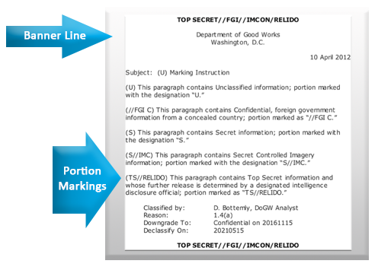
Information Security Marking Syntax
UNCLASSIFIED
UNCLASSIFIED
Classification
Markings
are for Training Purposes Only
CAB
UNCLASSIFIED

Slide 21
Classification by Compilation
UNCLASSIFIED
Classification by compilation occurs when unclassified elements of information are combined to reveal classified information, or when classified elements are combined to reveal information at a higher classification level than the individual elements.
The portion markings will continue to be marked appropriately, but the overall classification marking will be at a higher level, along with a note at the bottom of the page that explains the document is classified by compilation.

Slide 22
Information Security
Marking Slides and Working Papers
UNCLASSIFIED
Slide Presentations
Mark first slide with overall classification marking
Mark successive slides with either the overall classification or with the classification of the individual slide and portion markings for bullets
Mark charts, graphics or figures by the classification of the portion, not of the chart/graphic/figure itself
Classification authority block shall be placed on the first or last slide (less preferred)
Working Papers
Mark with highest classification of any information contained in the document
Date and annotate as “Working Papers”
Destroy when no longer needed, remark within 180 days as a finished document or when released by the originator outside the originating activity

Slide 23
Information Security Reproduction
UNCLASSIFIED
Classified information shall be reproduced only to the extent required by operational necessity or for complying with applicable statutes or directives.
Reproduction Guidelines
Use equipment approved at the appropriate level
Ensure copies are subject to the same controls as original
Limit reproduction to what is mission essential
Ensure personnel are knowledgeable of the procedures for classified reproduction and aware of the associated risk involved with the specific reproduction equipment
Comply with reproduction limitations
Facilitate oversight and control
[Add additional guidance as required]

Slide 24
Information Security
Processing Classified Information
UNCLASSIFIED
Rules for Processing Information: Use systems assessed or authorized to process information at the appropriate level.
CLASSIFIED DOCUMENTS MUST BE RETRIEVED FROM THE PRINTER IN A TIMELY FASHION
Do Not
Install software without approval
Use another person’s username and password
Allow an unauthorized person to use your computer
Circumvent or defeat security systems
Permit unauthorized access to any sensitive computer network
Modify or alter operating system configuration
Write down your password
[Add additional guidance as required]

Slide 25
Information Security
Controlled Unclassified Information (CUI)
UNCLASSIFIED
CUI: Unclassified information associated with a law, regulation, or government-wide policy and identified as needing safeguarding. Unauthorized disclosure of CUI could cause foreseeable harm.
Investigation documents
Inspection reports
Agency budgetary information
Procurement bids/proposals
Personally Identifiable Information (PII)
Information protected under Privacy Act of 1974
[Add additional guidance as required]
Examples of CUI
CUI DOES NOT INCLUDE
CLASSIFIED INFORMATION

Slide 26
Information Not Designated CUI
UNCLASSIFIED
Information will not be designated CUI in order to:
Conceal violations of law, inefficiency, or administrative error
Prevent embarrassment to a person, organization, or agency
Prevent open competition
Control information not requiring protection under a law, regulation, or government-wide policy, unless approved by the CUI EA at the National Archives and Records Administration (NARA), through the Under Secretary of Defense for Intelligence and Security (USD(I&S))

Slide 27
Information Security Safeguarding
UNCLASSIFIED
Safeguard Classified Information (During/After working hours)
Safeguard CUI
General Services Administration (GSA) approved container vaults
Secure rooms
Secure telephone
Maintain control, never leave unattended
Do not talk around using codes or hints
Do not divulge to unauthorized persons
[Add additional guidance as required]
Locked cabinets, file cabinets, bookcases
Rooms with locked outer office doors
Key or cipher locked rooms
Similarly secured areas
[Add additional guidance as required]

Slide 28
Storage Containers
UNCLASSIFIED
GSA Approved Containers: Required for storing all classified materials
Standard forms to be completed:
SF700: Security Container Information
  Record combinations to security containers, secure rooms, and controlled area doors and to identify personnel to be contacted in an emergency
SF701: Activity Security Checklist
  Must be completed after all areas have been secured
SF702: Security Container Checklist
  Record date and time when opening or closing security container
[Add additional guidance as required]

Slide 29
Preparing Classified
Documents for Mailing
UNCLASSIFIED
Checklist for Mailing Classified Information
Cover sheet required; opaque envelopes
Mark (INNER envelope only) with highest classification level of documents
Mark INNER envelope with recipient and return address in case outer envelope is damaged
Wrap and tape inner and outer envelope to mitigate tampering
Obtain address for an official US Government activity or cleared DOD contractor facility
Mark OUTER envelope with return and mailing address. NO PERSONAL NAMES should be annotated on the outer envelope.
Complete a document receipt and destruction certificate (if needed)

Slide 30
Information Security
Top Secret Transmission
UNCLASSIFIED
Transmit/Transport Top Secret/SCI
Direct contact between cleared U.S. personnel
Protected secure communication system (facsimile, data, e-mail voice)
U.S. Transportation Command, Defense Courier Division
Appropriately cleared U.S. Military, Government and DOD contractor
Do Not Send Via
U.S. Postal Service
Overnight Express (FedEx)
[Add additional guidance as required]

Slide 31
Information Security
Secret Transmission
UNCLASSIFIED
Transmit/Transport Secret
Any of the means approved for the transmission of Top Secret information
Appropriately cleared contractor employees if applicable
U.S. Postal Service registered mail or express within U.S. and Puerto Rico
  Check “Signature is Required” box
U.S. Postal Service registered mail through Army, Navy, or Air Force Postal Service outside the U.S. and territories
  Information may not pass out of U.S. citizen control
Commercial delivery for urgent, overnight delivery only
Open incoming packages immediately and secure
[Add additional guidance as required]

Slide 32
Information Security
Confidential Transmission
UNCLASSIFIED
Transmit/Transport Confidential
Any of the means approved for the transmission of Secret information
U.S. Postal Service certified mail to DOD contracting companies or non-DOD agencies
U.S. Postal Service first class mail between DOD components in the U.S. and its territories
Outer envelope marked “Return Service Requested”
DO NOT use external or street side mail collection boxes

Slide 33
Information Security CUI Transmission
UNCLASSIFIED
Transmit/Transport CUI
U.S. Postal Service certified mail, parcel post, or fourth class mail
Approved secure communications systems
Avoid wireless telephone transmission of CUI when other options are available.
Facsimile if appropriate protection is available at receiving location

Slide 34
Information Security Hand Carry
UNCLASSIFIED
Hand-Carry Requirements
Prepare inventory of material (one copy for your office and another with a responsible person)
Double wrap material (lockable briefcase or zippered pouch may serve as outer wrapping and approved for carrying classified material)
Keep under constant control
Deliver to authorized person ONLY
Receive courier briefing
Carry courier card
Carry courier letter (if transporting via commercial air)
Trips that involve overnight stopovers are NOT permitted unless arrangements for storage in a U.S. Government office or a cleared contractor facility have been previously made.

Slide 35
Information Security Destruction
UNCLASSIFIED
Classified material shall be destroyed completely to prevent anyone from reconstructing the information. The preferred method of destruction is shredding by using a National Security Agency (NSA) approved shredder.
Other Means of Destroying Classified Material
Destruction of Record and non-record CUI
Burning
Wet pulping
Mutilation
Chemical decomposition
Pulverizing
Same methods as classified
Other methods that would not allow recognition or reconstruction
Ensure law, regulation, or government-wide policy doesn’t specify a specific method of destruction

Slide 36
Security Incidents
UNCLASSIFIED
A Security Incident can be categorized as an infraction or violation.
Infraction
No loss or compromise of classified information
Requires an inquiry to prevent a future violation but does not require an in-depth investigation
Violation
Loss – information cannot be accounted for or physically located
Compromise – Unauthorized disclosure of classified information to person(s) without valid clearance, authorized access or need to know.
Negligent Discharge of Classified Information (NDCI) – the unauthorized disclosure of classified data on an information system not authorized for the appropriate security level access controls.
Report ALL infractions and violations immediately to your Security Officer

Slide 37
Examples of Incidents
UNCLASSIFIED
Examples of Incidents
Classified material not properly stored
Classified container not properly secured
Permitting personnel access to classified information without verifying need-to-know
Failing to mark classified information
Discussing classified information in unauthorized areas
For more information on security incidents refer to DODM 5200.01 Vol. 3 available in the resources.

Slide 38
Sanctions
UNCLASSIFIED
You are subject to sanctions if you knowingly, willfully, negligently:
Disclose classified or CUI to unauthorized persons
Classify information or continuing the classification of information in violation of DOD regulations
Sanctions include:
Warning
Reprimand
Loss/denial of classified access
Suspension without pay
Termination of employment
Discharge from military service
Criminal Prosecution

Slide 39
Information Security
Classified Information/Public Media
UNCLASSIFIED
Classified Information in the Public Media
Do not confirm or deny
Do not respond to questions about programs or projects including those released through:
  Radio or TV
  Newspapers
  Magazines
  Trade journals
  Social media sites, such as Facebook, Twitter, Pinterest, or LinkedIn
Do not view or download from unclassified IT systems. Make a note of the URL and other significant details.
Refer all questions to the Public Affairs Office (PAO) and your Security Officer

Slide 40
Pre-Publication Process
UNCLASSIFIED
You are responsible for protecting official information and complying with the pre-publication process
Materials subject to pre-publication review include:
Books, manuscript, or articles sent to the publisher, editor, movie producer, or game purveyor, or their respective support staffs
Speech, briefing, article, or content that will be publically disseminated
Information being released to the public, even through Congress or the courts
Official government products as well as materials submitted by cleared or formerly cleared personnel.
See DODI 5230.29 “Security and policy review of DOD Information for Public Release for more information.
The Defense Office of Prepublication and Security Review (DOPSR) is responsible for reviewing materials for public and controlled release.

Slide 41
Industrial Security Program
UNCLASSIFIED
Working with Contractors
Contractors may or may not be cleared
  Verify eligibility through a valid visit authorization request or system of record
  Cleared under National Industrial Security Program (NISP)
  Follow requirements of the National Industrial Security Program Operating Manual (NISPOM)
  Required to comply with your organization’s security program
  Check with your security office for information on verifying contractor employee clearance eligibility and need to know.

Slide 42
Physical Security Program
UNCLASSIFIED
Physical Security:
Active and passive measures to prevent unauthorized access to personnel, equipment, installations, and information, and to safeguard them against espionage, sabotage, terrorism, damage, and criminal activity.
Physical Security Countermeasures:
Barriers/Fencing establish boundaries and deter individuals
Intrusion Detection System (IDS) is used to deter, detect, document, deny, or delay intrusion by detecting a change in the environment.
Security forces are made up of DOD, military, contract personnel, and trained dogs
Lighting is used to deter intruders for fear of being seen

Slide 43
Physical Security
Employee Identification
UNCLASSIFIED
Homeland Security Presidential Directive 12 (HSPD-12) Common Access Card (CAC)
DOD wide form of identification
Used by civilians, contractors, and military personnel
Contains personal identifying data and Public Key Infrastructure (PKI) certificate
Used for email encryption, digital signing, and network access
If your CAC card is either lost or stolen, report it to your
security office immediately.

Slide 44
Physical Security
Escort Requirements
UNCLASSIFIED
Escort Requirements
Ensure access to controlled areas by non-cleared personnel is minimal
Only cleared personnel who are familiar with the security procedures of the facility are authorized to escort non-cleared personnel
Ensure all visitors sign the Visitor Log upon entry
[Add additional guidance as required]

Slide 45
Operations Security (OPSEC)
UNCLASSIFIED
OPSEC: Process of protecting critical information that can be used against us by preventing our adversaries access to information and actions that may compromise an operation.
OPSEC Practices:
Remove ID badge when leaving your facility and secure it in a safe place
Loss of any form of ID should be reported IMMEDIATELY to your security office
Do not post or send sensitive information over the web
Guard against calls to obtain sensitive information
Do not discuss sensitive information in public, or over an UNCLASSIFIED phone line
Watch for and report suspicious activity

Slide 46
Security Executive Agent Directive 3
(SEAD 3) Reporting Requirements
UNCLASSIFIED
Individuals in the federal government with access to classified information should be aware of established reporting requirements or hold sensitive positions.
SEAD 3 implementations may vary for industry, DOD departments and agencies.
Reporting requirements for ALL covered individuals include Foreign Travel, Foreign Contacts and Reportable Actions by Others.

Slide 47
Foreign Travel Official
UNCLASSIFIED
All DOD government personnel must provide advance notice of foreign travel plans to their Security Office and receive approval prior to foreign travel.
Foreign Travel Requirements:
Obtain defensive foreign travel security briefing prior to travel or at least once a year
Obtain country specific briefing from the Counterintelligence Office (if required)
Antiterrorism/Force Protection Level 1 training completion must be current
Contact nearest U.S. Consulate, Defense Attaché, Embassy Regional Security Officer, or Post Duty Officer if detained or subjected to harassment or provocation
[Add additional guidance as required]

Slide 48
Foreign Travel SCI
UNCLASSIFIED
SCI indoctrinated personnel planning foreign travel, personal or officially must follow the previous steps in addition to:
Complete a foreign travel questionnaire prior to travel
Provide complete copy of itinerary
Be aware of nearest U.S. Consulate, Defense Attaché, Embassy Regional Security Officer, or Post Duty Officer
Upon arrival from travel, complete return questionnaire
[Add additional guidance as required]

Slide 49
Foreign Contact Reporting
UNCLASSIFIED
All DOD government personnel must report foreign relationships to their Security Office. SEAD 3 requires that all unofficial contacts be reported if the contact:
    Is Continuing
    Involves bonds of affection, personal obligation, or intimate contact
    Involves the exchange of personal information
This reporting requirement is based on the continuing association with the foreign national, regardless of whether the relationship has continued in person, online or via mail.

Slide 50
Reportable Contact By Others
UNCLASSIFIED
All DOD government personnel should report any activity that raises doubt whether another employee’s continued national security eligibility is clearly consistent with the interests of national security.
The following activities must also be reported:
  Unexplained affluence or excessive indebtedness
  An unwillingness to comply with rules and regulations
  Suspected mental health issues
  Illegal use of drugs
  Excessive alcohol consumption
  Criminal conduct
SEE SOMETHING, SAY SOMETHING

Slide 51
Summary
UNCLASSIFIED
Now that you have completed this course, you should be familiar with the following:
National Security Eligibility Process
Information Security Program
Pre-Publication Process
Physical Security Program
Operations Security (OPSEC) Program
SEAD 3 Reporting Requirements
[Add additional guidance as required]

Slide 52

Any Questions?
UNCLASSIFIED

