Slide 1
Controlled Unclassified Information (CUI)
UNCLASSIFIED
Training Template

Slide 2
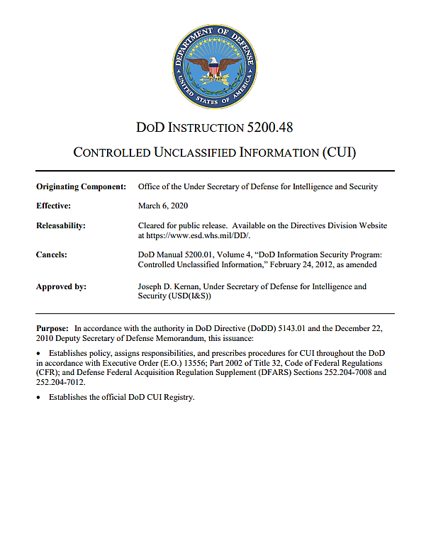
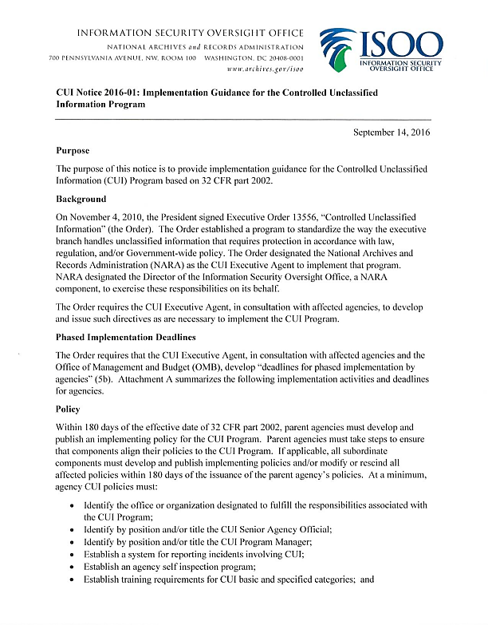
CUI Training Standards
UNCLASSIFIED
DODI 5200.48
This template captures all 11 CUI training standards in accordance with Information Security Oversight Office (ISOO) Notice 2016-01 and Department of Defense Instruction (DODI) 5200.48 Controlled Unclassified Information (CUI):
“Identify individual responsibilities for protecting CUI”
“Identify the organizational index with CUI categories routinely handled by DOD personnel.”
“Describe the CUI Registry, including purpose, structure, and location (http://www.archives.gov/cui).”
“Describe the differences between CUI Basic and CUI Specified.”
“Identify the offices or organizations with DOD CUI Program oversight responsibilities.”
“Address CUI marking requirements as described in this issuance.”
ISOO Notice 2016-01

Slide 3
CUI Training Standards (cont.)
UNCLASSIFIED
DODI 5200.48
This template captures all 11 CUI training standards in accordance with Information Security Oversight Office (ISOO) Notice 2016-01 and Department of Defense Instruction (DODI) 5200.48 Controlled Unclassified Information (CUI):
“Address the required physical safeguards and CUI protection methods as described in this issuance.”
“Address the destruction requirements and methods as described in this issuance.”
“Address the incident reporting procedures as described in this issuance.”
“Address methods for properly disseminating CUI within the DOD and with external entities inside and outside of the Executive Branch.”
“Address the methods for properly decontrolling CUI as described in this issuance.”
ISOO Notice 2016-01

Slide 4
Content
UNCLASSIFIED
Defining CUI (slide 5)
National-Level CUI Policy and Oversight (slide 6)
DOD CUI Policy and Oversight (slide 7)
Individual Responsibilities for Protecting CUI (slide 8)
CUI Registry (slide 9)
DOD CUI Registry (slide 10)
DOD CUI Registry Categories (slide 11)
Determining if Information Falls Into A CUI Category (slide 12)
CUI and U//FOUO (slide 13)
Marking CUI—Mandatory Markings (slide 14)
Marking CUI—Portion Markings (slide 15)
CUI Basic and CUI Specified (slide 16)
CUI in Classified Documents (slide 17)
Distribution Statements (slide 18)
Limited Dissemination Controls (slide 19)
CUI Warning Statements (slide 20)
CUI Markings in Non-Documents (slide 21)
Marking Media (slide 22)
CUI Safeguarding and Protection Methods (slide 23)
Destruction Requirements (slide 24)
Destruction Methods (slide 25)
Incident Reporting Procedures (slide 26)
Incident Investigation and Resolution (slide 27)
Disseminating CUI (slide 28)
Sharing CUI with Foreign Entities (slide 29)
Transporting and Mailing CUI (slide 30)
SF 901 CUI coversheet (slide 31)
CUI Over the Phone and Fax (slide 32)
Decontrolling CUI (slide 33)
Public Release of Decontrolled CUI (slide 34)

Slide 5
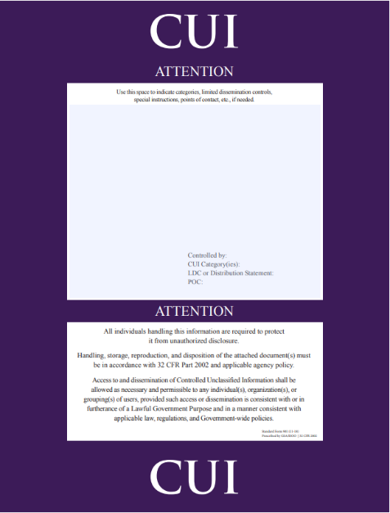

Defining CUI
UNCLASSIFIED
CUI Program: Federal agencies handle information that, while not classified, requires safeguarding from unauthorized access for reasons such as privacy or law enforcement. This information is known as Controlled Unclassified Information (CUI).
Definition of CUI: Unclassified information requiring safeguarding and dissemination controls, consistent with applicable law, regulation, or Government-wide policy
Forms of CUI: CUI exists in various forms, including physical documents, media, telephone conversations, and electronic communications.
Describing CUI: CUI is not a classification and is not to be referred to as “classified as CUI.” Instead, information is “controlled as CUI.”
SF 901 CUI Coversheet

Slide 6
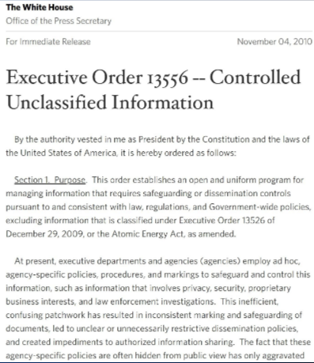
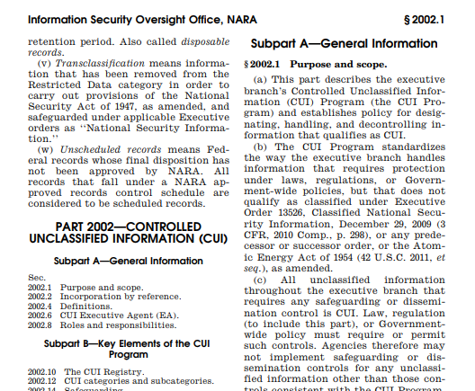
National-Level CUI Policy and Oversight
UNCLASSIFIED
E.O. 13556
Executive Order (E.O.) 13556 Controlled Unclassified Information, November 04, 2010
  Established the national-level CUI program.
  Designated the National Archives and Records Administration (NARA) to oversee the compliance of Executive branch agencies.
National Archives and Records Administration (NARA)
  Established a CUI office.
  Appointed the Information Security Oversight Office (ISOO) as the CUI Executive Agent to manage the national program.
Information Security Oversight Office (ISOO)
  Issued the implementing directive, 32 Code of Federal Regulations (CFR) Part 2002 Controlled Unclassified Information, which provides policy on designating, safeguarding, and disseminating CUI.
  Issues regulatory guidance for the CUI program.
  Maintains the national CUI Registry, which lists all authorized CUI categories.
  Establishes and maintains a common CUI marking system for the Executive branch.
32 CFR Part 2002

Slide 7
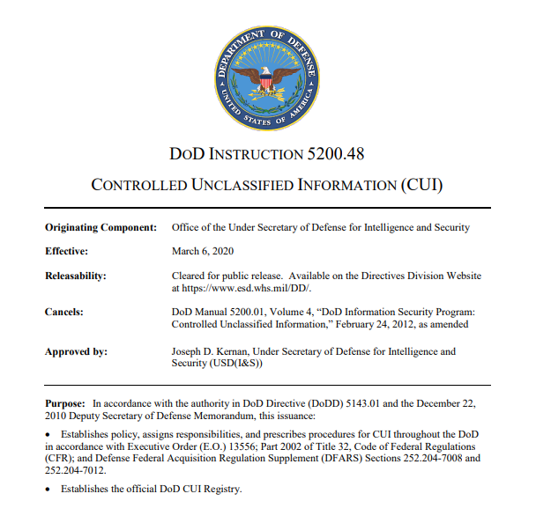
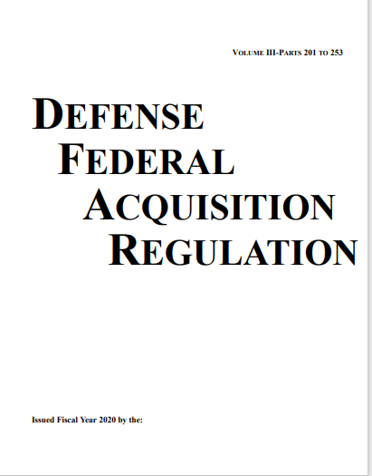
DOD CUI Policy and Oversight
UNCLASSIFIED
Department of Defense Instruction (DODI) 5200.48, March 6, 2020
  Established the Department of Defense (DOD) Controlled Unclassified Information (CUI) policy.
  The Under Secretary of Defense for Intelligence and Security (USD(I&S)) is the DOD CUI Senior Agency Official.
Office of the Undersecretary of Defense for Intelligence & Security (USD I&S)
  Oversees the Department of Defense (DOD)
  CUI Program.
  Issues policy guidance and training resources.
  Maintains the DOD list of CUI categories.
Defense Federal Acquisition Regulation Supplement (DFARS)
  Provides guidance for DOD contractors on protecting DOD CUI (see sections 252.204-7008 and 252.204-7012).
DODI 5200.48
DFARS

Slide 8

Individual Responsibilities for Protecting CUI
UNCLASSIFIED
All Personnel
  Every individual, including DOD civilian and military personnel, and contractors supporting DOD, must comply with the requirements outlined in DODI 5200.48.
Authorized Holder
  The authorized holder of a document or material is responsible for determining at the time of its creation if the information qualifies as CUI.
  If holder determines information to be CUI, he or she must apply the appropriate CUI markings.

Slide 9
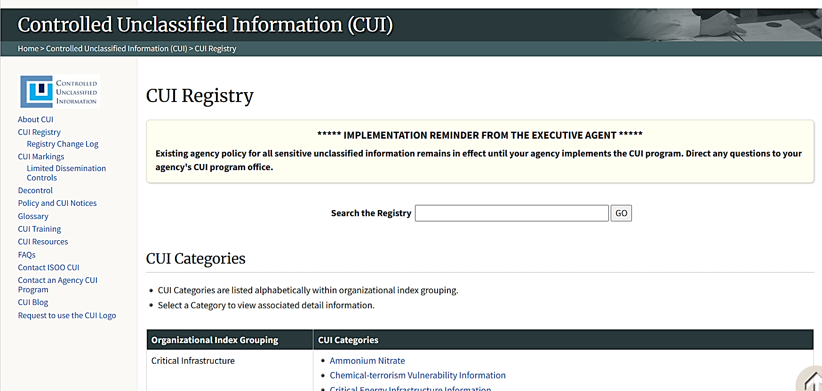
CUI Registry
UNCLASSIFIED
CUI Registry
  Identifies the categories and subcategories of CUI, organizes the categories into indexes.
  Provides definitions for each category and subcategory, identifies the basis for safeguarding and dissemination controls; contains associated markings, and includes applicable safeguarding, dissemination, and decontrol procedures.
  The CUI Executive Agent, ISOO, is the approval authority for all categories and subcategories of information identified as CUI in the Registry and only those categories or subcategories listed are
  considered CUI.
CUI Registry Webpage
  Location of CUI Registry:

Slide 10
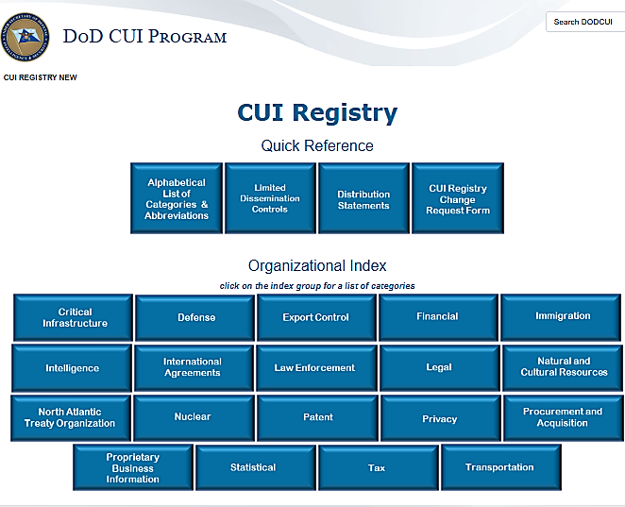
DOD CUI Registry
UNCLASSIFIED
DOD CUI Registry Webpage
DOD CUI Registry
  Mirrors the National CUI Registry but aligns each National CUI Registry index and category to DOD issuances.
  Location of DOD CUI Registry: https://www.dodcui.mil/CUI-Registry-New/

Slide 11
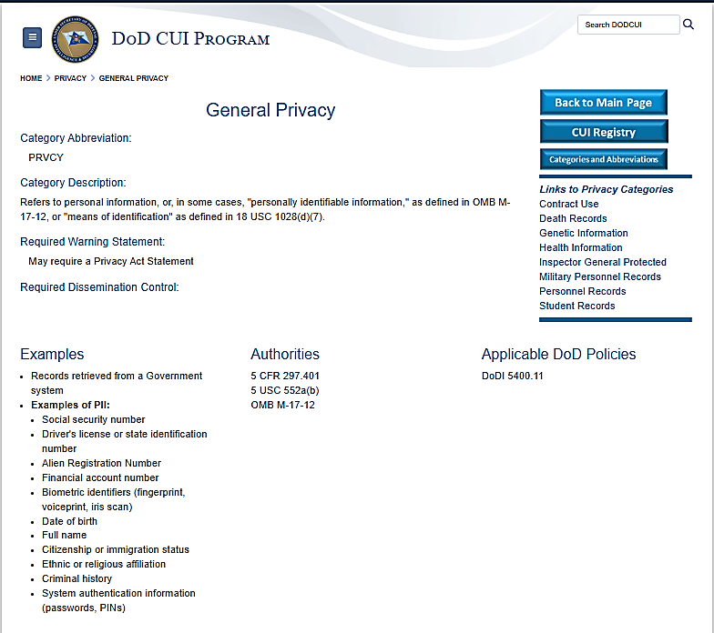
DOD CUI Registry Categories
UNCLASSIFIED
DOD CUI Registry Categories
  Categories include (but are not limited to):
    Controlled Technical Information (CTI)
    Protected Health Information (PHI)
    General Privacy Information (including certain types of personally identifiable information
    Personnel Records (of Federal employees)
DOD CUI Category Page
  Describes category
  Notes any required warning statements or dissemination controls
  States examples of information covered in category
  List authorities for category’s existence
  Note applicable DOD policies
General Privacy Category in the DOD CUI Registry

Slide 12
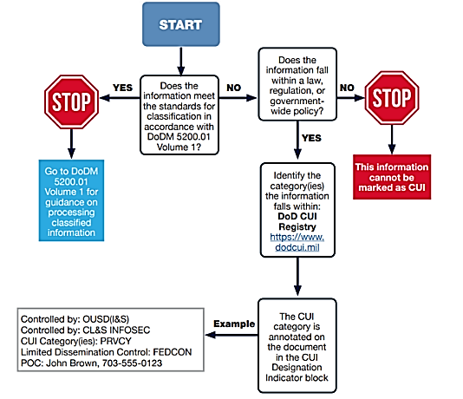
Determining if Information Falls Into A CUI Category
UNCLASSIFIED
Before you mark a document as CUI, you must first determine if the information is CUI. Does it fall into a CUI category? To determine if information can be controlled as CUI:
  Determine if the information has been classified or not; only unclassified information can be controlled as CUI
  Compare the information to the categories in the DOD CUI Registry
    Unclassified information may only be marked as CUI if it aligns with a category established in the DOD CUI Registry
    The CUI category’s page identifies the law, regulation, or Government-wide policy that justifies that category
On a piece of CUI, the designation indicator block will note the applicable CUI category using the category’s abbreviation (found on the category’s page in the DOD CUI Registry).
CUI Decision Tree

Slide 13
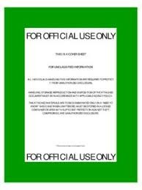
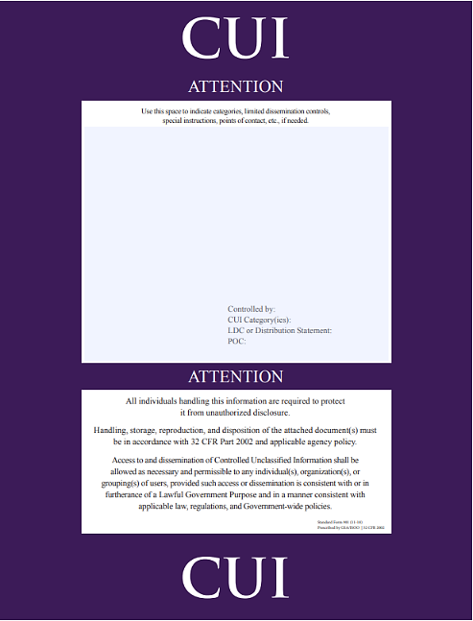
CUI and U//FOUO
UNCLASSIFIED
For Official Use Only “(U//FOUO)”
  DOD marking that was authorized to protect unclassified information that may be exempt from mandatory disclosure under the Freedom of Information Act (FOIA).
  Now a legacy marking: obsolete and no longer authorized for use on newly created documents or portions
CUI, and Information marked as FOUO
  Some information previously marked as FOUO will qualify as CUI, some will not.
  Information previously marked as FOUO does not need to be re-marked as long it remains under DOD control or is accessed online and downloaded for use within the DOD. However, if that same information is put in a new document or is shared outside of DOD, it needs to be assessed to see if it meets the criteria for CUI and re-marked appropriately.
Does all legacy-marked FOUO qualify as CUI?
No, some will, some will not.

Slide 14
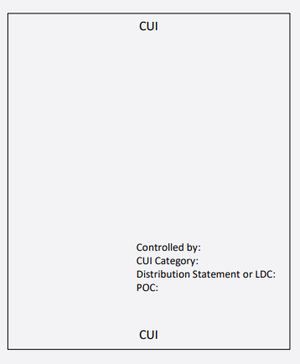
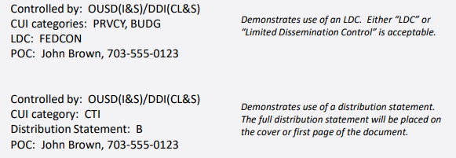
Marking CUI—Mandatory Markings
UNCLASSIFIED
Banner and Footer Markings
  Documents containing only CUI, or unclassified information and CUI: the acronym “CUI” in the banner and footer (top and bottom) of the page.
Designation Indicator Block: Notifies the recipient about information related to the document and the originator of the document. Located on first page or cover.
  Controlled by: Office making determination that information is CUI
  CUI category: The applicable DOD CUI Registry category, that is, the type of CUI in the document
  Distribution Statement or LDC: Distribution statement or dissemination controls, only if applicable
  POC: Phone number or office mailbox for the originating DOD Component or authorized CUI holder
Document Containing CUI Banner and Footer Markings and Designation Indicator Block
_______________
_______________
_______________
CUI Designation Indicator Block Examples

Slide 15
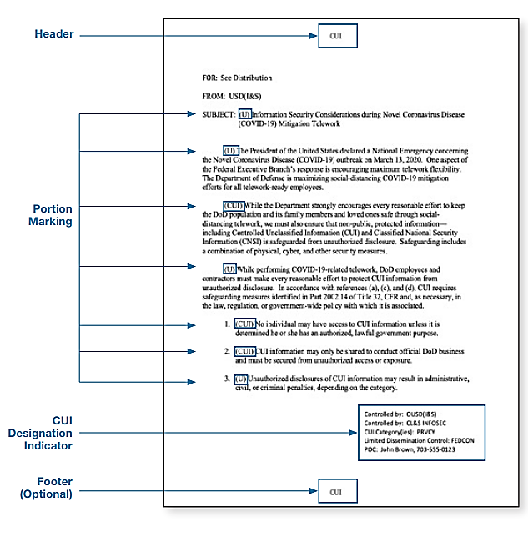
Marking CUI—Portion Markings
UNCLASSIFIED
Example Document Containing “(CUI)”
and “(U)” Portion Marks
CUI Portion Mark
  When portion marking, all portions containing CUI will begin with “(CUI)”.
  Portions include subjects, titles, paragraphs and sub-paragraphs, bullet points and sub-bullet points, headings, pictures, graphs, charts, maps.
CUI Portion Marks in Documents Containing Only CUI
  Portion marking optional
CUI Portion Marks in Documents Containing CUI and Unclassified Information
  CUI portions marked “(CUI)”
  Unclassified portions marked “(U)”
CUI Portion Marks in Documents Containing CUI and Classified Information
  CUI markings in classified documents will appear in paragraphs or subparagraphs known to contain only CUI and must be portion marked with “(CUI).”

Slide 16
CUI Basic and CUI Specified
UNCLASSIFIED
CUI Basic vs CUI Specified in Portion Markings
CUI Basic
  Subset of CUI for which the authorizing law, regulation, or Government-wide policy does not set out specific handling or dissemination controls.
CUI Specified
  Subset of CUI in which the authorizing law, regulation, or Government-wide policy contains specific handling controls that it requires or permits agencies to use that differ from those for CUI Basic.
CUI Basic and CUI Specified in DOD
  DOD does not differentiate between CUI Basic and CUI Specified—DOD uses CUI Basic markings only.
  Specified CUI categories have specific requirements for dissemination controls or warning statements—DOD does not apply the CUI specified markings but applies required dissemination controls and warning statements.
CUI Basic Portion Mark
(CUI) Paragraph A
(CUI//SP-CTI) Paragraph B
CUI Specified portion marking containing “SP” to note that marking is CUI Specified and contains category information (CTI-Controlled Technical Information) abbreviation—Do not use CUI Specified portion markings

Slide 17
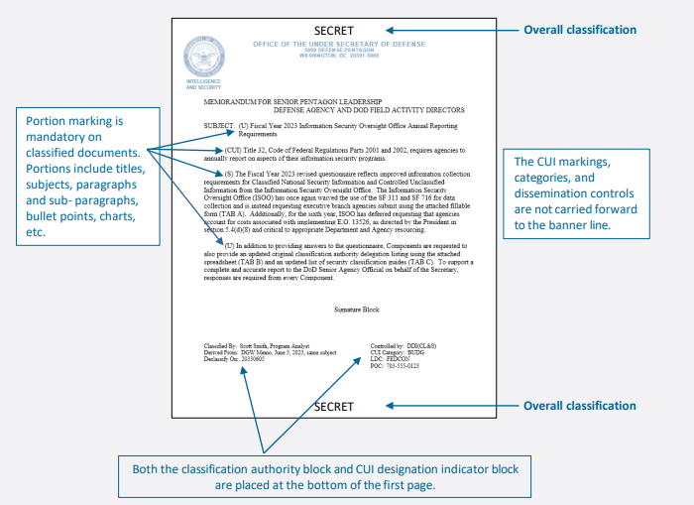
CUI in Classified Documents
UNCLASSIFIED
Documents containing both CUI and classified information will contain:
  Classification banner lines—CUI markings not included in banner lines
  Classification Authority Block
  CUI Designation Indicator Block
  Portion marks
Example Document Containing CUI and Classified Portions

Slide 18
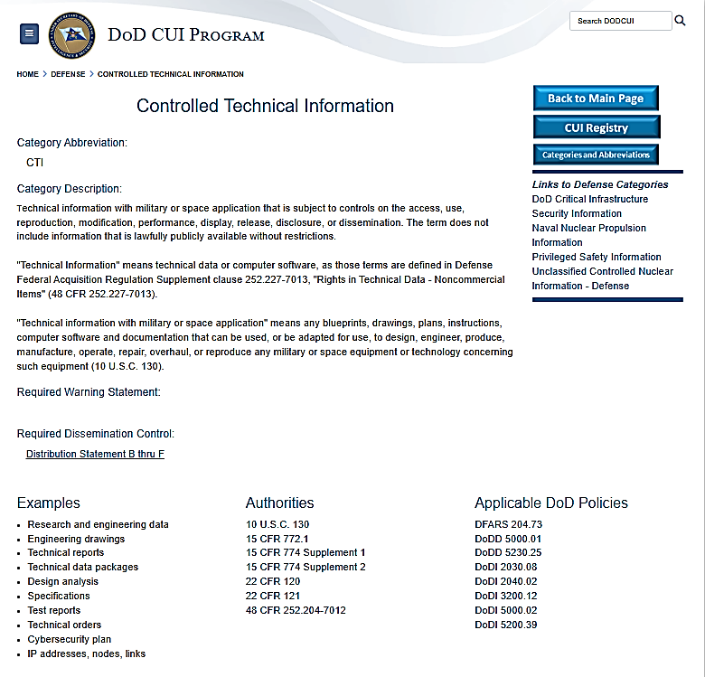
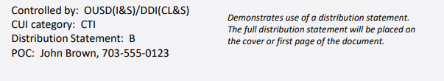
Distribution Statements
UNCLASSIFIED
Controlled Technical Information CUI Category Page, Noting Requirement for Distribution Statement
Distribution Statements: Specify the extent to which information can be shared with others (secondary distribution) without needing to get additional permission from the controlling DOD office.
Required on, in accordance with DODI 5230.24, Distribution Statements on Technical Documents, documents containing:
  Export controlled information (DOD CUI category: EXPT)
  Controlled technical information (DOD CUI category: CTI)
  Other scientific, technical, and engineering information
Distribution Statements in documents containing CUI:
  Identified by letter in “Distribution/Dissemination Control“ section of CUI Designation Indicator Block. For example, “Distribution Statement B.”
  Full distribution statement placed on cover or first page of document
Distribution Statement
Distribution Statement Identified in CUI Designation Indicator Block--Example
Note: Presence of distribution statement does not automatically mean the document is CUI--distribution statements can be applied to all technical and scientific information.

Slide 19
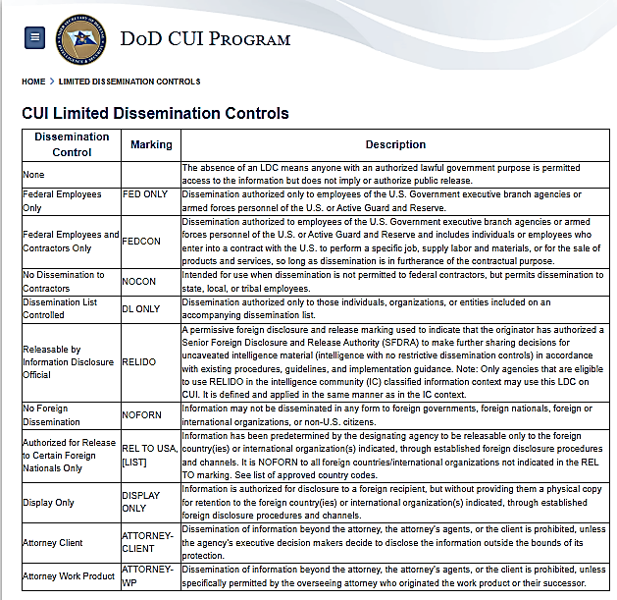
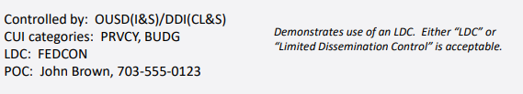
Limited Dissemination Controls
UNCLASSIFIED
DOD CUI LDCs List
Limited Dissemination Controls (LDCs): Can be used to limit the sharing of CUI so it only furthers an authorized, lawful Government purpose.
Example:
  The LDC “NOFORN” prevents the CUI from being shared with non-U.S. citizens and governments.
Identifying Dissemination Controls:
  DOD Components can choose from the DOD CUI Limited Dissemination Control List on the DOD CUI Program website.
  DOD Components may use LDCs to limit access to a piece of CUI to those on an accompanying dissemination list.
LDC Identified in CUI Designation Indicator Block--Example
  Location of DOD CUI LDCs List: https://www.dodcui.mil/limited-dissemination-controls/

Slide 20
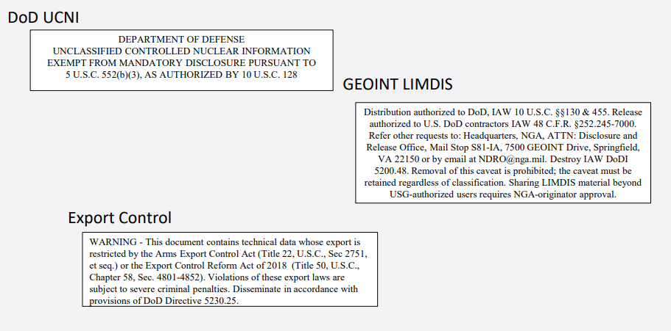
CUI Warning Statements
UNCLASSIFIED
Required warning statements noted in CUI Category pages.
Example: Export controlled information must be marked with an export control warning
Placed on cover or first page of document.
Examples of Required Warning Statements

Slide 21
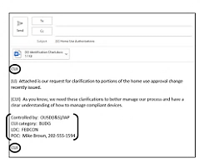
CUI Markings in Non-Documents
UNCLASSIFIED
Emails Containing CUI:
  First and last lines of the email are to be “CUI”.
  Add Designation Indicator Block to email.
Emails Not Containing CUI Body Text But Containing CUI Attachment(s):
  First and last lines of the email to be “CUI”.
  Add statement that the email is unclassified when CUI attachments are removed.
  Designation Indicator Block not required in email body.
  All attachments to be properly marked.
PowerPoint Presentations:
  Include the CUI Designation Indicator Block on the first slide.
  Apply “CUI” banner and footer markings on the top and bottom of each slide.
  For the slides not containing CUI, optional to mark them as unclassified.
Spreadsheets:
  Place “CUI” at the top of the spreadsheet so it is visible when the document is open.
  Place “CUI” in the header and footer
  Place the Designation Indicator Block at the top of the spreadsheet—placing it at the top ensures that it will remain on the first page
Examples of Email Containing CUI
Note: Portion markings are not required on unclassified emails that contain CUI; however, when portion markings are used, they must be applied consistently to all sections. This includes subjects and titles, as well as individual parts, paragraphs, sub-paragraphs, or similar portions known to contain CUI. When portion markings are used, it is required to portion mark the unclassified sections of the CUI document with (U).

Slide 22

Marking Media
UNCLASSIFIED
Media such as USB sticks, hard drives, and CD ROMs must be marked to alert holders to the presence of CUI stored on the device.
Due to space limitations, it may not be possible to include CUI category or LDC Markings. At a minimum, mark media with the CUI control marking (“CUI”) and the designating agency.
Equipment can be marked or labeled to indicate that CUI is stored on the device.
SF 902 CUI stickers are available through the U.S. General Services Administration (GSA) for purchase, but only the Government can order them.
Engage with Component for additional guidance on what is required to be marked for your program (systems, materials etc.).
Examples of Media Marked as Containing or Storing CUI

Slide 23

CUI Safeguarding and Protection Methods
UNCLASSIFIED
Physical Safeguards and Protection
  CUI must be stored in controlled environments suitable for preventing or detecting unauthorized access.
  During working hours: Minimize the risk of access by unauthorized personnel by not reading, discussing, or leaving CUI information unattended when unauthorized personnel are present.
  After working hours: Store CUI in unlocked containers, desks, or cabinets if the Government or contractor building provides security for continuous monitoring of access. If continuous monitoring security is not provided, the containers, desk, cabinets, or rooms where the CUI is stored must be locked.
Electronic Safeguards and Protection
  CUI may only be digitally stored on authorized DOD information technology (IT) systems or applications provided they are categorized at no less than the “Moderate” confidentiality impact level and implement guidance in DODI, 8500.01, Cybersecurity and DODI 8510.01, Risk Management Framework for DOD.

Slide 24
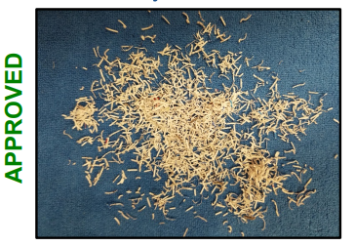
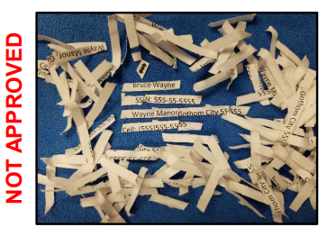
Destruction Requirements
UNCLASSIFIED
Unreadable, Indecipherable, Irrecoverable
Authorized holders may destroy CUI when the Component no longer needs the information and when records disposition schedules published or approved by NARA allow.
When destroying CUI, including electronic CUI, it is required to use a method that makes it unreadable, indecipherable, and irrecoverable.
Use a destruction method specifically required by law, regulation, or Government-wide policy if it exists. When a specific destruction method is not required by a law, regulation, or Government-wide policy, use the destruction guidance in NIST SP 800-53, Security and Privacy Controls for Federal Information Systems and Organizations, and NIST SP 800-88, rev 1, Guidelines for Media Sanitation, or use any method approved for destroying Classified National Security Information.
Potentially Readable, Decipherable, Recoverable

Slide 25
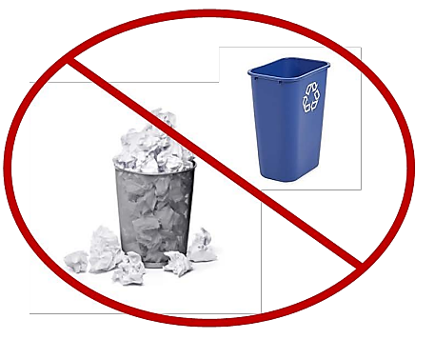
Destruction Methods
UNCLASSIFIED
Destroying paper CUI, per ISOO CUI Notice 2019-03, Destroying CUI in Paper Form
  Cross-cut shredding: Using a cross-cut shredder that produces particles that are 1 millimeter by 5 millimeters (1mm x 5mm) or smaller--standard office strip-cut shredders do not meet this requirement.
  Burning: Destroy the documents by burning them completely.
  Pulping: Destroy the documents by turning them into a pulp, a process that breaks down the paper fibers.
  Placing CUI in a standard trash or recycling bin is prohibited
Per DODI 5200.48, media containing CUI must include decontrolling indicators--specific instructions as to when the CUI protections can be lifted.
NIST SP 800-88, rev 1, Guidelines for Media Sanitation, describes authorized methods for destroying media types (other than paper) containing CUI.
  Destruction methods vary by media.
  Destruction must render the media completely unusable and ensures the data is impossible to recover, even with advanced laboratory techniques.
  After destruction, use verification step key to ensure process was successful.
Never Use Trash Cans or Recycling Bins to Dispose of CUI

Slide 26

Incident Reporting Procedures
UNCLASSIFIED
Examples of CUI incidents:
  Finding papers with CUI markings left unattended
  Knowing information in a document or system is CUI, but not marking this information properly
  Emailing unencrypted CUI improperly
Individuals who discover or suspect the misuse, mishandling, or unauthorized disclosure of CUI are required to report the incident immediately to their supervisor, commander, or the organization's designated security office.
  Refer to Component for specific guidance: the DOD Component’s Senior Agency Official and the CUI Component Program Manager must establish procedures to ensure prompt and appropriate action is taken to manage incidents involving the misuse or mishandling of CUI. Actions should include focus on correcting or eliminating the conditions that are contributing to CUI-related incidents.
  Facility Security Officers (FSOs) follow guidance in the NISPOM.

Slide 27

Incident Investigation and Resolution
UNCLASSIFIED
Incident Inquiry and Corrective Action
  The official who receives the report must initiate an inquiry or investigation into the incident to determine the cause, extent, and potential impact of the compromise.
  Upon conclusion of the inquiry, the organization must implement corrective actions designed to mitigate damage, prevent future incidents, and, where possible, recover the CUI.
Sanctions
  Appropriate administrative, judicial, or non-judicial sanctions shall be imposed upon individuals determined to be responsible for the incident, in accordance with applicable laws and regulations.
Contractor Reporting Requirements
  For incidents that involve CUI on contractor information systems, the contractor is required to adhere to the specific cyber incident reporting requirements detailed in DFARS Clause 252.204-7012; these requirements include reporting the incident to DOD via the DIBNet portal within 72 hours.

Slide 28

Disseminating CUI
UNCLASSIFIED
CUI access should be encouraged and permitted.
Dissemination of CUI is allowed when the access:
  Complies with the law, regulation, or Government-wide policy identifying the information as CUI.
  Is not restricted by an authorized Limited Dissemination Control (LDC).
  Is not otherwise prohibited by any other law, regulation, or Government-wide policy.
Application of Dissemination Controls:
  LDCs or distribution statements can restrict access but can’t do so unnecessarily.
  When DOD Components need to retain certain agency-specific CUI within their organizations, they may use the specific approved LDCs that limit access to those on an accompanying dissemination list.
Specific Requirements for Controlled Technical Information (CTI):
  CTI must be marked with Distribution Statements in accordance with DoDI 5230.24, Distribution Statements on DoD Technical Information, January 10, 2023, as amended.

Slide 29

Sharing CUI with Foreign Entities
UNCLASSIFIED
The USD I&S Memorandum “Change to Policy on Sharing Controlled Unclassified Information With Foreign Entities” January 13, 2024 eliminates the requirement in Paragraph 3.7(b)(4) of DODI 5200.48 that a positive foreign disclosure decision must be made before CUI is released to a foreign entity.
DOD-authorized holders of CUI may provide CUI to foreign entities to conduct official business for DOD and the U.S. Government if there is a lawful, Government purpose to do so, unless the CUI is expressly marked as not releasable to foreign nationals (“NOFORN”) by the originator.

Slide 30

Transporting and Mailing CUI
UNCLASSIFIED
Transporting CUI:
  Authorized holders of CUI must protect it from unauthorized access or observation when outside of a controlled environment, including during physical transport from one area or location to another, by using at least one physical barrier (e.g., cover sheet, folder, or envelope).
Approved Mailing and Shipping Services:
  CUI may be sent by the U.S. Postal Service (USPS) using First-Class Mail; while not required, using services that provide tracking, such as Certified Mail or Registered Mail, is permitted.
  CUI may also be sent by any commercial delivery service (e.g., FedEx, UPS, or DHL) that provides a tracking number and confirms delivery.
Packaging and Marking Requirements During Transit:
  Documents must be enclosed in an opaque envelope or package.
  Package must be securely sealed to prevent inadvertent opening and to provide evidence of tampering.
  Outside of the package must have a complete and correct delivery address and a return address.
  Exterior of the package must NOT have any CUI markings

Slide 31
SF 901 CUI coversheet
UNCLASSIFIED
Designated coversheet for CUI: Standard Form (SF) 901, "Controlled Unclassified Information (CUI).”
Can be used to safeguard CUI when sharing CUI or to protect it from unauthorized access during the workday.
Using the SF 901 coversheet is optional but is considered a "best practice" to protect CUI from unauthorized access.
SF 901 CUI coversheet
  Download SF 901 CUI coversheet at either:
  https://www.gsa.gov/forms-library/controlled-unclassified-information-cui-coversheet-0
  or
  https://www.archives.gov/cui/additional-tools

Slide 32


CUI Over the Phone and Fax
UNCLASSIFIED
Faxing CUI:
  Authorized holder sending CUI is responsible for determining and ensuring that appropriate safeguarding is in place on the receiving end of the fax
  As a best practice, use SF 901 coversheet when faxing CUI.
CUI Over the Phone:
  Avoid wireless telephone transmission of CUI when other options are available.
  CUI should only be transmitted on systems that meet NIST 800-171 and 800-53 standards for Federal and non-Federal systems.

Slide 33
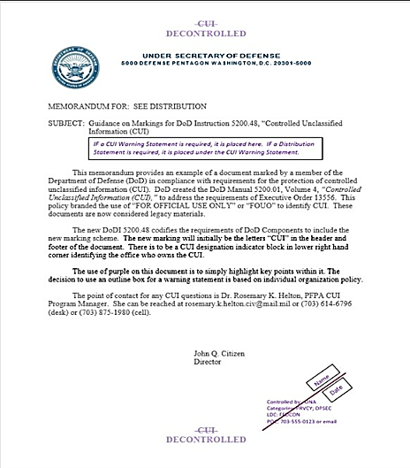
Decontrolling CUI
UNCLASSIFIED
Timeline for Decontrol:
  No specific timelines to decontrol CUI unless required by a law, regulation, or Government-wide policy.
  When a law regulation, or Government-wide policy no longer warrants additional safeguarding or dissemination controls, the CUI must be decontrolled.
  The authorized holder or originator (or their designated representative) determines if and when the CUI must be decontrolled.
Decontrol Process:
  The CUI document(s) or material(s) will have the CUI banner and footer markings lined through and replaced with “DECONTROLLED”.
  The Designation Indicator block will have a 45-degree diagonal line drawn through it with the name of the person/date of decontrol.
Example Decontrolled CUI Document

Slide 34

Public Release of Decontrolled CUI
UNCLASSIFIED
Decontrolled CUI is not automatically eligible for public release. The CUI originator or authorized CUI holder must ensure the prepublication security review process is conducted before the information can be approved for public release.
The information must still be reviewed in accordance with DODI 5230.09, Clearance of DOD Information for Public Release.

Slide 35
Assessment
UNCLASSIFIED

Slide 36
Assessment
UNCLASSIFIED
How many Controlled Unclassified Information (CUI) requirements must be trained annually?
  A.) 9
  B.) 10
  C.) 11
  D.) 12
Legacy markings (i.e. FOUO) will automatically become CUI.
  A.) True
  B.) False
Notes:
DCSA
Unauthorized disclosure occurs when an authorized holder of CUI intentionally or unintentionally discloses CUI without a lawful Government purpose, in violation of restrictions imposed by safeguarding or dissemination controls, or contrary to limited dissemination controls. Reference: 32 CFR 2002 / 2002.4 (IT), page 502 (Definitions Section)
As it regards to UD’s, the DODI 5200.48 states: “For UD of CUI, no formal security inquiry or investigation is required unless disciplinary action will be taken against the individual(s) responsible. In such cases, a preliminary inquiry is appropriate. UD of certain CUI, such as export controlled-technical data, may also result in potential civil and criminal sanctions against responsible persons based on the procedures codified in the relevant law, regulation, or government-wide policy. The DoD Component originating the CUI will be informed of any UD.” Reference: DODI 5200.48 / Section 3.9 General Release and Disclosure Requirements Section 3 (d) page 24.

Slide 37
Assessment
UNCLASSIFIED
How many Controlled Unclassified Information (CUI) requirements must be trained annually?
  A.) 9
  B.) 10
  C.) 11
  D.) 12
Legacy markings (i.e. FOUO) will automatically become CUI.
  A.) True
  B.) False
Notes:
DCSA
Unauthorized disclosure occurs when an authorized holder of CUI intentionally or unintentionally discloses CUI without a lawful Government purpose, in violation of restrictions imposed by safeguarding or dissemination controls, or contrary to limited dissemination controls. Reference: 32 CFR 2002 / 2002.4 (IT), page 502 (Definitions Section)
As it regards to UD’s, the DODI 5200.48 states: “For UD of CUI, no formal security inquiry or investigation is required unless disciplinary action will be taken against the individual(s) responsible. In such cases, a preliminary inquiry is appropriate. UD of certain CUI, such as export controlled-technical data, may also result in potential civil and criminal sanctions against responsible persons based on the procedures codified in the relevant law, regulation, or government-wide policy. The DoD Component originating the CUI will be informed of any UD.” Reference: DODI 5200.48 / Section 3.9 General Release and Disclosure Requirements Section 3 (d) page 24.

Slide 38
Assessment
UNCLASSIFIED
3. Which registry aligns each Index and Category to DOD Issuances?
  A.) DOD CUI Registry
  B.) ISOO
  C.) Policy
  D.) DODI 5200.48
4. CUI is a classification.
  A.) True
  B.) False
Notes:
DCSA
Unauthorized disclosure occurs when an authorized holder of CUI intentionally or unintentionally discloses CUI without a lawful Government purpose, in violation of restrictions imposed by safeguarding or dissemination controls, or contrary to limited dissemination controls. Reference: 32 CFR 2002 / 2002.4 (IT), page 502 (Definitions Section)
As it regards to UD’s, the DODI 5200.48 states: “For UD of CUI, no formal security inquiry or investigation is required unless disciplinary action will be taken against the individual(s) responsible. In such cases, a preliminary inquiry is appropriate. UD of certain CUI, such as export controlled-technical data, may also result in potential civil and criminal sanctions against responsible persons based on the procedures codified in the relevant law, regulation, or government-wide policy. The DoD Component originating the CUI will be informed of any UD.” Reference: DODI 5200.48 / Section 3.9 General Release and Disclosure Requirements Section 3 (d) page 24.

Slide 39
Assessment
UNCLASSIFIED
3. Which registry aligns each Index and Category to DOD Issuances?
  A.) DOD CUI Registry
  B.) ISOO
  C.) Policy
  D.) DODI 5200.48
4. CUI is a classification.
  A.) True
  B.) False
Notes:
DCSA
Unauthorized disclosure occurs when an authorized holder of CUI intentionally or unintentionally discloses CUI without a lawful Government purpose, in violation of restrictions imposed by safeguarding or dissemination controls, or contrary to limited dissemination controls. Reference: 32 CFR 2002 / 2002.4 (IT), page 502 (Definitions Section)
As it regards to UD’s, the DODI 5200.48 states: “For UD of CUI, no formal security inquiry or investigation is required unless disciplinary action will be taken against the individual(s) responsible. In such cases, a preliminary inquiry is appropriate. UD of certain CUI, such as export controlled-technical data, may also result in potential civil and criminal sanctions against responsible persons based on the procedures codified in the relevant law, regulation, or government-wide policy. The DoD Component originating the CUI will be informed of any UD.” Reference: DODI 5200.48 / Section 3.9 General Release and Disclosure Requirements Section 3 (d) page 24.

Slide 40
Assessment
UNCLASSIFIED
5. What are the two types of CUI?
  A.) Classified and Sensitive
  B.) Physical and Information
  C.) Basic and Specified
  D.) Beginning and End
6. CUI is not an authorized banner (Header/Footer) marking.
  A.) True
  B.) False
Notes:
DCSA
Unauthorized disclosure occurs when an authorized holder of CUI intentionally or unintentionally discloses CUI without a lawful Government purpose, in violation of restrictions imposed by safeguarding or dissemination controls, or contrary to limited dissemination controls. Reference: 32 CFR 2002 / 2002.4 (IT), page 502 (Definitions Section)
As it regards to UD’s, the DODI 5200.48 states: “For UD of CUI, no formal security inquiry or investigation is required unless disciplinary action will be taken against the individual(s) responsible. In such cases, a preliminary inquiry is appropriate. UD of certain CUI, such as export controlled-technical data, may also result in potential civil and criminal sanctions against responsible persons based on the procedures codified in the relevant law, regulation, or government-wide policy. The DoD Component originating the CUI will be informed of any UD.” Reference: DODI 5200.48 / Section 3.9 General Release and Disclosure Requirements Section 3 (d) page 24.

Slide 41
Assessment
UNCLASSIFIED
5. What are the two types of CUI?
  A.) Classified and Sensitive
  B.) Physical and Information
  C.) Basic and Specified
  D.) Beginning and End
6. CUI is not an authorized banner (Header/Footer) marking.
  A.) True
  B.) False
Notes:
DCSA
Unauthorized disclosure occurs when an authorized holder of CUI intentionally or unintentionally discloses CUI without a lawful Government purpose, in violation of restrictions imposed by safeguarding or dissemination controls, or contrary to limited dissemination controls. Reference: 32 CFR 2002 / 2002.4 (IT), page 502 (Definitions Section)
As it regards to UD’s, the DODI 5200.48 states: “For UD of CUI, no formal security inquiry or investigation is required unless disciplinary action will be taken against the individual(s) responsible. In such cases, a preliminary inquiry is appropriate. UD of certain CUI, such as export controlled-technical data, may also result in potential civil and criminal sanctions against responsible persons based on the procedures codified in the relevant law, regulation, or government-wide policy. The DoD Component originating the CUI will be informed of any UD.” Reference: DODI 5200.48 / Section 3.9 General Release and Disclosure Requirements Section 3 (d) page 24.

Slide 42
Assessment
UNCLASSIFIED
7. When sending emails, CUI must be encrypted.
  A.) True
  B.) False
8. SF 901 (CUI Coversheet) is optional.
  A.) True
  B.) False
Notes:
DCSA
Unauthorized disclosure occurs when an authorized holder of CUI intentionally or unintentionally discloses CUI without a lawful Government purpose, in violation of restrictions imposed by safeguarding or dissemination controls, or contrary to limited dissemination controls. Reference: 32 CFR 2002 / 2002.4 (IT), page 502 (Definitions Section)
As it regards to UD’s, the DODI 5200.48 states: “For UD of CUI, no formal security inquiry or investigation is required unless disciplinary action will be taken against the individual(s) responsible. In such cases, a preliminary inquiry is appropriate. UD of certain CUI, such as export controlled-technical data, may also result in potential civil and criminal sanctions against responsible persons based on the procedures codified in the relevant law, regulation, or government-wide policy. The DoD Component originating the CUI will be informed of any UD.” Reference: DODI 5200.48 / Section 3.9 General Release and Disclosure Requirements Section 3 (d) page 24.

Slide 43
Assessment
UNCLASSIFIED
7. When sending emails, CUI must be encrypted.
  A.) True
  B.) False
8. SF 901 (CUI Coversheet) is optional.
  A.) True
  B.) False
Notes:
DCSA
Unauthorized disclosure occurs when an authorized holder of CUI intentionally or unintentionally discloses CUI without a lawful Government purpose, in violation of restrictions imposed by safeguarding or dissemination controls, or contrary to limited dissemination controls. Reference: 32 CFR 2002 / 2002.4 (IT), page 502 (Definitions Section)
As it regards to UD’s, the DODI 5200.48 states: “For UD of CUI, no formal security inquiry or investigation is required unless disciplinary action will be taken against the individual(s) responsible. In such cases, a preliminary inquiry is appropriate. UD of certain CUI, such as export controlled-technical data, may also result in potential civil and criminal sanctions against responsible persons based on the procedures codified in the relevant law, regulation, or government-wide policy. The DoD Component originating the CUI will be informed of any UD.” Reference: DODI 5200.48 / Section 3.9 General Release and Disclosure Requirements Section 3 (d) page 24.

Slide 44
Assessment
UNCLASSIFIED
9. A Designation Indicator, if needed, is always placed on the last page of a CUI document.
  A.) True
  B.) False
10. CUI is destroyed using a cross-cut shredder producing particles less than _________.
  A.) .75 inch by 2 inches
  B.) 5mm by 8mm
  C.) 1mm by 5mm
  D.) 1 inch by 2 inches
Notes:
DCSA
Unauthorized disclosure occurs when an authorized holder of CUI intentionally or unintentionally discloses CUI without a lawful Government purpose, in violation of restrictions imposed by safeguarding or dissemination controls, or contrary to limited dissemination controls. Reference: 32 CFR 2002 / 2002.4 (IT), page 502 (Definitions Section)
As it regards to UD’s, the DODI 5200.48 states: “For UD of CUI, no formal security inquiry or investigation is required unless disciplinary action will be taken against the individual(s) responsible. In such cases, a preliminary inquiry is appropriate. UD of certain CUI, such as export controlled-technical data, may also result in potential civil and criminal sanctions against responsible persons based on the procedures codified in the relevant law, regulation, or government-wide policy. The DoD Component originating the CUI will be informed of any UD.” Reference: DODI 5200.48 / Section 3.9 General Release and Disclosure Requirements Section 3 (d) page 24.

Slide 45
Assessment
UNCLASSIFIED
9. A Designation Indicator, if needed, is always placed on the last page of a CUI document.
  A.) True
  B.) False
10. CUI is destroyed using a cross-cut shredder producing particles less than _________.
  A.) .75 inch by 2 inches
  B.) 5mm by 8mm
  C.) 1mm by 5mm
  D.) 1 inch by 2 inches
Notes:
DCSA
Unauthorized disclosure occurs when an authorized holder of CUI intentionally or unintentionally discloses CUI without a lawful Government purpose, in violation of restrictions imposed by safeguarding or dissemination controls, or contrary to limited dissemination controls. Reference: 32 CFR 2002 / 2002.4 (IT), page 502 (Definitions Section)
As it regards to UD’s, the DODI 5200.48 states: “For UD of CUI, no formal security inquiry or investigation is required unless disciplinary action will be taken against the individual(s) responsible. In such cases, a preliminary inquiry is appropriate. UD of certain CUI, such as export controlled-technical data, may also result in potential civil and criminal sanctions against responsible persons based on the procedures codified in the relevant law, regulation, or government-wide policy. The DoD Component originating the CUI will be informed of any UD.” Reference: DODI 5200.48 / Section 3.9 General Release and Disclosure Requirements Section 3 (d) page 24.

Slide 46
Certificate of Completion
UNCLASSIFIED
This is to certify that
INSERT NAME
Has completed
Controlled Unclassified Information (CUI) Training
INSERT DATE

