Slide 1
Unauthorized Disclosure Training
DoD Component Name
Notes:
These slides have been provided by the DoD UD PMO for use in command or component level Unauthorized Disclosure Awareness Briefings. Feel free to customize the briefing with your command’s name and logo. Slide 12 provides an opportunity to input customized reporting SOP and POC.
Consider supplementing this briefing with job aids, case studies, and other awareness materials available under Unauthorized Disclosure Toolkit at https://www.cdse.edu/toolkits/unauthorized/index.php
For questions on content or any other matters related to DoD Unauthorized Disclosure, please reach out to the DoD UD Program Management Office at dss.quantico.dss-hq.mbx.ditmac-unauthorized-disclosure@mail.mil.

Slide 2
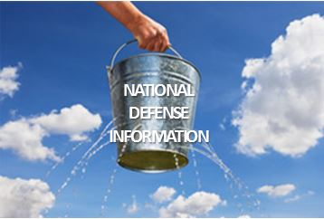
The Problem
Trusted individuals inside the DoD are leaking classified and controlled unclassified information (CUI) to unauthorized recipients.

Slide 3
What is an Unauthorized Disclosure?
The communication or physical transfer of classified or CUI to an unauthorized recipient.
Other related definitions:
Compromise – A security incident in which there is an UD of classified information
Data Spill – Transfer of classified or CUI to a computer system accredited at a lower classification level than the data being entered

Slide 4
Whistleblowing vs. ud
Whistleblowers are protected by law, executive order, and DoD policy
Whistleblowers can make a protected disclosure to:
A member of Congress
An Inspector General
A member of a DoD audit, inspection, or law enforcement organization
Any person in the chain of command
A court-martial proceeding
Any other person designated pursuant to regulations or other established administrative procedures to receive such communications

Slide 5
Why do people leak information?
Individuals who leak information do so for a number of reasons, including:
Financial gain
Influence political decisions
Disagree with official government policy
Believe the public has a need to know
Ego

Slide 6
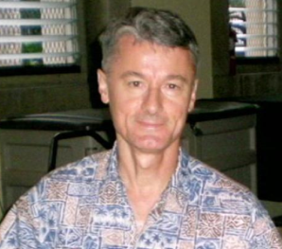
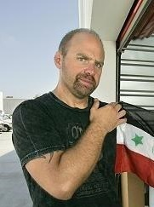
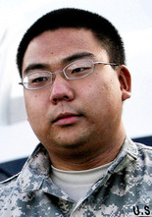
Case examples

Slide 7
Benjamin Bishop
Government Contractor and Retired Army O-5
Arrested March 2013
Emailed classified information to a Chinese woman with whom he had a romantic relationship
Pled guilty March 13, 2014 for unlawfully retaining classified national defense information at his home and willfully communicating classified national defense information to a person not authorized to receive it
Sentenced to 87 months of imprisonment and 3 years of supervised release
SENTENCED TO 87 MONTHS

Slide 8
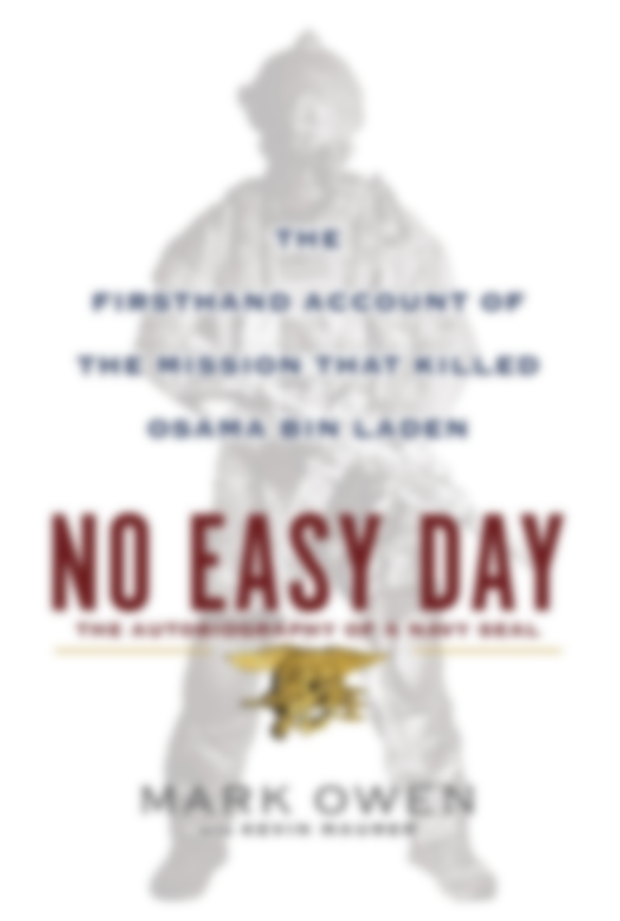
Matt Bissonnette
Former Navy SEAL
Wrote “No Easy Day,” an account of the raid that killed Osama bin Laden which was published in 2012
Failed to submit the manuscript to the Defense Office of Prepublication and Security Review (DOPSR) for review, resulting in the publication of classified and sensitive unclassified information
Agreed to forfeit $6.8 million in book royalties and speaking fees as part of a non-prosecution agreement
FORFEITURE OF $6.8 MILLION

Slide 9
Bryan Martin
Navy E-4
Arrested December 2010
Attempted to deliver classified information to a representative of a foreign government
Sentenced to 48 years in prison, forfeiture of all pay and allowance, reduction to pay grade of E-1, and a dishonorable discharge
SENTENCED TO 48 YEARS

Slide 10
Gary Maziarz
Marine Corps E-7
He and four co-conspirators were arrested in October 2006 for leaking classified information to the Los Angeles Terrorism Early Warning Group
Pled guilty and received a 26 month jail sentence
SENTENCED TO 26 MONTHS

Slide 11
Reporting unauthorized disclosures
If you suspect an unauthorized disclosure has occurred
REPORT IT TO SECURITY
If you suspect an unauthorized disclosure has occurred
REPORT IT TO SECURITY
If you are a
DoD employee ………………… report to your Security Manager
Cleared contractor …………. report to your Facility Security Officer

Slide 12
Component Resources
Component policy governing UDs:
Policy/regulations
Component UD program manager(s):
Name(s)
Office
Contact information

Slide 13
Questions?

