Slide 1
[Organization Name Here]
Initial Orientation and Awareness Training
Initial Orientation Training is required per DoDM 5200.01, Vol. 3, Enclosure 5. This training provides basic security knowledge to recognize and respond to threats to National Security Information.
Note for Security Managers: This template is provided so you may customize it to meet your organization’s specific needs.

Slide 2
AGENDA
Personnel Security Clearance Process
Information Security Program
Pre-Publication Process
Physical Security Program
Operations Security (OPSEC) Program
Understand the requirements for reporting foreign travel
Insert additional topics as needed

Slide 3
Personnel Security
The Personnel Security Program: This program provides security policies and procedures; establishes standards, criteria, and guidelines for personnel security determinations and overall program management responsibilities.
Position Designations
Special-sensitive: Access to Sensitive Compartmented Information (SCI)/Top Secret (TS) or Special Access Program (SAP). Potential for inestimable damage to National Security.
Critical-sensitive: Access to Top Secret (TS). Potential for exceptionally grave damage to National Security.
Noncritical-Sensitive: Access to Secret or Confidential. Potential for significant or serious damage to National Security.
Non-sensitive: No Clearance or other sensitive

Slide 4
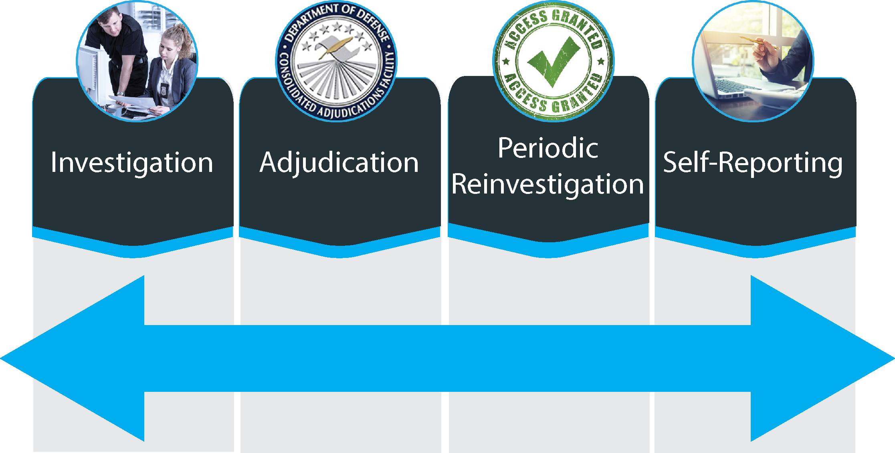
Personnel Security Clearance Process

Slide 5
Personnel Security Investigation
Investigation
New Federal Investigative Standards (FIS)
Uses a five-tiered approach
Five-Tiered Investigative Model
HSPD-12
SUITABILITY
NATIONAL SECURITY
5 CFR 731 OR 731 LIKE
5 CFR 732
5 SF86
Q, Top Secret, Sensitive
Compartmented Information,
Critical Sensitive, Special Sensitive
High Risk
Public Trust
4 SF85P
3 SF86
Non-Critical Sensitive, L,
Confidential and Secret Information
Moderate Risk
Public Trust
2 SF85P
1 SF85P
Low Risk, Non-Sensitive
Physical/Logical Access
(HSPD-12 Credentialing

Slide 6
Personnel Security Adjudication
Adjudications
DoD Consolidated Adjudications Facility (DoD CAF) is the primary authority for making security clearance eligibility determinations
Uses whole person concept
Uses 13 Adjudicative Guidelines

Slide 7
Personnel Security Periodic Reinvestigation
Periodic Reinvestigation
Tier 3R: Secret and Confidential
Tier 3 Reinvestigations will continue to be conducted every 10 ten (10) years.
Tier 5R: Top Secret (TS) or Sensitive Compartmented Information (SCI)
Reinvestigations have been extended from five (5) years to six (6) years with DNI endorsement.
See DoD Memorandum “Extension of Periodic Reinvestigation Timelines to Address the Backlog Investigation Backlog” <http://www.cdse.edu/documents/toolkits-psa/extension.pdf>

Slide 8
Personnel Security Self-Reporting
Self Reporting
Report changes in:
Status: Marriage, co-habitation, addition of new family member
Adverse Information:
Criminal activity (domestic violence, issuance of restraining order)
DUI/DWI
Traffic tickets over $300
Excessive indebtedness, financial difficulties, bankruptcy
Use of illegal drugs
Foreign Contacts: Close or continuing association with foreign nationals
Reporting does not automatically result in revocation of eligibility, so don’t be afraid to report!

Slide 9
Information Security
The Information Security Program is a system of policies, procedures, and requirements established to protect classified and controlled unclassified information (CUI) that, if subjected to unauthorized disclosure, could reasonably be expected to cause damage to National Security.

Slide 10
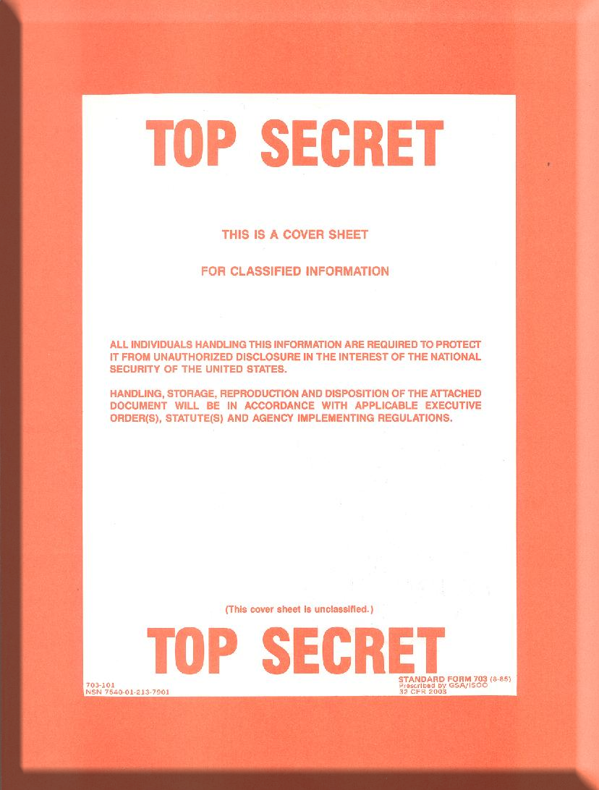
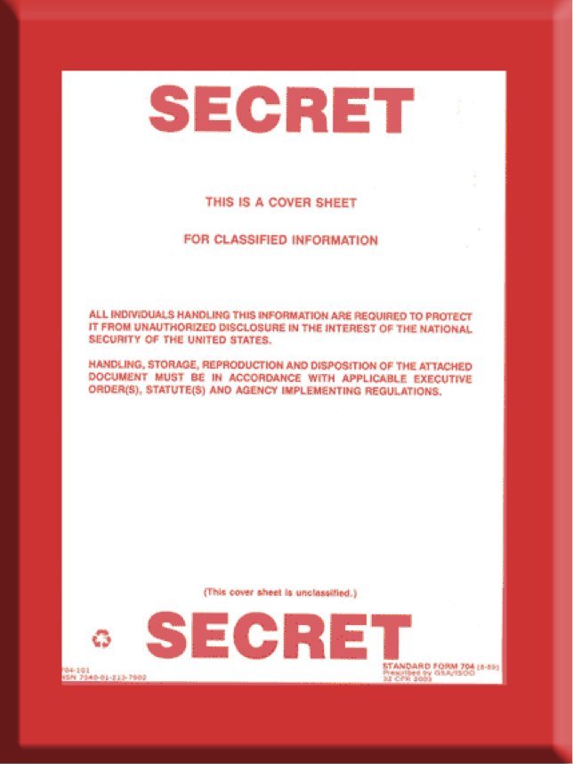
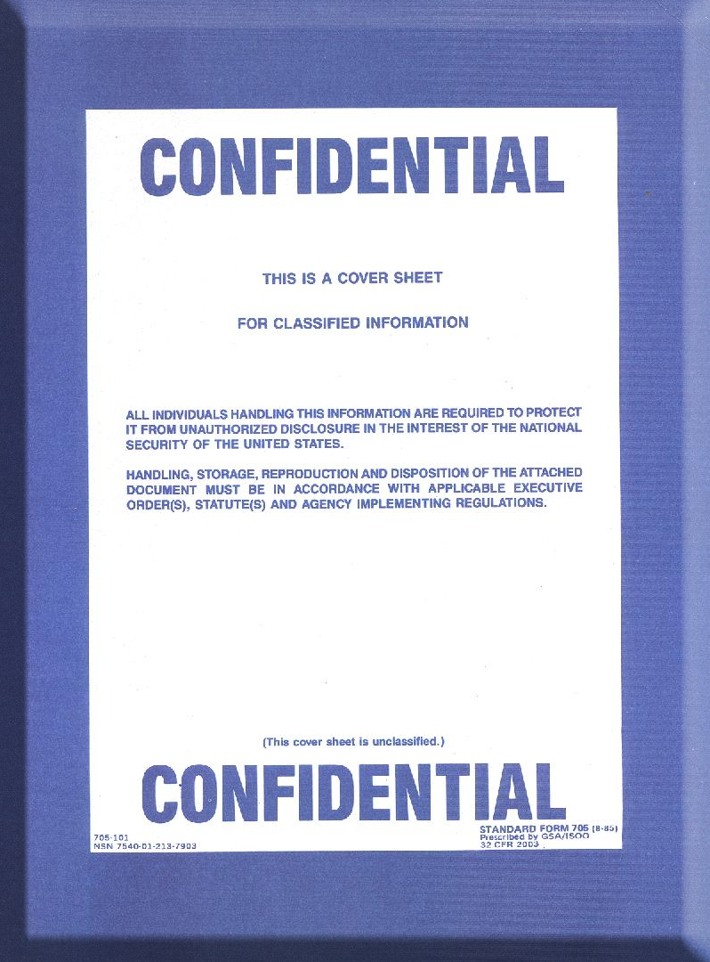
Information Security Levels of Classified Information
Top Secret: Could cause exceptionally grave damage to national security (SF703)
Secret: Could cause serious damage to national security (SF704)
Confidential: Could cause damage to national security (SF705)

Slide 11
Information Security Original Classification
ORIGINAL CLASSIFICATION: The initial decision that an item of information could reasonably be expected to cause identifiable or describable damage to the national security if subjected to unauthorized disclosure and requires protection in the interest of national security.
Information may be originally classified only by the Secretary of Defense, the Secretaries of the Military Departments, and other officials to whom they delegate this authority in writing.
Delegation of OCA shall be limited to the minimum number of officials required for effective operation of the Department of Defense.
The authority shall be delegated to, and retained by, only those officials who have a demonstrable and continuing need to exercise it.

Slide 12
Information Security Original Classification

Slide 13
Information Security Derivative Classification
DERIVATIVE CLASSIFICATION: Defined as incorporating, paraphrasing, restating, or generating in new form, information that is already classified, and marking the newly developed material consistent with the classification markings that apply to the source information.
Derivative Classification Requirements
Appropriate security clearance
Need-to-know
Properly trained

Slide 14
Information Security Marking Syntax
UNCLASSIFIED
Classification
Markings
are for Training Purposes Only
UNCLASSIFIED

Slide 15
Information Security Marking Slides and Working Papers
Slide Presentations
Mark title slide with overall marking and classification authority block
Mark successive slides with overall classification and portion markings for bullets
Mark slide graphics with overall classification
Working Papers
Mark with highest classification of any information contained in the document
Date and annotate as “Working Papers”
Destroy when no longer needed or remark within 180 days

Slide 16
Information Security Reproduction
Reproduction Guidelines
Use equipment approved at the appropriate level
Ensure copies are subject to same controls as original
Limit reproduction to what is mission essential
Comply with reproduction limitations
Facilitate oversight and control
[Add additional guidance as required]

Slide 17
Information Security Processing Classified Information
Rules for Processing Information: Use systems accredited or authorized to process information at the appropriate level.
Do Not
Install Software without approval
Use another person’s username and password
Allow an unauthorized person to use your computer
Circumvent or defeat security systems
Permit unauthorized access to any sensitive computer network
Modify or alter operating system configuration
Write down your password
[Add additional guidance as required]

Slide 18
Information Security Controlled Unclassified Information (CUI)
CUI: Unauthorized disclosure could cause foreseeable harm.
Examples of CUI
Investigation documents
Inspection reports
Agency budgetary information
Procurement bids/proposals
Personally Identifiable Information (PII)
Information protected under Privacy Act of 1974
[Add additional guidance as required]

Slide 19
Information Security Safeguarding
Safeguard Classified Information
Safeguard CUI
GSA approved container
Vaults
Secure rooms
Secure telephone
Maintain control, never leave unattended
Do not talk around using codes or hints
Do not divulge to unauthorized persons
[Add additional guidance as required]
Locked cabinets
Rooms with locked outer office doors
Key or cipher locked rooms
[Add additional guidance as required]

Slide 20
Storage Containers
GSA Approved Containers: Required for storing all classified materials
Standard forms to be completed:
SF700: Security Container Information
Record combinations to security containers, secure rooms, and controlled area doors
SF701: Activity Security Checklist
Must be completed after all areas have been secured
SF702: Security Container Checklist
Record date and time when opening or closing security container
[Add additional guidance as required]

Slide 21
Preparing Classified Documents for Mailing
Checklist for Mailing Classified Information
Cover sheet required; opaque envelope
Mark highest classification level
Wrap and tape envelope
Address properly
Complete a document receipt
Mitigate tampering
[Add additional guidance as required]

Slide 22
Information Security Top Secret Transmission
Transmit/Transport Top Secret/SCI
Direct contact between cleared U.S. personnel
Protected facsimile, message, voice [secure telephone equipment (STE)]
Appropriately cleared courier
[Add additional guidance as required]
Do Not Send Via
U.S. Postal Service
Overnight Express (FedEx)
[Add additional guidance as required]

Slide 23
Information Security Secret Transmission
Transmit/Transport Secret
U.S. Postal Service registered mail or priority mail express within U.S. and Puerto Rico
Check “Signature is Required” box
U.S. Postal Service registered mail through Army, Navy, or Air Force Postal Service outside the U.S. and territories
Information may not pass out of U.S. citizen control
Commercial delivery for urgent, overnight delivery only
Open incoming packages immediately and secure
[Add additional guidance as required]

Slide 24
Information Security Confidential Transmission
Transmit/Transport Confidential
U.S. Postal Service certified mail to DoD contracting companies or non-DoD agencies
U.S. Postal Service first class mail between DoD components in the U.S. and its territories
Outer envelope marked “Return Service Requested”
[Add additional guidance as required]
DO NOT use external or street side mail collection boxes

Slide 25
Information Security CUI Transmission
Transmit/Transport CUI
U.S. Postal Service certified mail, parcel post, or fourth class mail
Approved secure communications systems
Facsimile if appropriate protection is available at receiving location
[Add additional guidance as required]

Slide 26
Information Security Hand Carry
Hand Carry Requirements
Prepare inventory
Double wrap material
Keep under constant control
Deliver to authorized person
Receive courier briefing
Carry courier card
Carry courier letter if transporting via commercial air
[Add additional guidance as required]

Slide 27
Information Security Destruction
Destruction of Classified Material
Destruction of CUI
NSA approved crosscut shredder
Burning
Wet pulping
Mutilation
Chemical decomposition
Pulverizing
[Add additional guidance as required]
Same methods as classified
Other methods that would not allow recognition or reconstruction
[Add additional guidance as required]

Slide 28
Security Incidents
Security Incident: Categorized as infraction or violation
Infraction
No loss or compromise
Violation
Loss – material cannot be accounted for or physically located
Compromise– material disclosed to an unauthorized person
NDCI - occurs when data is placed on an IT system with insufficient controls at the required classification level
[Add additional guidance as required]
Report infractions and violations immediately to your security officer

Slide 29
Sanctions
You are subject to sanctions if you knowingly, willfully, negligently:
Disclose classified or CUI to unauthorized persons
Classify information in violation of DoD regulations
[Add additional guidance as required]
Sanctions include:
Warning
Reprimand
Loss/denial of classified access
Suspension without pay
Termination of employment
Discharge from military service
Criminal Prosecution
[Add additional guidance as required]

Slide 30
Information Security Classified Information/Public Media
Classified Information in the Public Media
Do not confirm or deny
Do not respond to questions about programs or projects
[Add additional guidance as required]
Refer all questions to the Public Affairs Office (PAO) and your Security Officer

Slide 31
Pre-Publication Process
You are responsible for protecting official information
and complying with the pre-publication process
Materials subject to pre-publication review include:
Books, manuscript, or articles sent to the publisher, editor, movie producer, or game purveyor, or their respective support staffs
Speech, briefing, article, or content that will be publically disseminated
Information released to the public, even through Congress or the courts
[Add additional guidance as required]
See DoDI 5230.29 Security and Policy Review of DoD Information for Public Release

Slide 32
Industrial Security
Working with Contractors
Contractors may or may not be cleared
Verify through a valid visit authorization and/or DD Form 254, Department of Defense Contract Security Classification Specification
Cleared under National Industrial Security Program (NISP)
Follow requirements of DoD 5220.22-M, National Industrial Security Program Operating Manual (NISPOM)
Required to comply with your organization’s security program
Check with your security office for information on verifying contractor employee clearance eligibility and need to know.

Slide 33
Physical Security
Physical Security: Concerned with active and passive measures to prevent unauthorized access to personnel, equipment, installations, and information, and to safeguard them against espionage, sabotage, terrorism, damage, and criminal activity.
Physical Security Countermeasures
Barriers/Fencing: establish boundaries and deter individuals
Intrusion Detection System (IDS): deter, detect, document, deny, or delay intrusion by detecting a change in the environment.
Security forces: DoD, military, contract personnel, and trained dogs
[Add additional guidance as required]

Slide 34
Physical Security Employee Identification
Homeland Security Presidential Directive 12 (HSPD-12) Common Access Card (CAC)
DoD wide form of identification
Used by civilians, contractors, and military personnel
Contains personal identifying data and Public Key Infrastructure (PKI) certificate
Used for email encryption, digital signing, and network access
If your CAC card is either lost or stolen, report it to your security office immediately.

Slide 35
Physical Security Escort Requirements
Escort Requirements
Ensure access to controlled areas by non-cleared personnel is minimal
Only DoD civilians and contract and military personnel are authorized to escort non-cleared personnel
Ensure all visitors sign the Visitor Log upon entry
Check with your security office for specific escort procedures
[Add additional guidance as required]

Slide 36
Operations Security (OPSEC)
OPSEC: Process to protect critical (classified or CUI) information from access by an adversary.
OPSEC Practices:
Remove ID badge when you leave your facility
Do not post or send sensitive information over the web
Guard against calls to obtain sensitive information
Do not discuss sensitive information in public, or over the telephone
Watch for and report suspicious activity

Slide 37
Foreign Travel Official
All DoD government personnel must provide advance notice of foreign travel plans to the Security Office.
Foreign Travel Requirements
Obtain defensive foreign travel security briefing prior to travel or at least once a year
Obtain country specific briefing from the Counterintelligence Office (if required)
Current Antiterrorism/Force Protection Level 1 training
Contact nearest U.S. Consulate, Defense Attaché, Embassy Regional Security Officer, or Post Duty Officer if detained or subjected to harassment or provocation
[Add additional guidance as required]

Slide 38
Foreign Travel SCI
SCI indoctrinated personnel must follow the previous steps.
Additional SCI Foreign Travel Requirements
Complete foreign travel questionnaire
Provide copy of itinerary
Be aware of nearest U.S. Consulate, Defense Attaché, Embassy Regional Security Officer, or Post Duty Officer
[Add additional guidance as required]

Slide 39
Summary
Personnel Security Clearance Process
Information Security Program
Pre-Publication Process
Physical Security Program
Operations Security (OPSEC) Program
Understand the requirement for reporting foreign travel
[Add additional guidance as required]

Slide 40
Any Questions?

